Slide 1
Chapter 8 Operating
Systems and Utility Programs

Slide 2
Chapter 8 Objectives
Identify the types of system software
Summarize the features of several
stand-alone operating systems
Summarize the startup process
on a personal computer
Identify various network operating systems
Describe the functions of an operating system
Identify devices that use several
embedded operating systems
Discuss ways that some operating
systems help administrators control a
network and administer security
Explain the purpose of several
stand-alone utility programs
Explain the purpose of the utilities
included with most operating systems
Next

Slide 3
System Software
What is system software?
Programs that control
or maintain operation
of computer
Two types are
operating systems
and utility programs
Operating system (OS)
(sometimes called the platform)
coordinates all activities
among computer
hardware
resources
p. 398 - 399
Next

Slide 4
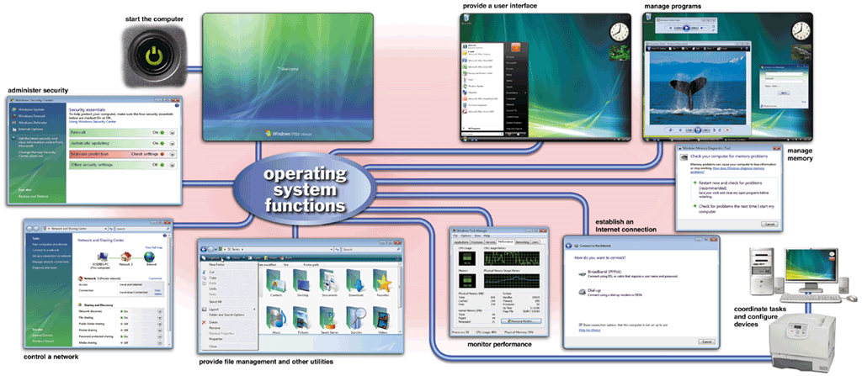
Operating Systems
What are the functions of an operating system?
p. 398 - 399 Fig. 8-1
Next

Slide 5
Operating Systems
What is a cross-platform application?
  Runs the same on multiple operating systems
Application
Operating System/
Platform A
Operating System/
Platform B
Operating System/
Platform C
Operating System/
Platform D
p. 399
Next

Slide 6
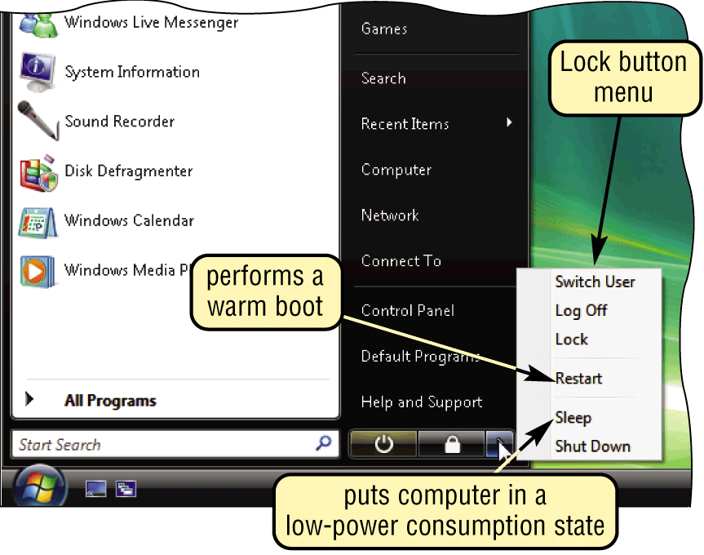
Operating System Functions
What is booting?
  Process of starting or restarting a computer
    Cold boot Turning on computer that has been powered off
    Warm boot Restarting computer that is powered on
p. 400 Fig. 8-2
Next

Slide 7
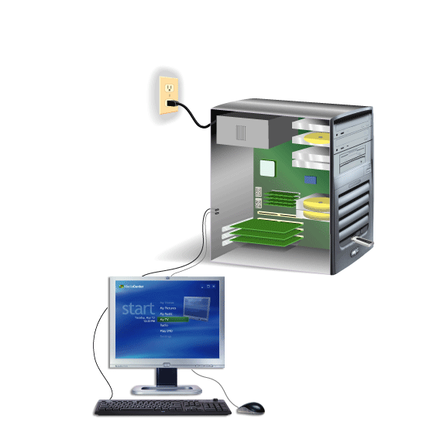
Operating System Functions
How does a personal computer boot up?
Step 1. Power supply sends signal to com-ponents in system unit
Step 4. Results of POST are compared with data in CMOS chip
Step 5. BIOS looks for system files on a USB flash drive or CD/DVD drive, and then drive C (hard disk)
Step 2. Processor accesses BIOS to start computer
Step 3. BIOS runs tests, called the POST, to check components such as mouse, keyboard, and adapter cards
Step 6. Kernel (core) of operating system loads into RAM
Step 7. Operating system loads configuration information and displays desktop on screen
Click to view Web
Link, click Chapter 8, Click
Web Link from left
navigation, then click
Windows Registry
below Chapter 8
p. 400 - 401 Fig. 8-3
Next

Slide 8
Operating System Functions
What is a boot disk?
  Contains system files that will start computer when computer cannot boot
    Also called recovery disk
p. 402
Next

Slide 9
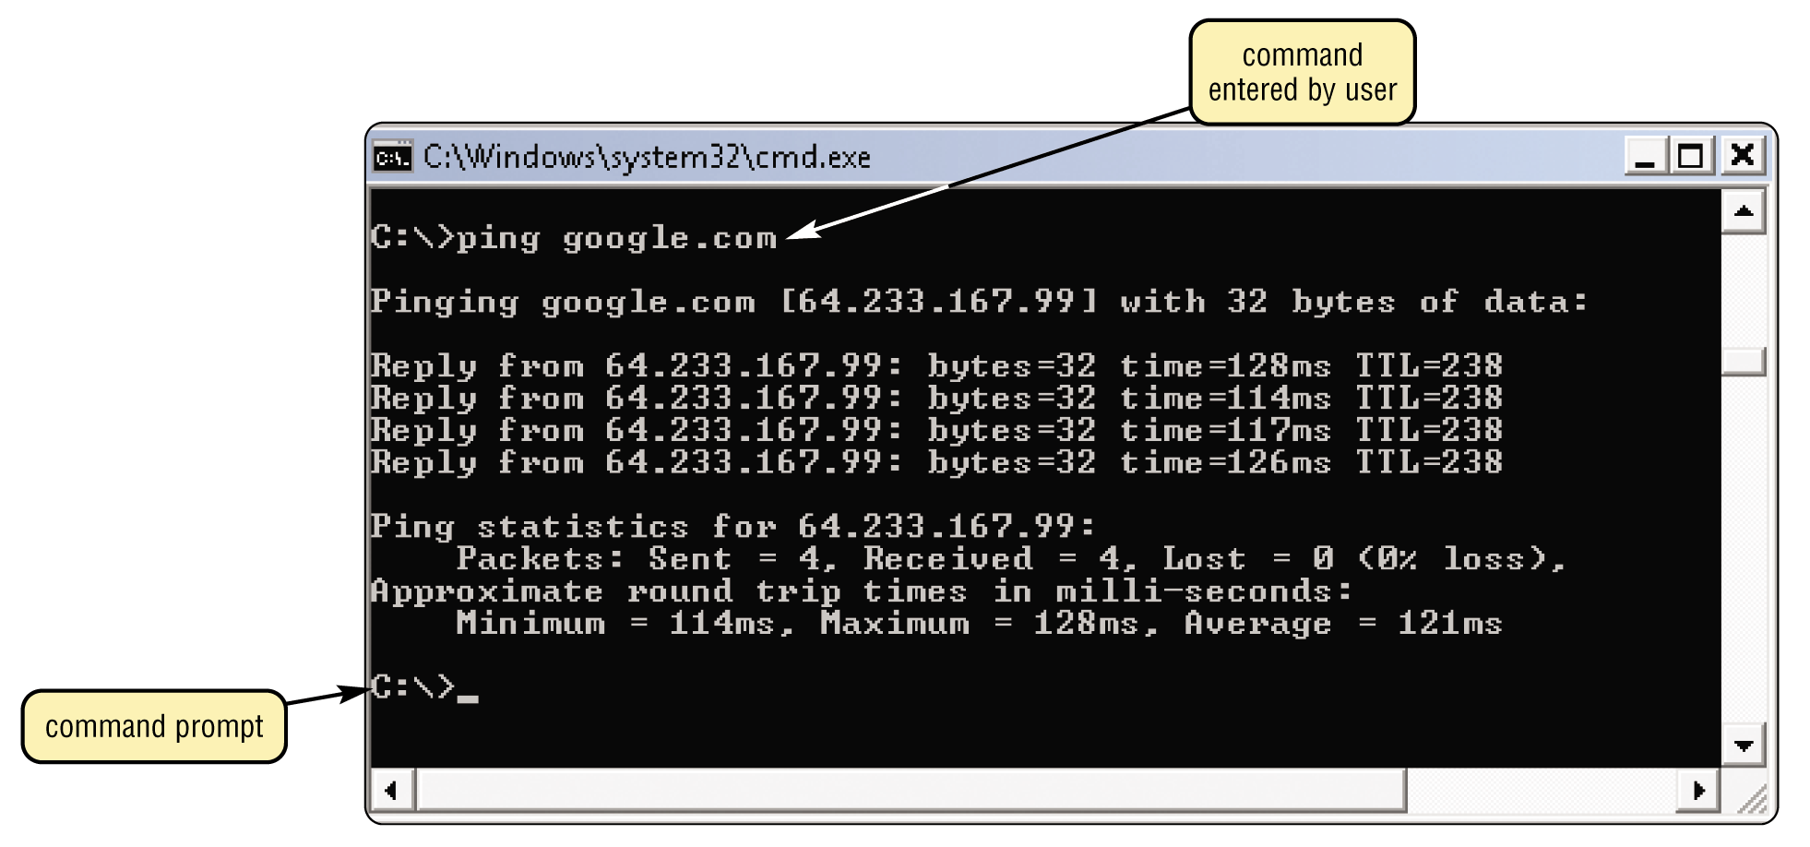
Operating System Functions
What is a user interface?
  Controls how you enter data and instructions and how information displays on screen
p. 402 Fig. 8-4
Next

Slide 10
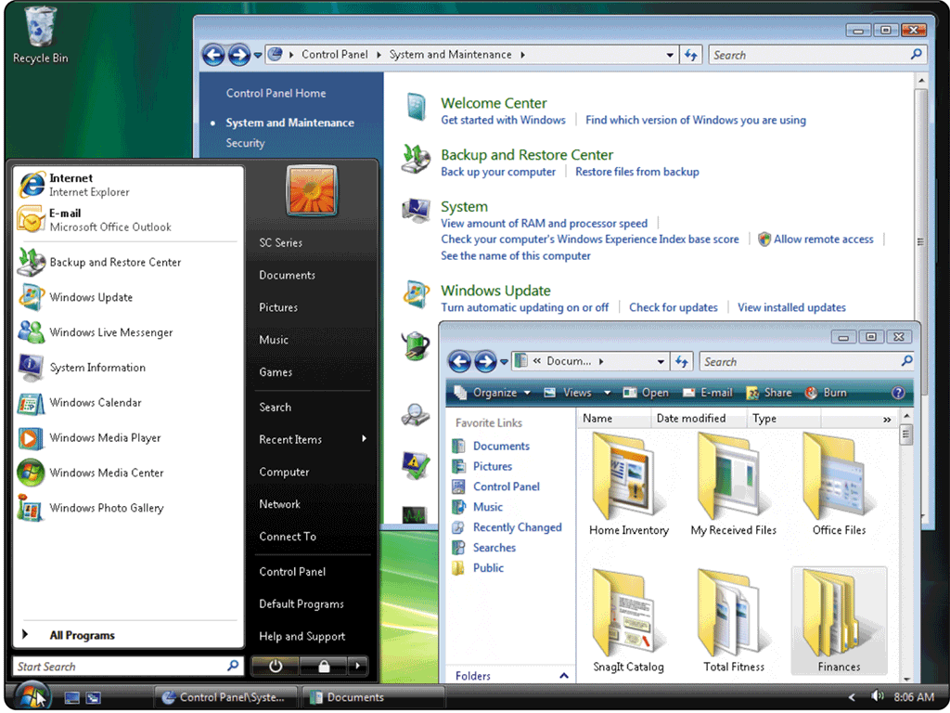
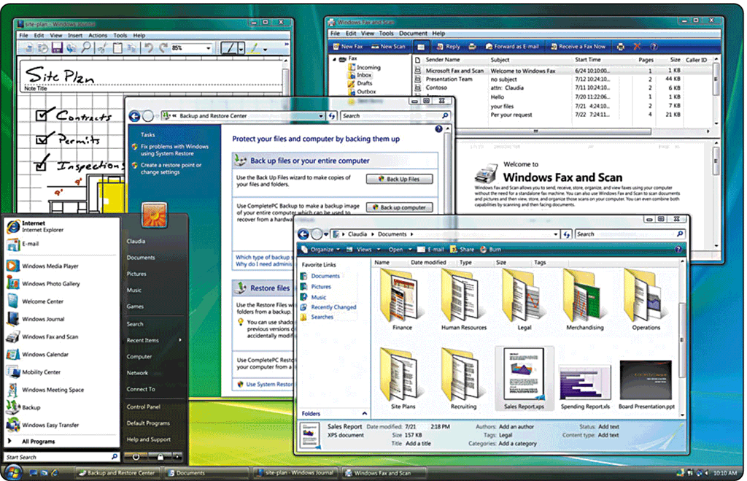
Operating System Functions
What is a graphical user interface (GUI)?
  User interacts with menus and visual images such as buttons and other graphical objects
    Basic Interface
    Windows Aero Interface
p. 403 Fig. 8-5a and 8-5b
Next

Slide 11
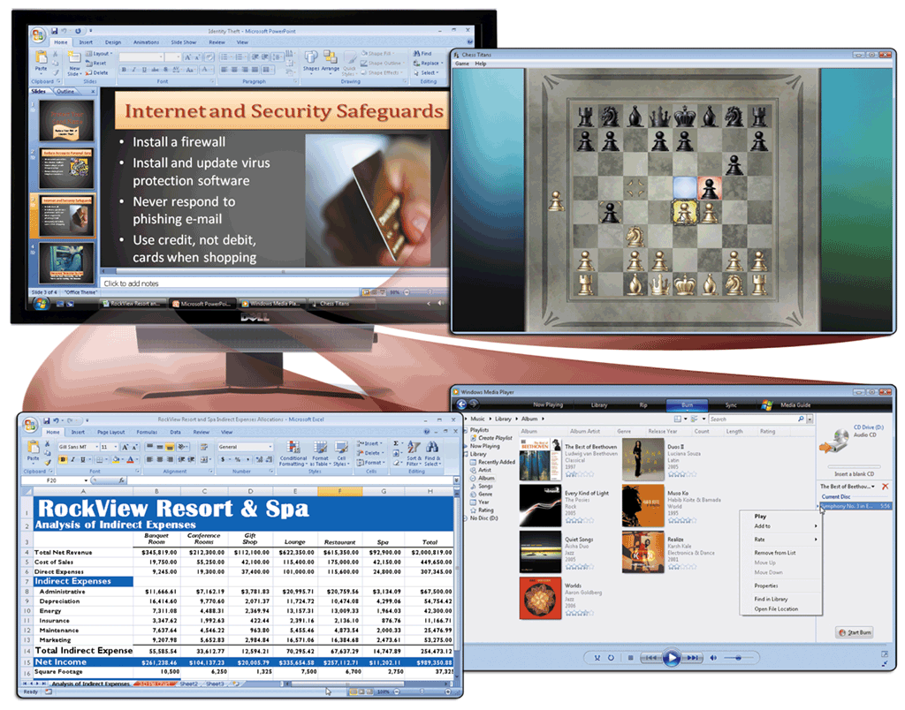
Operating System Functions
What is single user/ multitasking?
  Working on two or more programs that reside in memory at same time
    Foreground contains program you are using
    Background contains
    programs that are
    running but are not
    in use
p. 403 - 404 Fig. 8-6
Next

Slide 12
Operating System Functions
What are other program management features of operating systems?
Enables two or
more users to
run programs
simultaneously
multiprocessing
Can support two
or more processors
running programs
at same time
multiuser
Has duplicate
components such as
processors, memory,
and disk drives
fault-tolerant computer
Continues to
operate when one
of its components
fails
p. 405
Next

Slide 13
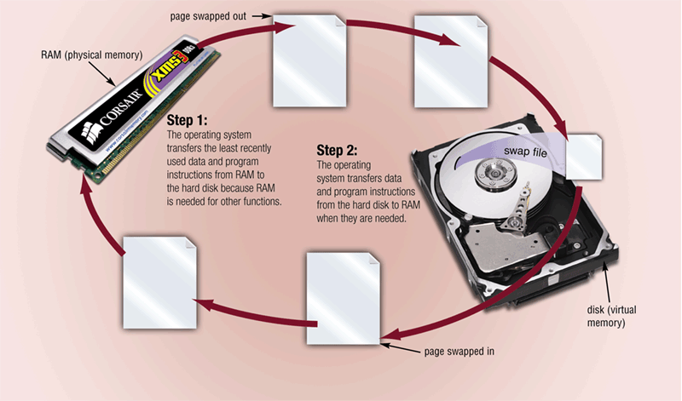
Operating System Functions
What is memory management?
  Optimizing use of random access memory (RAM)
  With virtual memory (VM), portion of hard disk is allocated to function as RAM
p. 405 - 406 Fig. 8-8
Next

Slide 14
Operating System Functions
How does an operating system schedule jobs?
Adjusts schedule
based on
job’s priority
Receiving data
from input device
Sending
information
to output device
A job is an operation
the processor manages
Processing
instructions
Transferring items
between storage
and memory
p. 407
Next

Slide 15
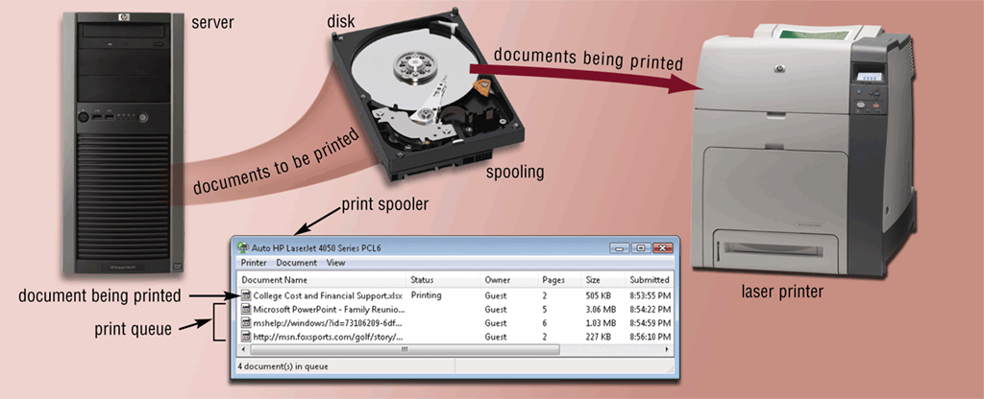
Operating System Functions
What is spooling?
  Sending print jobs to buffer instead of directly to printer
  Print jobs line up in queue
p. 407 Fig. 8-9
Next

Slide 16
Operating System Functions
What is a device driver?
Program that
tells operating system
how to communicate
with device
With Plug and Play, operating system automatically configures new devices as you install them
Device Driver
Also called driver
Click to view Web
Link, click Chapter 8, Click
Web Link from left
navigation, then click
Plug and Play below Chapter 8
p. 407
Next

Slide 17
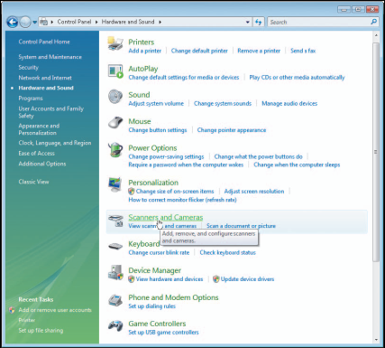
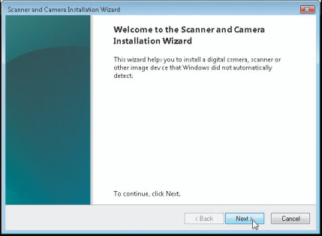
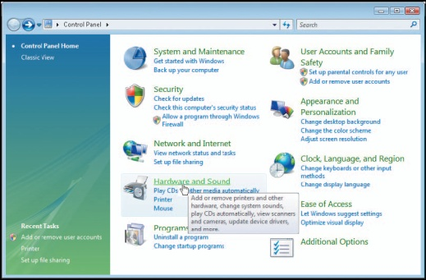
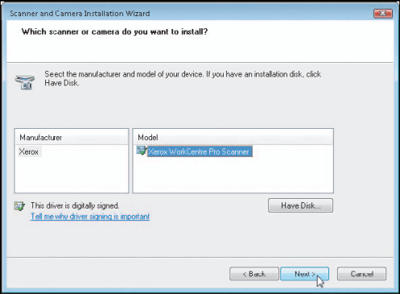
Operating System Functions
How do you install a device driver?
Step 3. Click the Scanners and Cameras link to display the Scanners and Cameras dialog box. Point to the Add Device button.
Step 4. Click the Add Device button to start the Scanner and Camera Installation Wizard. Point to the Next button.
Step 1. Open Control Panel window. Point to Hardware and Sound link.
Step 2. Click the Hardware and Sound link to display the Hardware and Sound options. Point to the Scanners and Cameras link.
Step 5. Click the Next button to proceed with the wizard. Select the correct manufacturer and model of scanner or camera. Follow the on-screen instructions to complete installation of the necessary driver files for the selected device.
p. 408 Fig. 8-10
Next

Slide 18
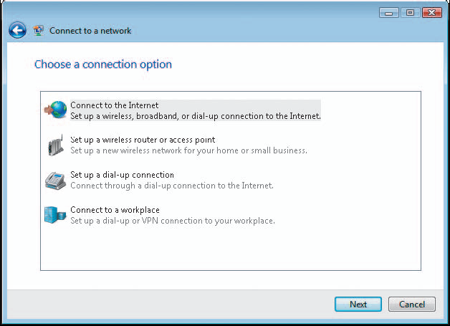
Operating System Functions
How do you establish an Internet connection?
  Windows Vista includes Connect to a network wizard
    Guides user through setting up connection between computer and Internet service provider
p. 409 Fig. 8-11
Next

Slide 19
Operating System Functions
How does an operating system monitor performance?
  Provides program, called performance monitor, that assesses and reports information about
  system resources
  and devices
p. 409 Fig. 8-12
Next

Slide 20
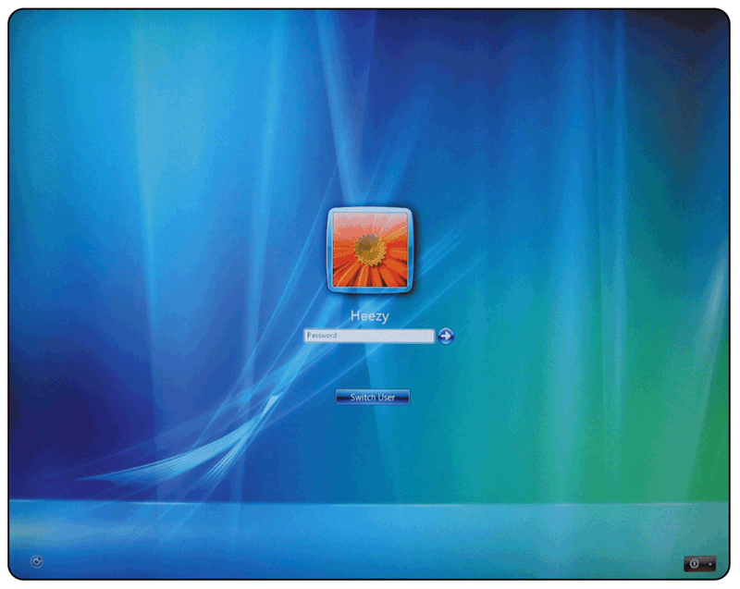
Operating System Functions
What is a network operating system?
  Allows users to share resources on a network
  Administers security
  by establishing user name and password for each user
p. 410 Fig. 8-13
Next

Slide 21
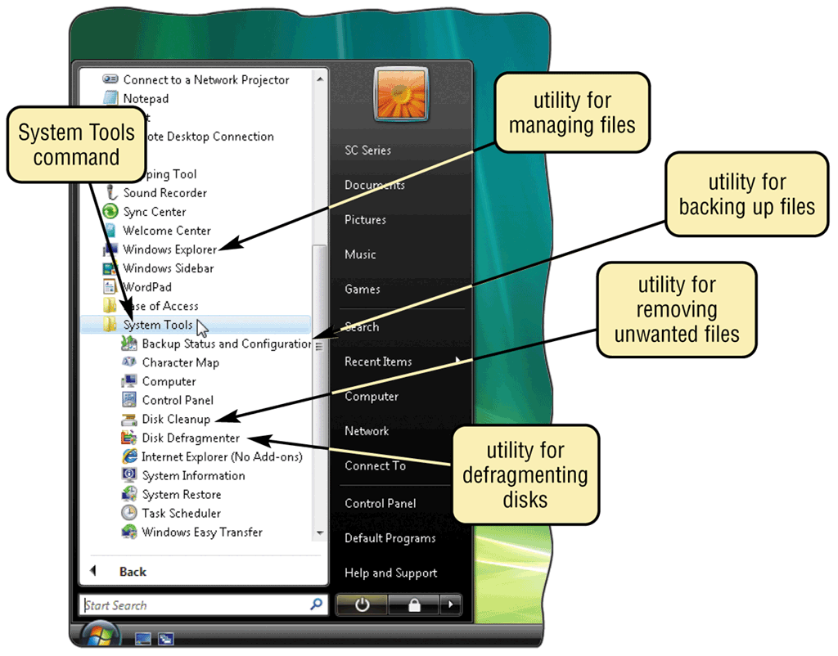
Operating System Utility Programs
What is a utility program?
  System software that performs maintenance-type tasks
    Also called
    utility
p. 411 Fig. 8-14
Next

Slide 22
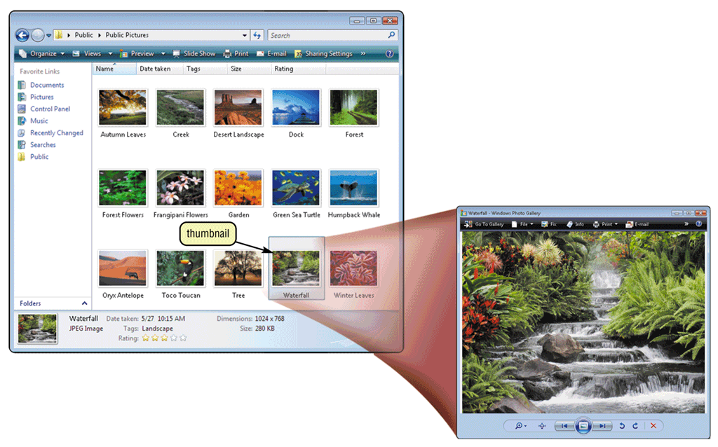
Operating System Utility Programs
What is a file manager?
  Performs functions related to file management
  Search utility attempts to locate files on your computer
  Image viewer displays, copies, and prints contents of graphics file
p. 412 Figs. 8-15–8-16
Next

Slide 23
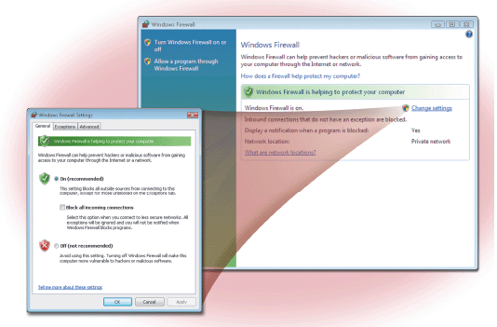
Operating System Utility Programs
What is a personal firewall?
  Detects and protects a personal computer from unauthorized intrusions
  Windows Vista automatically enables the built-in personal firewall upon installation
Click to view Web
Link, click Chapter 8, Click
Web Link from left
navigation, then click
Personal Firewalls below Chapter 8
p. 413 Figs. 8-17
Next

Slide 24
Operating System Utility Programs
What is an uninstaller?
Removes a
program and
all associated files
In Windows Vista,
uninstaller is available through
the Uninstall a program command
in the Control Panel
p. 413
Next

Slide 25
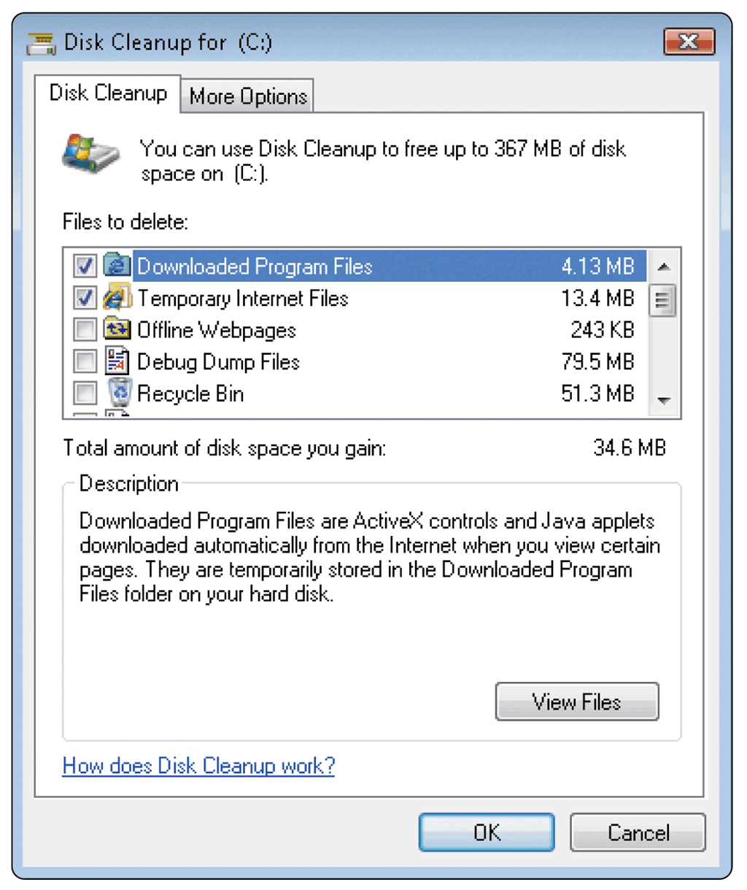
Operating System Utility Programs
What is a disk scanner?
  Searches for and removes unnecessary files
  Windows Vista includes
  Disk Cleanup
p. 414 Fig. 8-18
Next

Slide 26
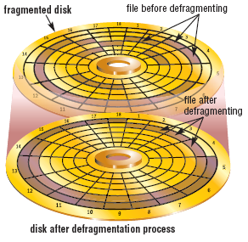
Operating System Utility Programs
What is a disk defragmenter?
  Reorganizes files and unused space on hard disk so that programs run faster
p. 414 Fig. 8-19
Next

Slide 27
Operating System Utility Programs
What is a diagnostic utility?
  Compiles technical information about hardware and some software
  Prepares report outlining problems
p. 414
Next

Slide 28
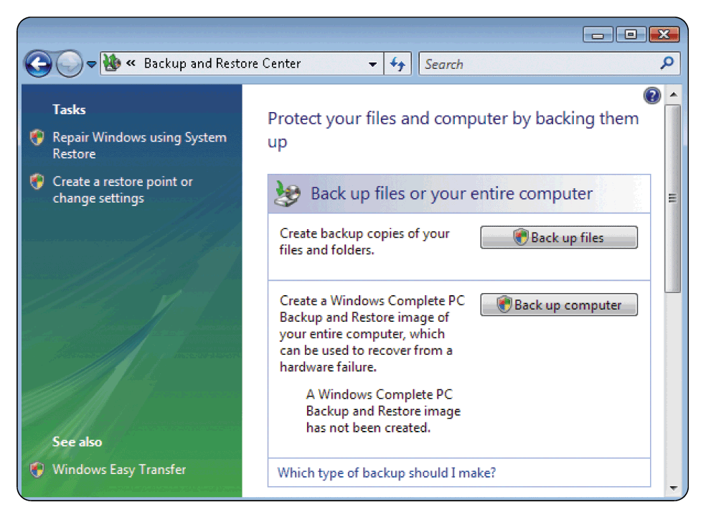
Operating System Utility Programs
What is a backup utility?
  Copies selected files or entire hard disk onto another storage medium
  Most compress files during backup to require less storage space
p. 415 Fig. 8-20
Next

Slide 29
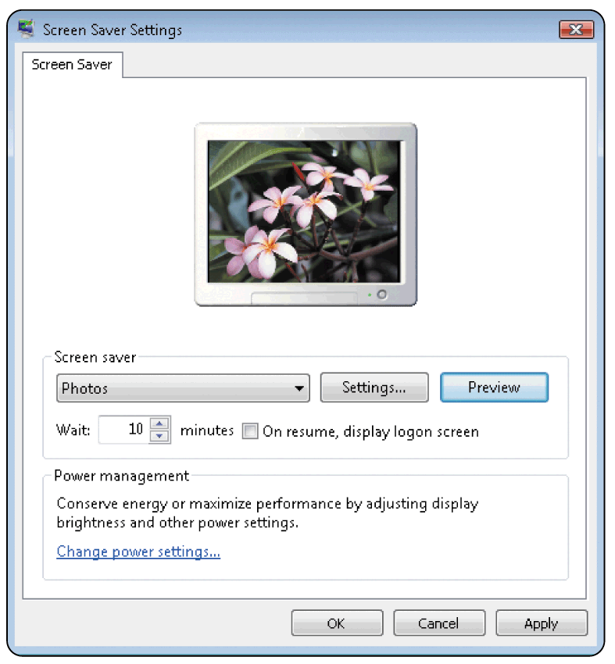
Operating System Utility Programs
What is a screen saver?
  Causes monitor’s screen to display moving image or blank screen if there is no activity for a specified time
  To secure computer, user configures screen saver to require password to
  deactivate
Click to view Web
Link, click Chapter 8, Click
Web Link from left
navigation, then click
Screen Savers below Chapter 8
p. 415 Fig. 8-21
Next

Slide 30
Types of Operating Systems
What are some characteristics of operating systems?
Proprietary software
Privately owned and limited to specific vendor or computer model
Device-dependent
Runs only on specific type of computer
Device-independent
Runs on many manufacturers’
computers
Downward compatible
Works with application software written for earlier version of operating system
Upward compatible
Runs on new versions of operating system
Click to view Web
Link, click Chapter 8, Click
Web Link from left
navigation, then click
Windows Vista below
Chapter 8
p. 415 - 416
Next

Slide 31
Types of Operating Systems
What are three categories of operating systems?
Embedded
Network
Stand-alone
p. 416
Next

Slide 32
Stand-Alone Operating Systems
How do Windows
versions compare?
Windows Version Year Released
Windows 3.x 1990
Windows NT 3.1 1993
Windows 95 1995
Windows NT Workstation 4.0 1996
Windows 98 1998
Windows Millennium Edition 2000
Windows 2000 Professional 2000
Windows XP 2001
Windows XP SP2 2004
Windows Vista 2006
p. 417 Fig. 8-23
Next

Slide 33
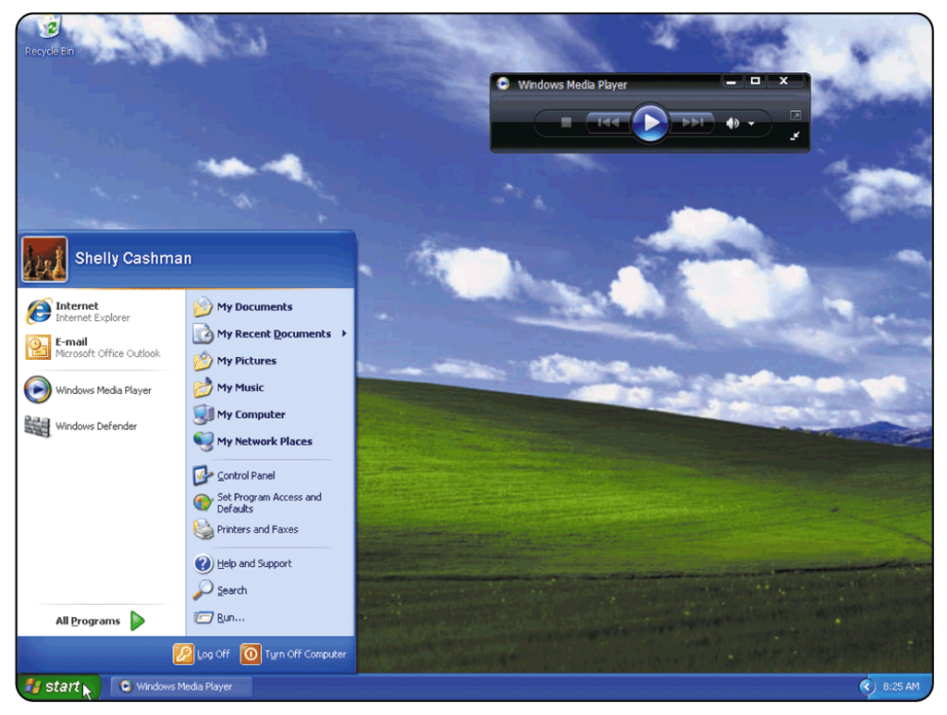
Stand-Alone Operating Systems
What is Windows XP?
  Fast, reliable Windows operating system
  Available in five editions:
  Home Edition, Professional Edition,
  Tablet PC Edition,
  Media Center Edition,
  and 64-bit Edition
p. 417 - 418 Fig. 8-24
Next

Slide 34
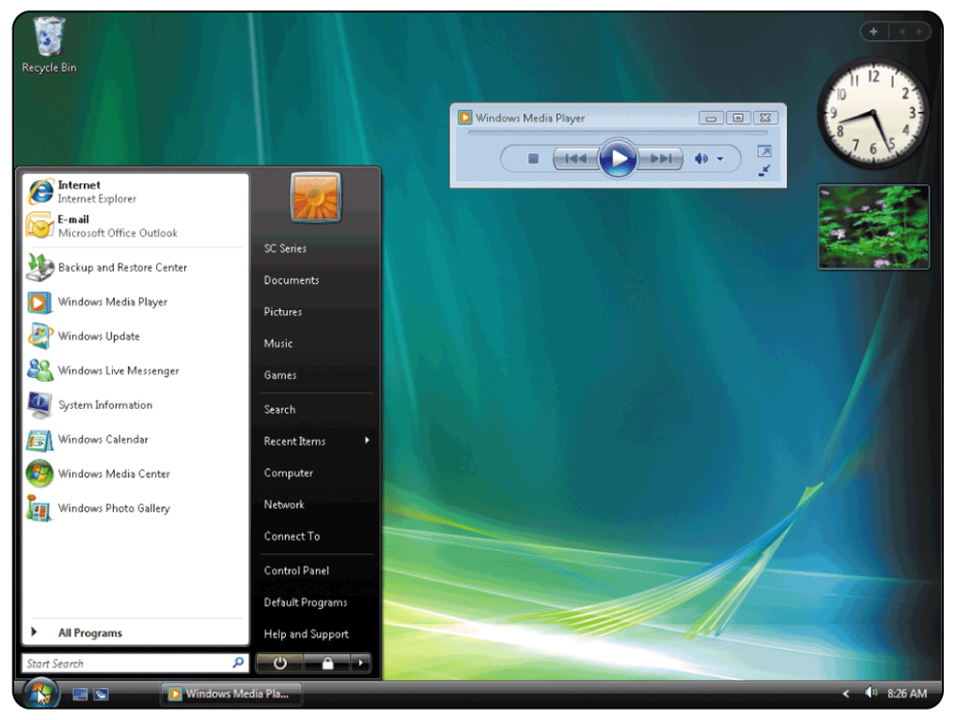
Stand-Alone Operating Systems
What is Windows Vista?
  Successor to Windows XP, containing a new interface and new / enhanced features
  Available in several editions, grouped into Home and Business categories
p. 418 - 419 Fig. 8-25
Next

Slide 35
Stand-Alone Operating Systems
What are some features of Windows Vista?
Windows Vista Features
Reliability and Performance
Security
Information Management
Appearance and Navigation
Communications and the Internet
p. 419
Next

Slide 36
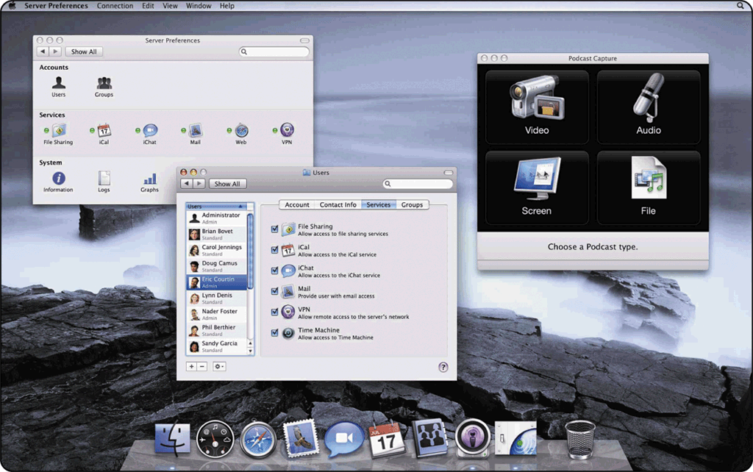
Stand-Alone Operating Systems
What is Mac OS X?
  Available only for computers manufactured by Apple
  Macintosh operating
  system has been
  model for most GUIs
Click to view Web
Link, click Chapter 8, Click
Web Link from left
navigation, then click
Mac OS X below Chapter 8
p. 420 Fig. 8-28
Next

Slide 37
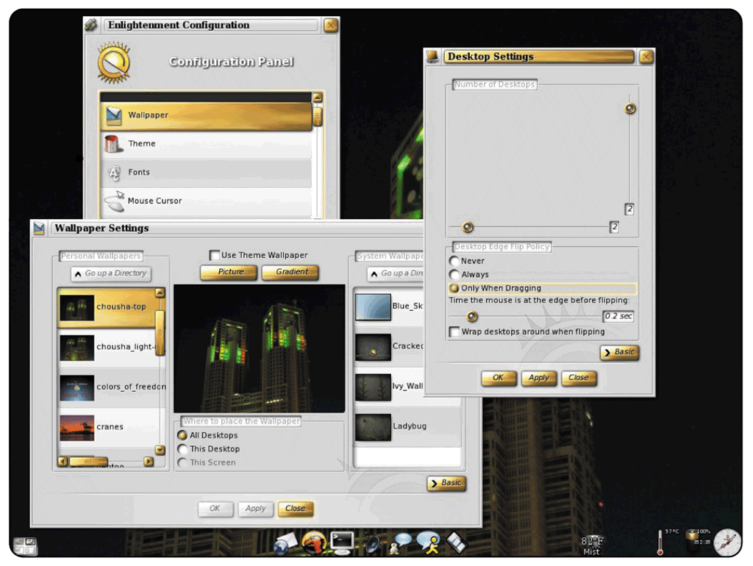
Stand-Alone Operating Systems
What is UNIX?
  Used by power users because of its flexibility and power
  Most versions
  offer GUI
  Available for
  computers of all
  sizes
p. 420 Fig. 8-29
Next

Slide 38
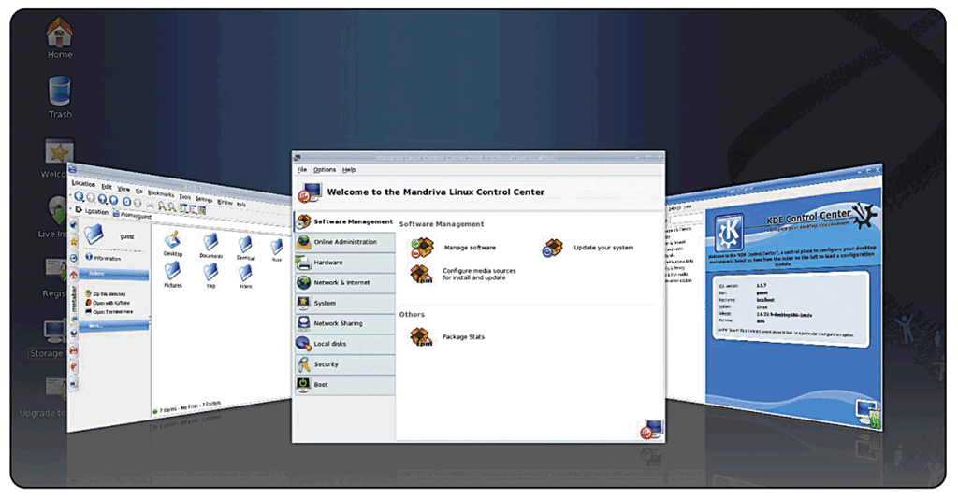
Stand-Alone Operating Systems
What is Linux?
  Popular, free, multitasking UNIX-type operating system
  Open-source software—
  code is available to
  public
  Both a stand-alone
  and a network
  operating system
Click to view Web
Link, click Chapter 8, Click
Web Link from left
navigation, then click
Linux below Chapter 8
p. 421 - 422 Fig. 8-30
Next

Slide 39
Network Operating Systems
What are examples of network
operating systems?
NetWare
Designed for
client/server
networks
UNIX / Linux
Multi-purpose
operating system
Windows
Server 2008
Upgrade to Windows 2003 Server
Solaris
Version of UNIX developed by Sun Microsystems
Specifically for
e-commerce applications
Click to view Web
Link, click Chapter 8, Click
Web Link from left
navigation, then click
Windows Server 2008
below Chapter 8
p. 422 - 423
Next

Slide 40
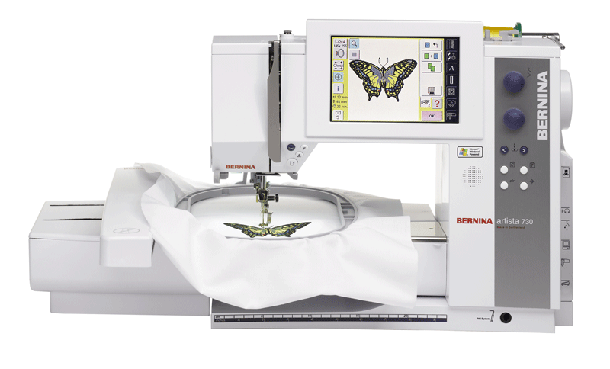
Embedded Operating Systems
What is an embedded operating system?
  Found on most smart phones and small devices
  Windows Embedded CE is
  scaled-down version of Windows
p. 423 Fig. 8-31
Next

Slide 41
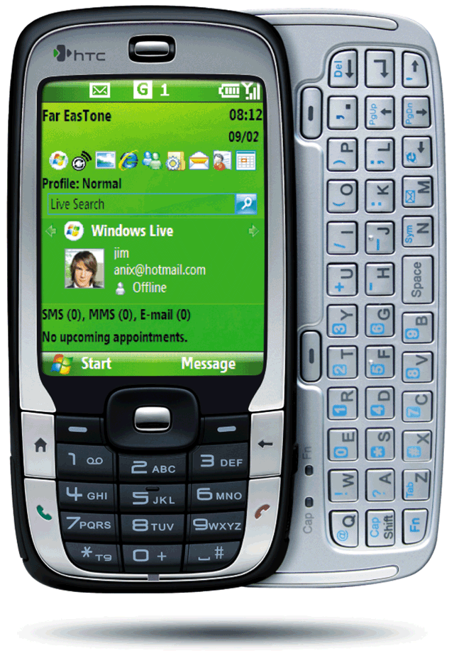
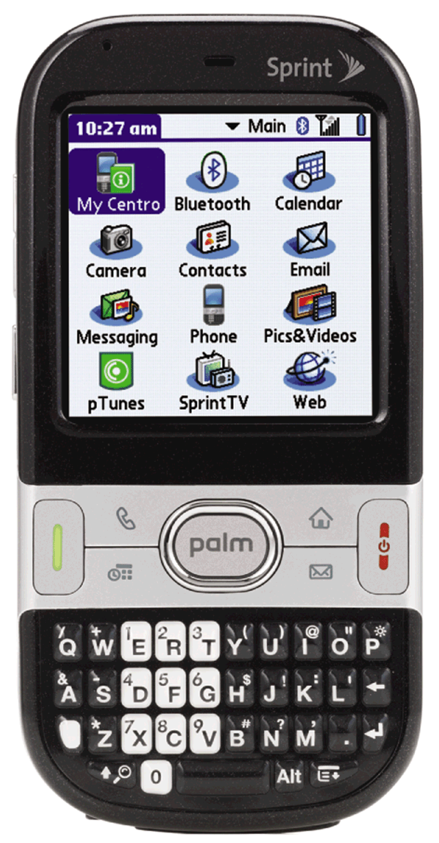
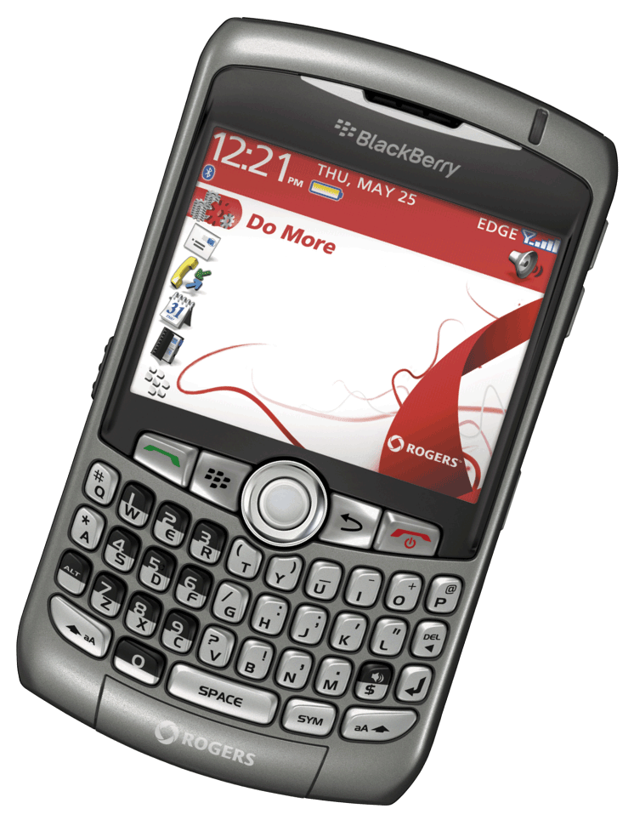
Embedded Operating Systems
What are three operating systems for PDAs?
  Windows Mobile for Pocket PC
  Palm OS for Palm
  Blackberry
Click to view Web
Link, click Chapter 8, Click
Web Link from left
navigation, then click
Windows Mobile
below Chapter 8
Click to view Web
Link, click Chapter 8, Click
Web Link from left
navigation, then click
BlackBerry below Chapter 8
p. 424 - 425 Figs. 8-32 - 8-34
Next

Slide 42
Embedded Operating Systems
What is Embedded Linux?
  Scaled-down Linux operating system
  designed for smart phones, PDAs,
  smart watches, set-top boxes,
  Internet telephones, and other
  devices
  Offers many PIM functions
p. 425
Next

Slide 43
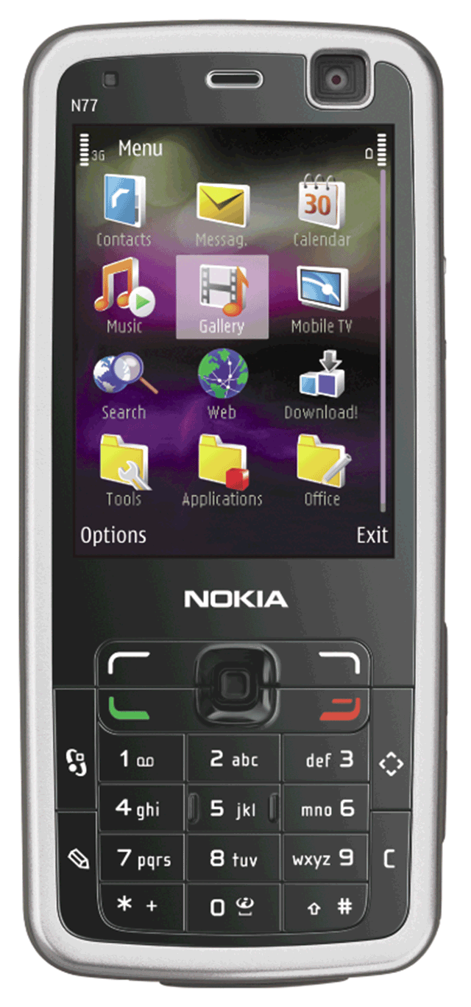
Embedded Operating Systems
What is Symbian OS?
  Open-source, multitasking operating system designed for smart phones
  Make telephone calls,
  save appointments,
  browse Web, send
  and receive text and picture
  messages, e-mail messages,
  faxes, and more
p. 425 Fig. 8-35
Next

Slide 44
Stand-Alone Utility Programs
What is a virus?
  Potentially damaging computer program
  Affects computer without user’s knowledge
An unusual message or image is displayed on the computer screen
An unusual sound or music plays randomly
The available memory is less than what should be available
A program or file suddenly is missing
An unknown program or file mysteriously appears
The size of a file changes without explanation
A file becomes corrupted
A program or file does not work properly
System properties change
The operating system runs much slower than usual
SIGNS OF VIRUS INFECTION
p. 425 - 426 Fig. 8-36
Next

Slide 45
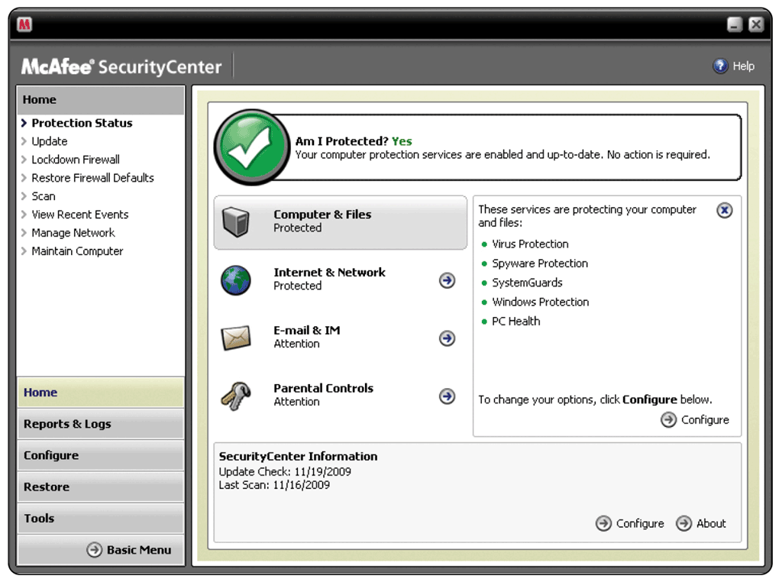
Stand-Alone Utility Programs
What is an antivirus program?
  Identifies and removes viruses in memory, storage media, and incoming files
  Must be updated frequently
p. 426 Fig. 8-37
Next

Slide 46

Stand-Alone Utility Programs
Video: Free Online Anti Virus
CLICK TO START
Next

Slide 47
Stand-Alone Utility Programs
What is spyware?
  Program placed on a computer without the user’s knowledge that secretly collects information about the user
  Often enters a computer as a result of a user installing a new program
  A spyware remover is a program that detects and deletes spyware
p. 427
Next

Slide 48
Stand-Alone Utility Programs
What are internet filters?
  Programs that remove or block certain items from being displayed
Anti-Spam
Programs
Web
Filters
Phishing
Filters
Pop-up
Blockers
Click to view Web
Link, click Chapter 8, Click
Web Link from left
navigation, then click
Phishing Filters below
Chapter 8
p. 427
Next

Slide 49
Stand-Alone Utility Programs
What is a file compression utility?
  Shrinks size of files to free up room and improve performance
  Compressed files are sometimes called zipped files
  Two popular utilities:
  PKZIP and WinZip
p. 427
Next

Slide 50
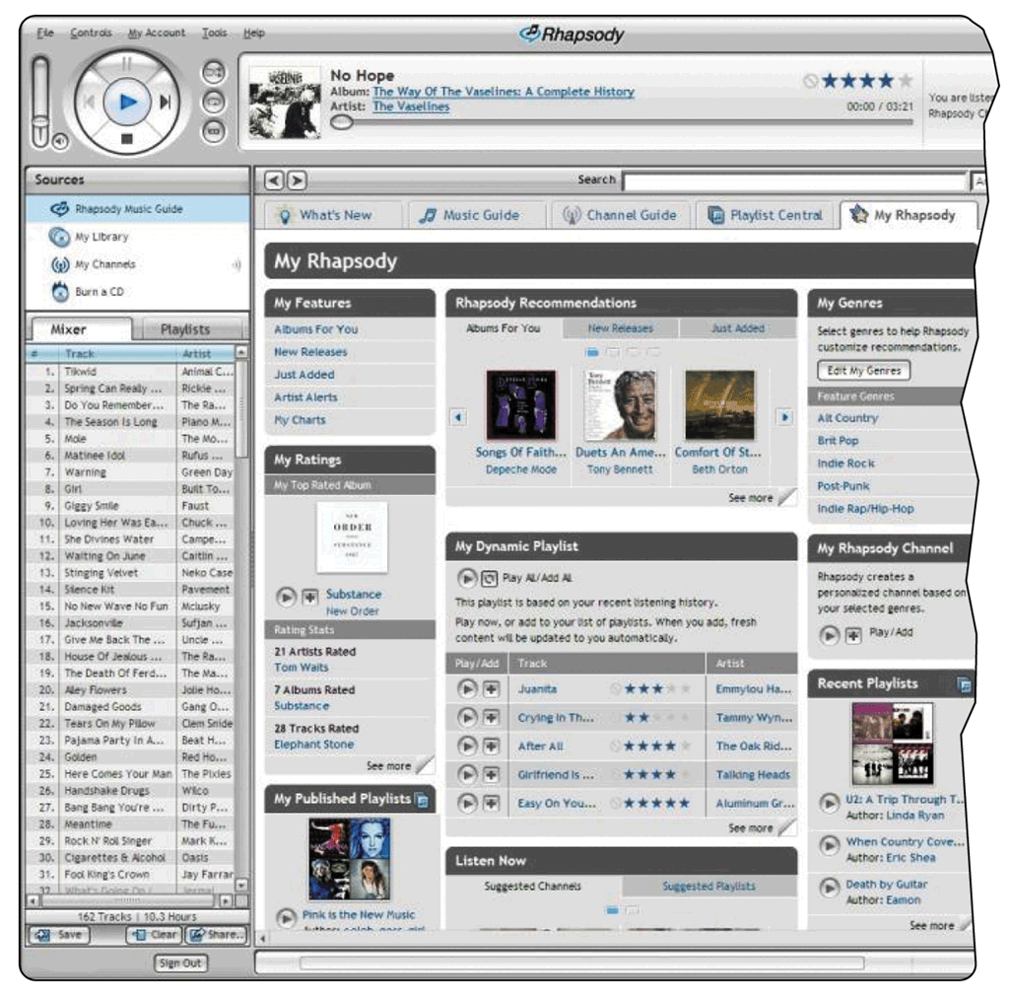
Stand-Alone Utility Programs
What is a media player?
  Allows you to view images and animation, listen to audio, and watch video files on your computer
p. 428 Fig. 8-38
Next

Slide 51
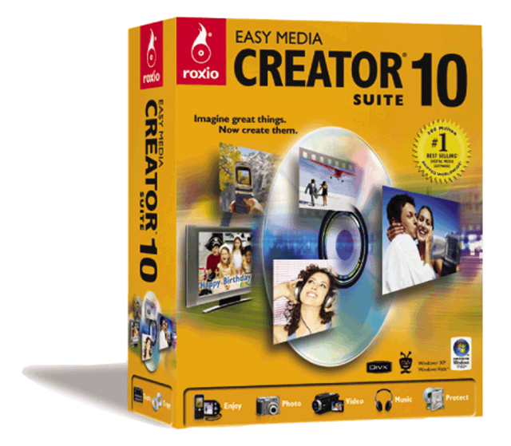
Stand-Alone Utility Programs
What is CD/DVD burning software?
  Writes text, graphics, audio, and video files to a recordable or rewriteable CD or DVD
p. 428 Fig. 8-39
Next

Slide 52
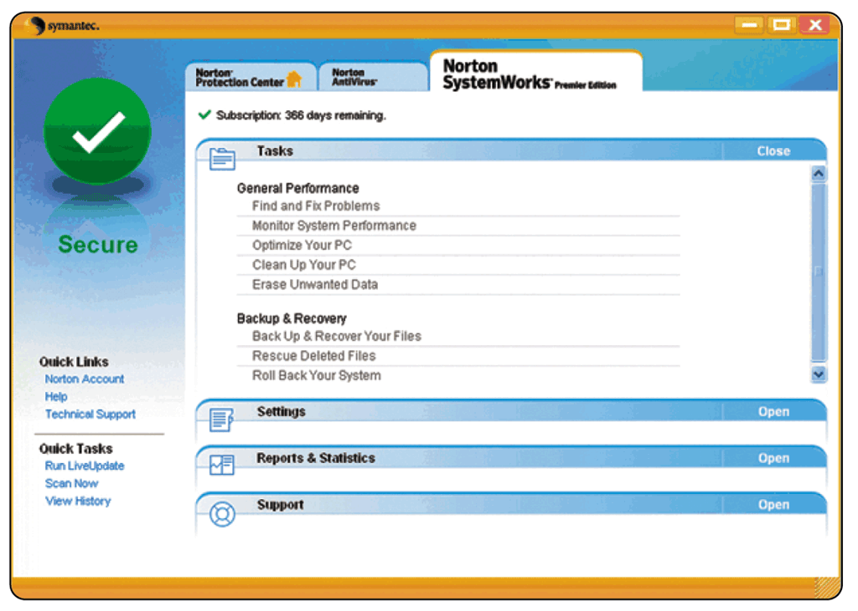
Stand-Alone Utility Programs
What is a personal computer maintenance utility?
  Identifies and fixes operating system problems and disk problems
  Some continuously
  monitor computer to
  identify problems
  before they occur
p. 428 Fig. 8-40
Next

Slide 53
Summary of Operating Systems and Utility Programs
Define an operating system
Discuss a variety of stand-alone
operating systems, network operating systems,
and embedded operating systems
Discuss the functions common to
most operating systems
Describe several stand-alone
utility programs
Introduce several utility programs commonly
found in operating systems
Chapter 8 Complete

