Slide 1
Chapter 4
The Components of the System Unit

Slide 2
Chapter 4 Objectives
Differentiate among various styles
of system units
Differentiate among the various
types of memory
Identify chips, adapter cards, and other components of a motherboard
Describe the types of expansion slots and adapter cards
Describe the components of a processor and how they complete a machine cycle
Explain the differences among a serial port, a parallel port, a USB port, a FireWire port, and other ports
Identify characteristics of various personal computer processors on the market today
Describe how buses contribute to a
computer’s processing speed
Define a bit and describe how a series of bits represents data
Identify components in mobile computers
and mobile devices
Explain how programs transfer in
and out of memory
Understand how to clean a system unit
Next

Slide 3
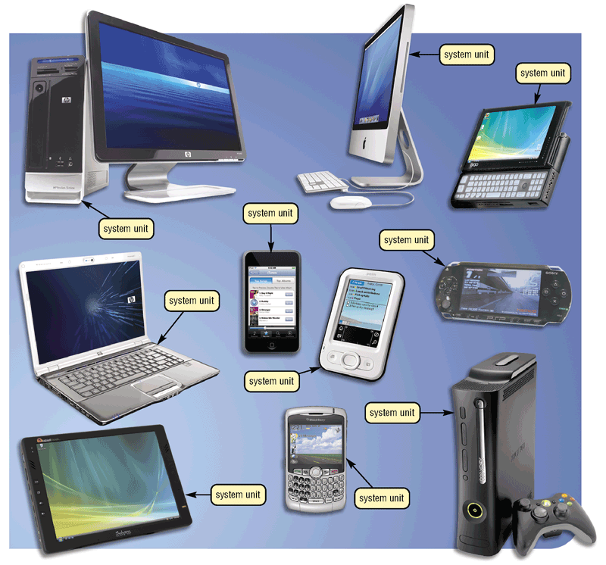
The System Unit
What is the system unit?
  Case that contains electronic components of the computer used
  to process data
    Sometimes called
    the chassis
p. 184 Fig. 4-1
Next

Slide 4
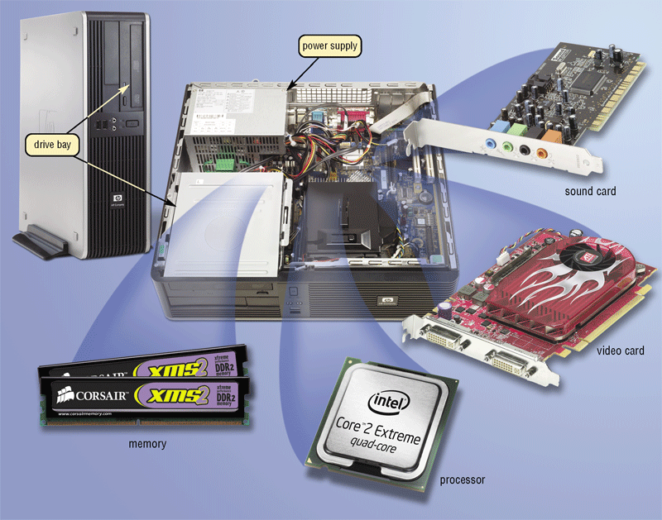
The System Unit
What are common components inside the system unit?
  Processor
  Memory
  Adapter cards
    Sound card
    Video card
  Drive bays
  Power supply
p. 185 Fig. 4-2
Next

Slide 5
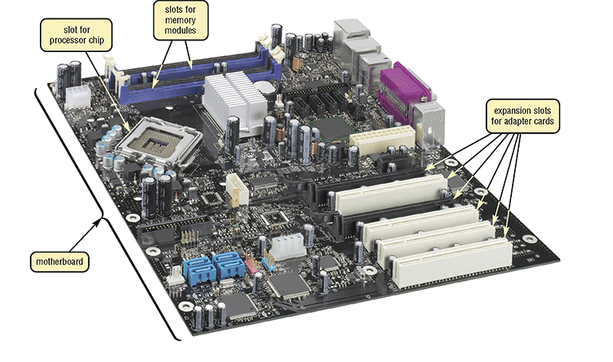
The System Unit
What is the motherboard?
  Main circuit board of the system unit
  Contains expansion slots, processor chips, and memory slots
  Also called system board
Click to view Web Link,
click Chapter 4, Click Web Link
from left navigation,
then click Motherboards below Chapter
p. 186 Fig. 4-3
Next

Slide 6
The System Unit
What is a chip?
  Small piece of semi-conducting material on which integrated circuits are etched
    Integrated circuits contain many microscopic pathways capable of carrying electrical current
  Chips are packaged so that they can be attached to a circuit board
p. 186
Next

Slide 7
Processor
What is the central processing unit (CPU)?
  Interprets and carries out basic instructions that operate a computer
Processor
Control
Unit
Arithmetic
Logic Unit (ALU)
Control
Unit
Arithmetic
Logic Unit (ALU)
    Control unit directs and coordinates operations in computer
Instructions
Data
Information
    Arithmetic logic unit
    (ALU) performs
    arithmetic, comparison,
    and logical operations
Memory
Input
Devices
Data
Information
Output
Devices
Instructions
Data
Information
  Also called the processor
Storage
Devices
p. 186 - 187 Fig. 4-4
Next

Slide 8
Processor
What are multi-core processors?
A multi-core processor is a chip with two or more
separate processors
A dual-core processor is a single chip that contains two
separate processors
A quad-core processor is a single chip that contains four
separate processors
Each processor on a multi-core chip generally
runs at a slower clock speed, but increases overall performance
Click to view Web Link,
click Chapter 4, Click Web Link
from left navigation,
then click Quad-Core
Processors below Chapter 4
p. 187
Next

Slide 9

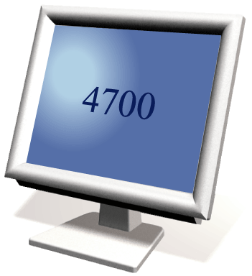
Processor
What is a machine cycle?
  Four operations of the CPU comprise a machine cycle
Step 1. Fetch
Obtain program instruction or data item from memory
Memory
Step 2. Decode
Translate instruction into commands
Step 4. Store
Write result to memory
Processor
ALU
Control Unit
Step 3. Execute
Carry out command
p. 188 Fig. 4-5
Next

Slide 10
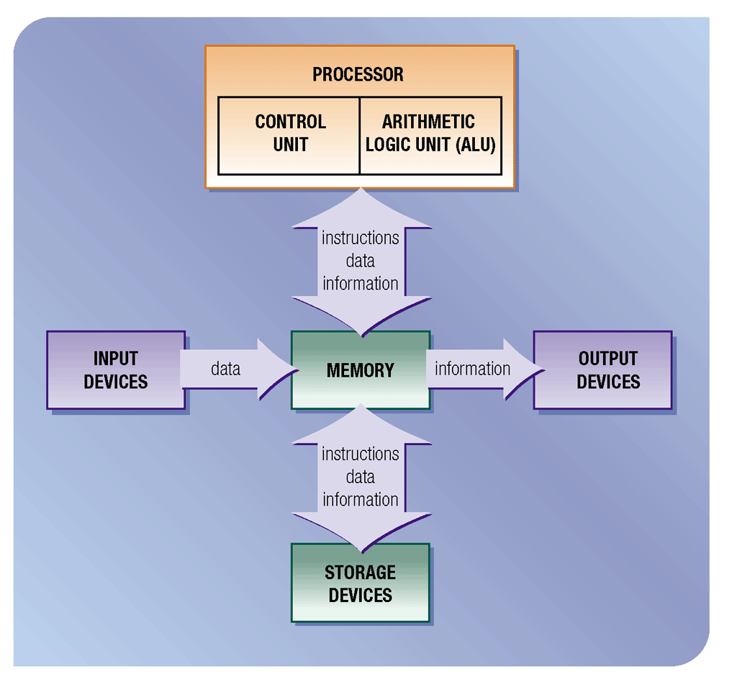
Processor
What is pipelining?
  Processor begins fetching second instruction before completing machine cycle for first instruction
  Results in faster processing
p. 189 Fig. 4-6
Next

Slide 11
Processor
What is a register?
  Temporary high-speed storage area that holds
  data and instructions
Stores location
from where instruction
was fetched
Stores
instruction while it is
being decoded
Stores data
while ALU
computes it
Stores results
of calculation
p. 189
Next

Slide 12
Processor
What is the system clock?
  Controls timing of all computer operations
  Generates regular electronic pulses, or ticks, that set operating pace of components of system unit
Each tick
is a
clock cycle
Pace of system
clock is clock speed
Most clock speeds are
in the gigahertz (GHz)
range (1 GHz = one
billion ticks of system
clock per second)
Processor speed can
also be measured in
millions of instructions
per second (MIPS)
p. 189 - 190
Next

Slide 13
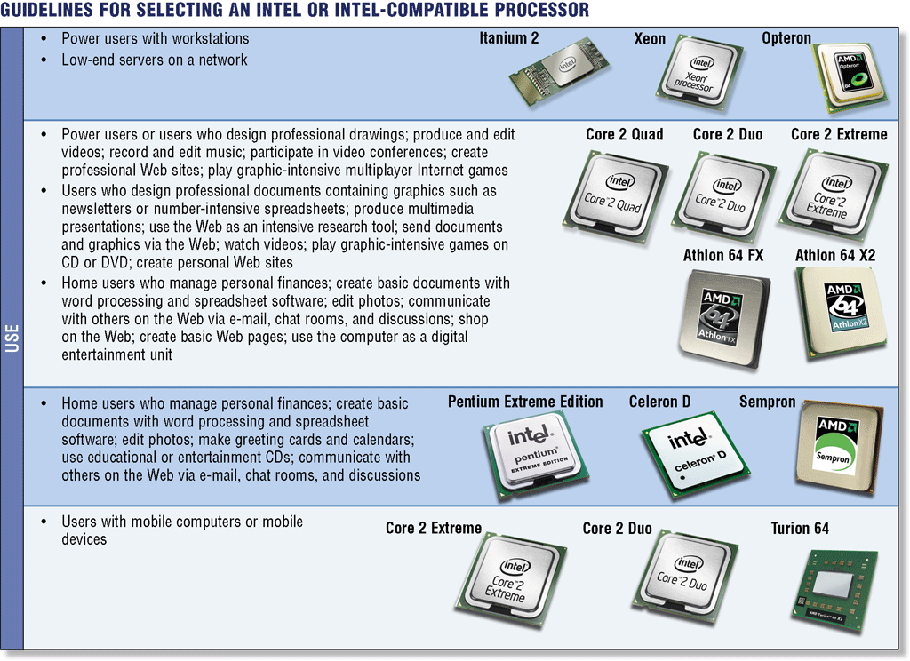
Processor
What are the guidelines for selecting a processor?
p. 192 Fig. 4-8
Next

Slide 14
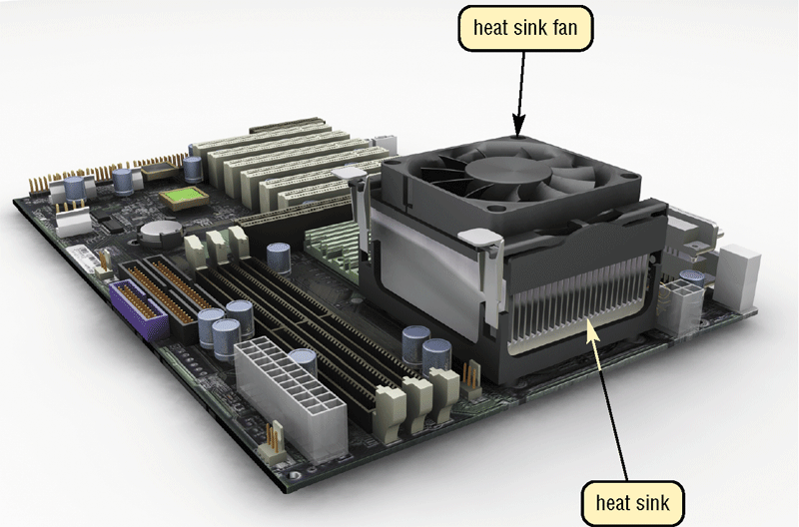
Processor
What are heat sinks, heat pipes, and liquid cooling?
  Heat sink—component
  with fins that cools
  processor
  Heat pipee—smaller
  device for notebook
  computers
  Liquid cooling—uses a continuous flow
  of fluids to transfer heat away
p. 193 Fig. 4-9
Next

Slide 15
Processor
What is parallel processing?
  Using multiple processors simultaneously to execute a program faster
  Requires special software to divide problem and bring results together
Control Processor
Processor 1
Processor 2
Processor 3
Processor 4
Memory
Memory
Memory
Memory
results combined
p. 194 Fig. 4-10
Next

Slide 16
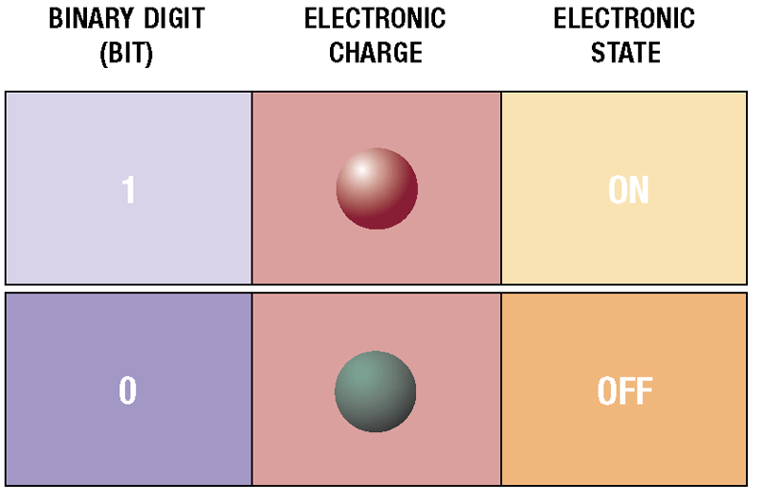
Data Representation
How do computers represent data?
  Most computers are digital
Recognize only two discrete states: on or off
Use a binary system to recognize two states
Use Number system with two unique digits: 0 and 1, called bits (short for binary digits)
p. 194 - 195 Fig. 4-11
Next

Slide 17
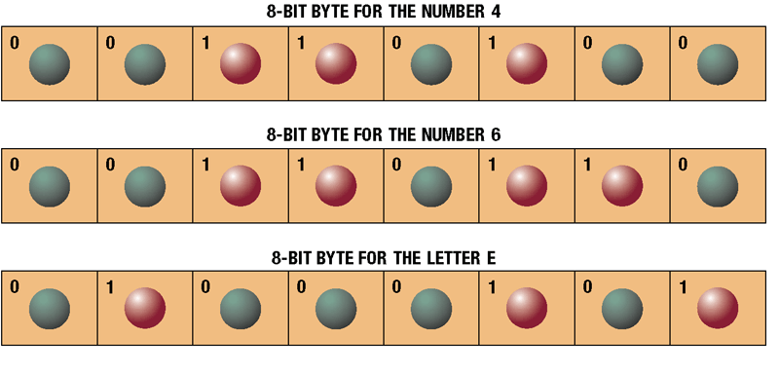
Data Representation
What is a byte?
  Eight bits grouped together as a unit
  Provides enough different combinations of 0s and 1s to represent 256 individual characters
    Numbers
    Uppercase
    and lowercase
    letters
    Punctuation
    marks
    Other
p. 195 Fig. 4-12
Next

Slide 18
Data Representation
What are three popular coding systems to represent data?
  ASCII—American Standard Code for Information Interchange
  EBCDIC—Extended Binary Coded Decimal Interchange Code
  Unicode—coding scheme capable of representing all
  world’s languages
ASCII Symbol EBCDIC
00110000 0 11110000
00110001 1 11110001
00110010 2 11110010
00110011 3 11110011
p. 195 Fig. 4-13
Next

Slide 19
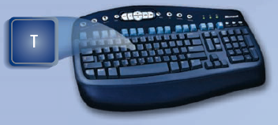
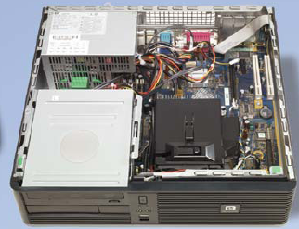
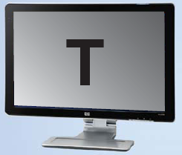
Data Representation
How is a letter converted to binary form and back?
Step 1.
The user presses the capital letter T (SHIFT+T key) on the keyboard.
Step 2.
An electronic signal for the capital letter T is sent to the system unit.
Step 3.
The system unit converts the scan code for the capital letter T to its ASCII binary code (01010100) and stores it in memory for processing.
Step 4.
After processing, the binary code for the capital letter T is converted to an image, and displayed on the output device.
p. 196 Fig. 4-14
Next

Slide 20
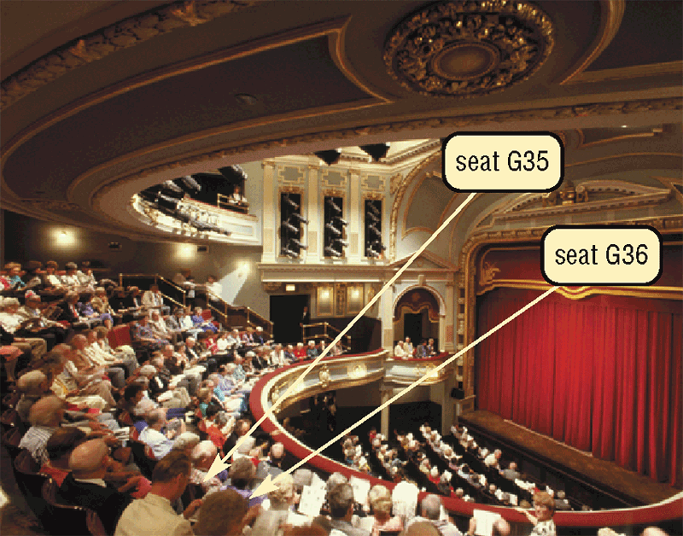
Memory
What is memory?
  Electronic components that store instructions, data, and results
  Consists of one or
  more chips on
  motherboard or
  other circuit board
  Each byte stored
  in unique location
  called an address,
  similar to seats in a concert hall
p. 197 Fig. 4-15
Next

Slide 21
Memory
How is memory measured?
  By number of bytes available for storage
Term Abbreviation Approximate Size
Kilobyte KB or K 1 thousand bytes
Megabyte MB 1 million bytes
Gigabyte GB 1 billion bytes
Terabyte TB 1 trillion bytes
p. 197 Fig. 4-16
Next

Slide 22
Memory
What is random access memory (RAM)?
Memory chips that can be
read from and written
to by processor
Also called
main memory
or primary
storage
Most RAM is
volatile, it is lost
when computer’s
power is
turned off
The more RAM a
computer has, the
faster it responds
Click to view Web Link,
click Chapter 4, Click Web Link
from left navigation,
then click RAM below Chapter
p. 198 - 199
Next

Slide 23
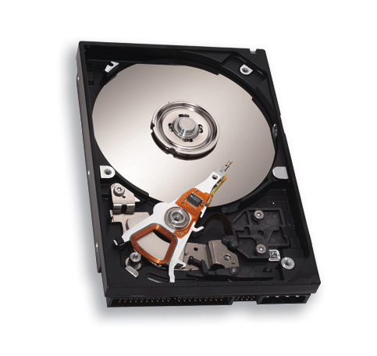
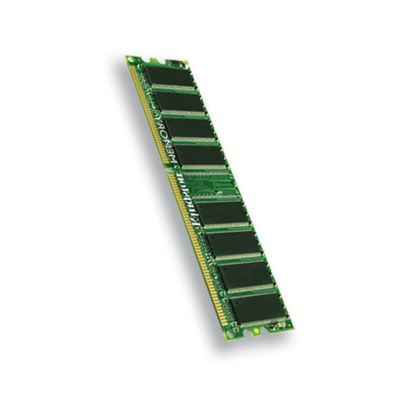
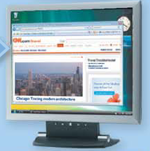
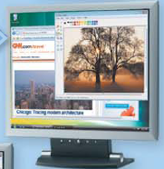
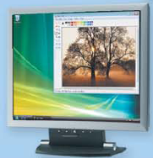
Memory
How do program instructions transfer in and out of RAM?
RAM
Step 1. When you start the computer, certain operating system files are loaded into RAM from the hard disk. The operating system displays the user interface on the screen.
Operating system instructions
Operating system interface
Step 2. When you start a Web browser, the program’s instructions are loaded into RAM from the hard disk. The Web browser window is displayed on the screen.
Web browser instructions
Web browser
window
Step 3. When you start a paint program, the program’s instructions are loaded into RAM from the hard disk. The paint program, along with the Web Browser and certain operating system instructions are in RAM. The paint program window is displayed on the screen.
Paint program instructions
Paint program window
RAM
Step 4. When you quit a program, such as the Web browser, its program instructions are removed from RAM. The Web browser is no longer displayed on the screen.
Web browser program instructions are removed from RAM
Web browser window is no longer displayed on desktop
p. 198 Fig. 4-17
Next

Slide 24

Memory
Video: The Leopard with a Time Machine
CLICK TO START
Next

Slide 25
Memory
What are two basic types of RAM chips?
Most
common
type
Do not have to
be re-energized
as often as
DRAM
Dynamic
RAM
(DRAM)
  Static
  RAM
  (SRAM)
Must be
re-energized
constantly
Faster and
more reliable
than DRAM
chips
Newer Type: Magnetoresistive RAM (MRAM)
p. 199
Next

Slide 26
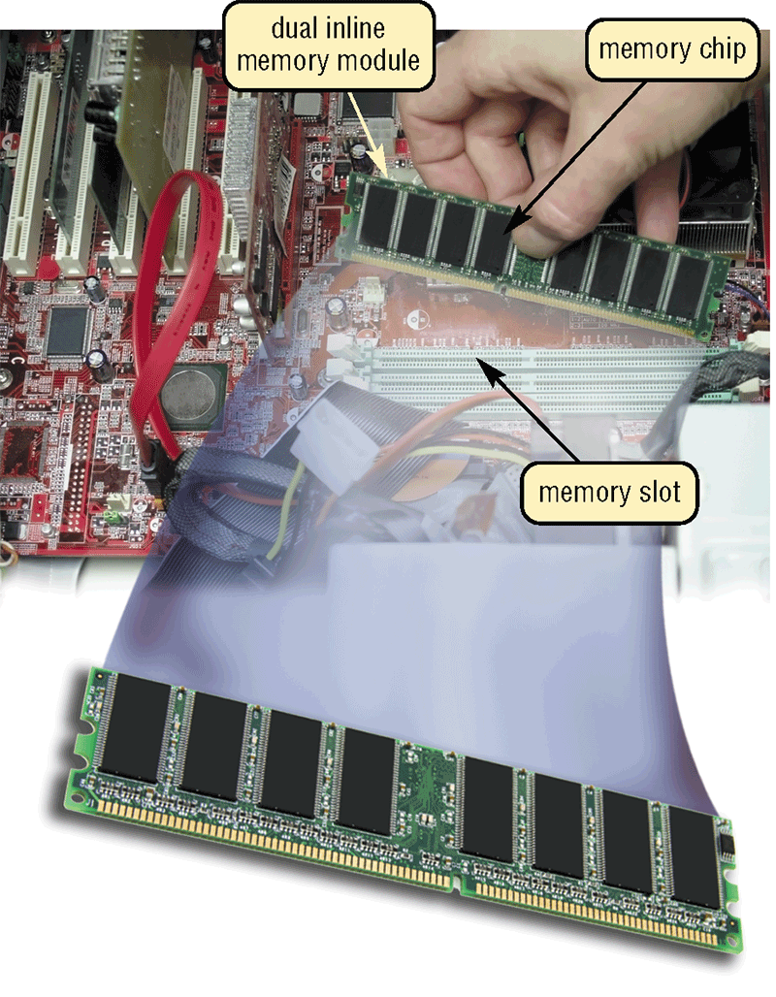
Memory
Where does memory reside?
  Resides on small circuit board called memory module
  Memory slots on motherboard hold memory modules
p. 199 Fig. 4-18
Next

Slide 27
Memory
How much RAM does an application require?
  Depends on the types of software you plan to use
  For optimal
  performance, you
  need more than
  minimum specifications
p. 199
Next

Slide 28
Memory
How much RAM do you need?
  Depends on type of applications you intend to run
  on your computer
RAM
1 GB or less
1 GB to 4 GB
4 GB and up
Use
Home and business
users managing
personal finances
Using standard
application software
such as word processing
Using educational
or entertainment
CDs
Communicating with others on the Web
Users requiring more advanced multimedia capabilities
Running number-intensive
accounting, financial, or
spreadsheet programs
Using voice recognition
Working with videos, music, and
digital imaging
Creating Web sites
Participating in video conferences
Playing Internet games
Power users creating professional Web sites
Running sophisticated
CAD, 3-D design, or
other graphics-intensive software
p. 200 Fig. 4-19
Next

Slide 29
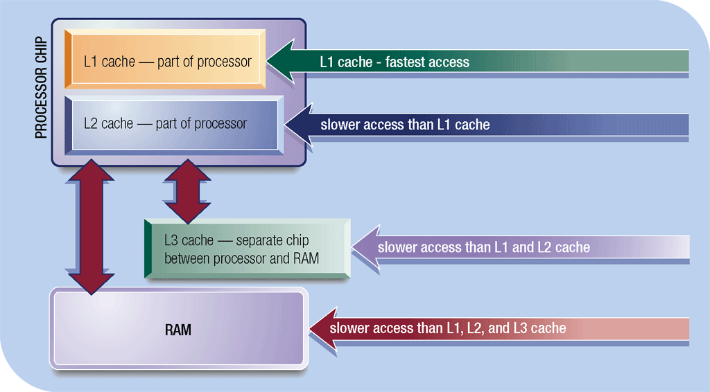
Memory
What is cache?
  Helps speed computer processes by storing frequently used instructions and data
  Also called memory cache
    L1 cache built into processor
    L2 cache slower but has larger capacity
    L2 advanced transfer cache is faster, built directly on processor chip
    L3 cache is separate from processor chip on motherboard (L3 is only
    on computers that use L2 advanced transfer cache)
Click to view Web Link,
click Chapter 4, Click
Web Link from left
navigation, then click
Windows ReadyBoost below Chapter 4
p. 201 Fig. 4-20
Next

Slide 30
Memory
What is read-only memory (ROM)?
Memory chips that store
permanent data
and instructions
Nonvolatile memory, it is not
lost when computer’s
power is turned off
Three types:
Firmware—
Manufactured with
permanently written
data, instructions,
or information
EEPROM
(electrically
erasable programmable
read-only memory)—
Type of PROM
containing microcode
programmer
can erase
PROM
(programmable
read-only
memory)—
Blank ROM
chip onto which
a programmer
can write permanently
p. 201 - 202
Next

Slide 31
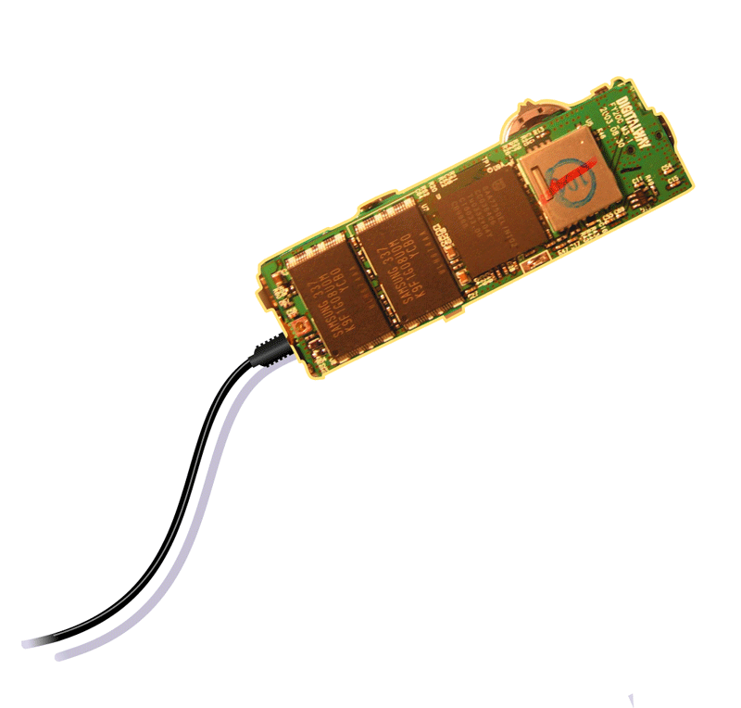
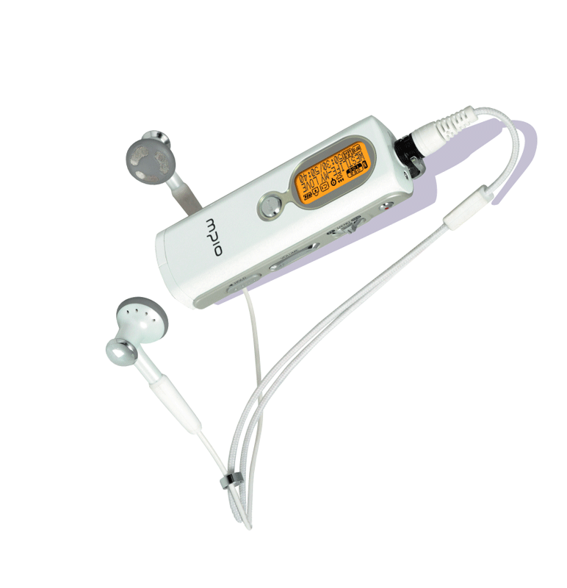
Memory
What is flash memory?
  Nonvolatile memory that can be erased electronically and rewritten
  Used with many mobile devices
Step 3.
Plug the headphones into the portable media player, push a button on the portable media player, and listen to the music through the earphones.
Step 1.
Purchase and download music tracks from a Web site. With one end of a special cable connected to the system unit, connect the other end to the USB port in the portable media player.
flash memory chips
USB port
Click to view Web Link,
click Chapter 4, Click Web Link
from left navigation,
then click Flash Memory
below Chapter 4
Step 2.
Instruct the computer to copy the music tracks to the flash memory chip in the portable media player.
MP3 Player
p. 202 Fig. 4-21
Next

Slide 32
Memory
What is CMOS?
Complementary metal-oxide semiconductor memory
Used in some
RAM chips, flash memory chips, and other types of memory chips
Uses battery
power to retain information when other power is turned off
Stores date,
time, and
computer’s
startup
information
p. 203
Next

Slide 33
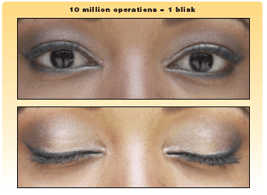
Memory
What is access time?
  Amount of time it takes processor
  to read data from memory
  Measured in nanoseconds (ns),
  one billionth of a second
  It takes 1/10 of a second to blink
  your eye; a computer can perform
  up to 10 million operations in same amount of time
Term Speed
Millisecond One-thousandth of a second
Microsecond One-millionth of a second
Nanosecond One-billionth of a second
Picosecond One-trillionth of a second
p. 203 Figs. 4-22-4-23
Next

Slide 34
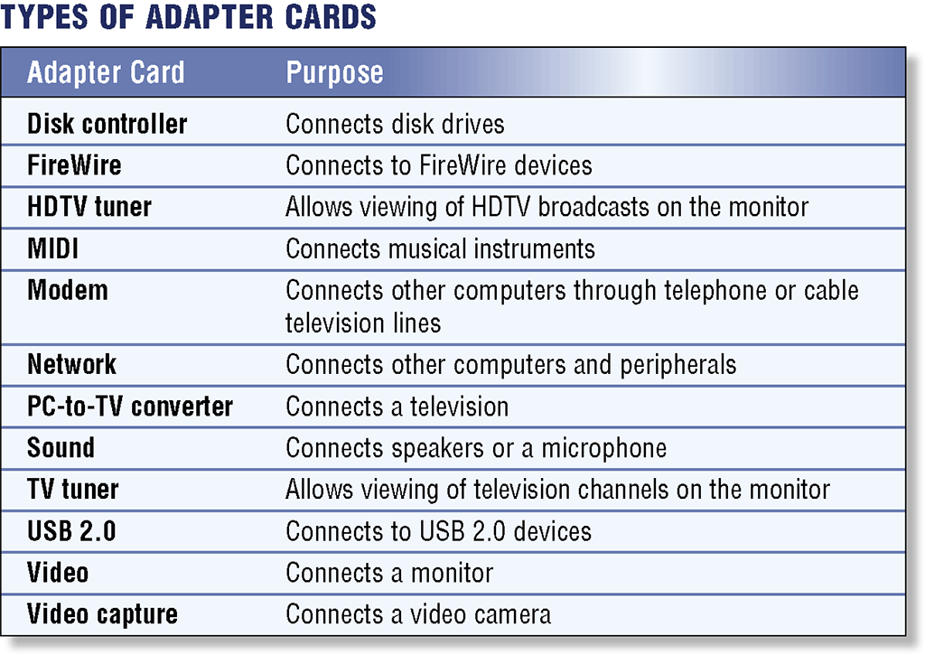
Expansion Slots and Adapter Cards
What is an adapter card?
  Enhances system unit or provides connections to external devices called peripherals
  Also called an expansion card
Click to view Web Link,
click Chapter 4, Click Web Link
from left navigation,
then click Video Cards
below Chapter 4
p. 204 Fig. 4-24
Next

Slide 35
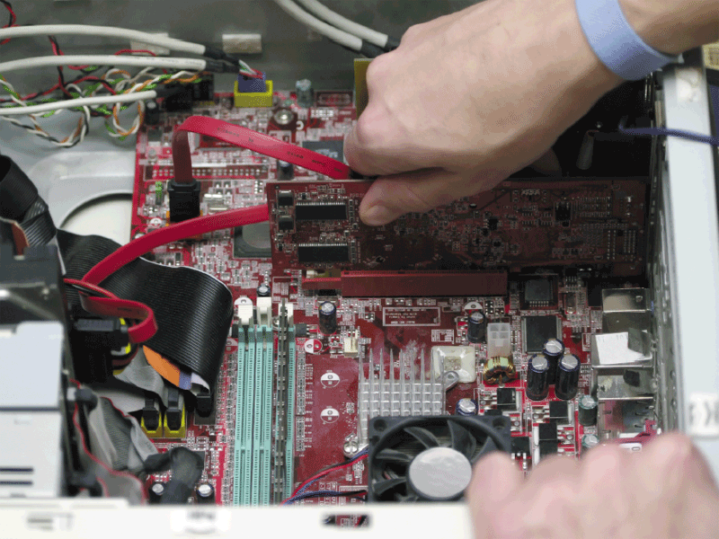
Expansion Slots and Adapter Cards
What is an expansion slot?
  An opening, or socket,
  on the motherboard
  that can hold an
  adapter card
  With Plug and Play,
  the computer
  automatically
  configures cards
  and other devices
  as you install them
p. 204 - 205 Fig. 4-25
Next

Slide 36
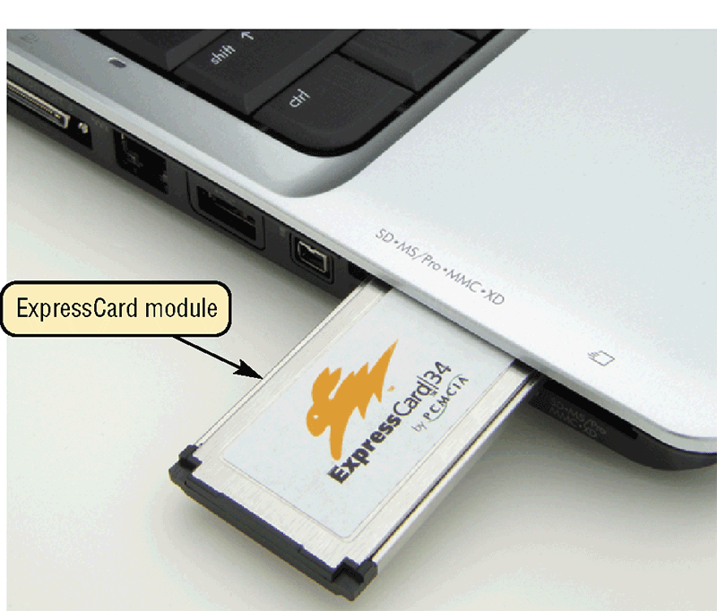
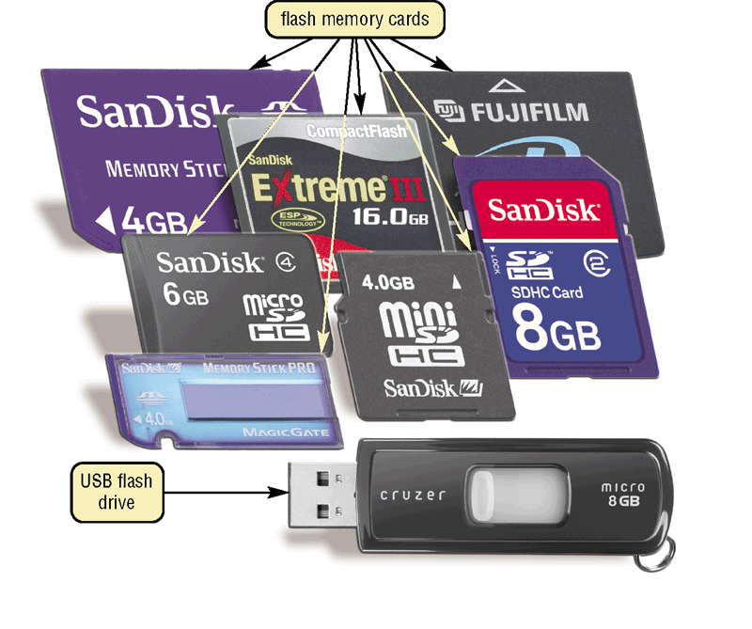
Expansion Slots and Adapter Cards
What are flash memory cards, PC cards, and ExpressCard modules?
  An ExpressCard module adds memory, storage, sound, fax/modem, communications, and other capabilities to notebook computers
  A flash memory card allows users to transfer data from mobile devices to desktop computers
  USB Flash drive
  An PC card adds various capabilities to computers
Click to view Web Link,
click Chapter 4, Click Web Link
from left navigation,
then click ExpressCard Modules
below Chapter 4
p. 205 Fig. 4-26–4-27
Next

Slide 37
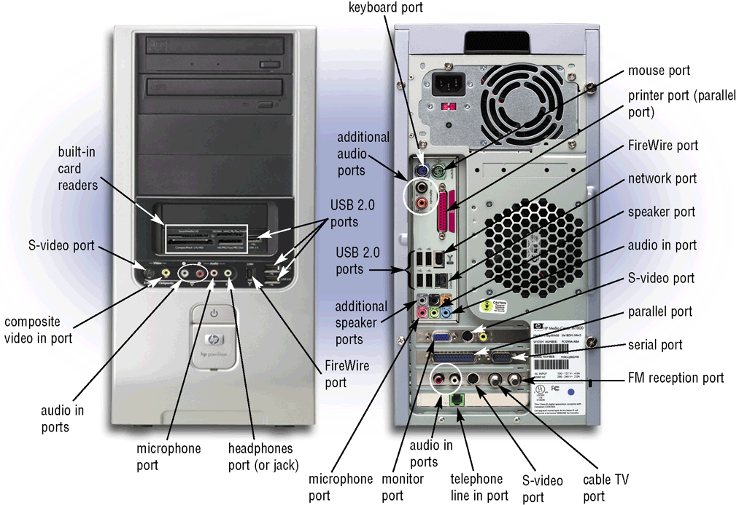
Ports and Connectors
What are ports and connectors?
  Port connects external devices to system unit
  Connector joins cable to peripheral
    Available in one of two genders: male and female
p. 206 Fig. 4-28
Next

Slide 38
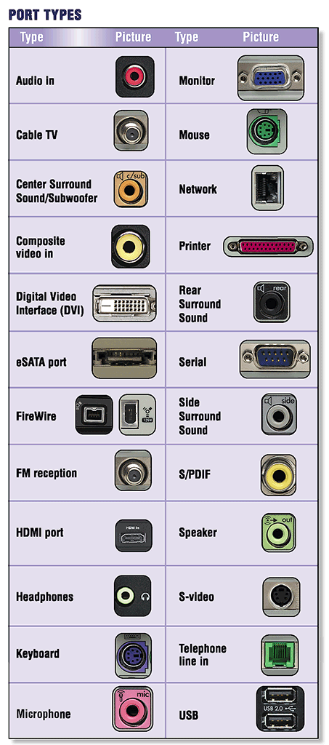
Ports and Connectors
What are different types
of connectors?
p. 207 Fig. 4-29
Next

Slide 39
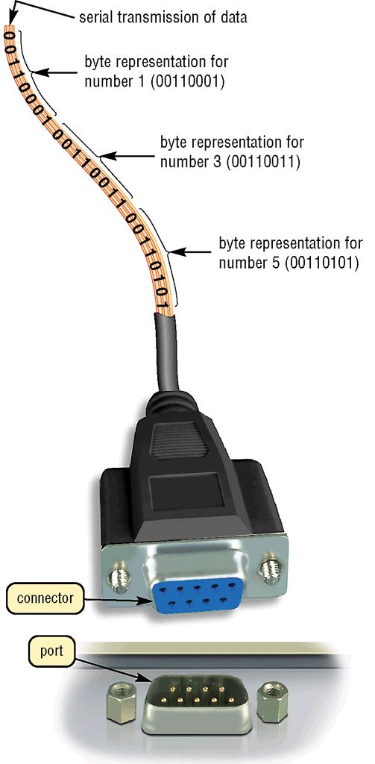
Ports and Connectors
What is a serial port?
  Transmits one bit of data at a time
  Connects slow-speed devices, such as mouse, keyboard, modem
p. 207 Fig. 4-30
Next

Slide 40
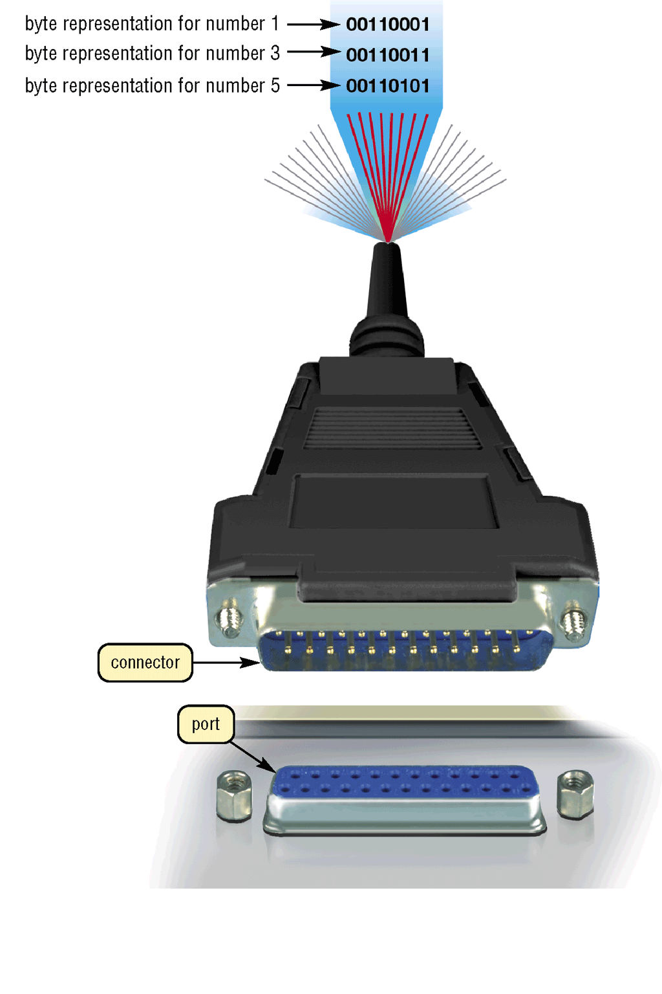
Ports and Connectors
What is a parallel port?
  Connects devices that can transfer more than one bit at a time, such as a printer
p. 208 Fig. 4-31
Next

Slide 41
Ports and Connectors
What are USB ports?
USB (universal serial bus) port can connect
up to 127 different peripherals together
with a single connector type
PCs typically have
six to eight USB ports
on front or back of
the system unit
Single USB port can
be used to attach
multiple peripherals
in a daisy chain
Third USB
device connects
to second USB
device, and so on
Second USB
device connects
to first USB
device
USB 2.0
First USB
device connects
to USB port
on computer
p. 208
Next

Slide 42
Ports and Connectors
What are FireWire ports?
  Connects multiple types of devices that require faster data transmission speeds
  Allows you to connect up to 63 devices together
  FireWire 800 is the latest FireWire version
  A FireWire hub is a device that plugs in a FireWire port on the system unit and contains multiple FireWire ports in which you plug cables from FireWire devices
p. 208 - 209
Next

Slide 43
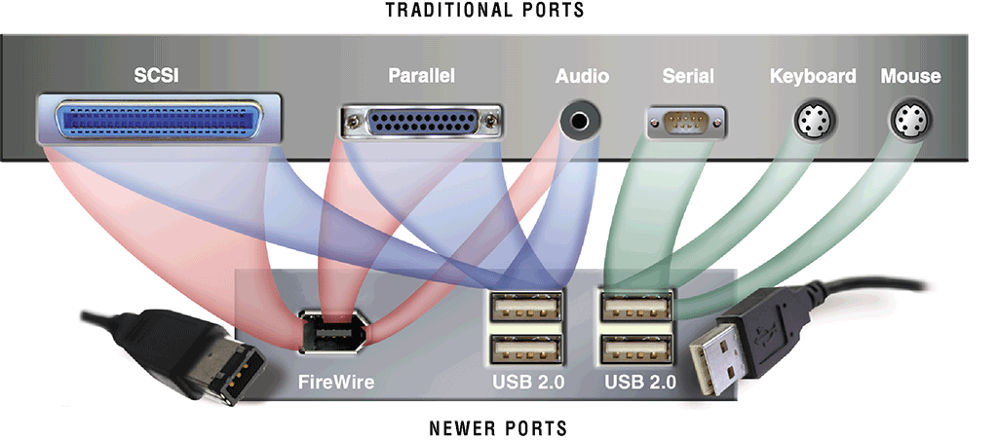
Ports and Connectors
What are special-purpose ports?
  Allow users to attach specialized peripherals or transmit data to wireless devices
    MIDI (Musical Instrument Digital Interface) port
    eSATA port
    SCSI port
    IrDA (Infrared Data Association) port
    Bluetooth port
Click to view Web Link,
click Chapter 4, Click Web Link
from left navigation,
then click MIDI Ports
below Chapter 4
p. 209 - 210 Fig. 4-32
Next

Slide 44
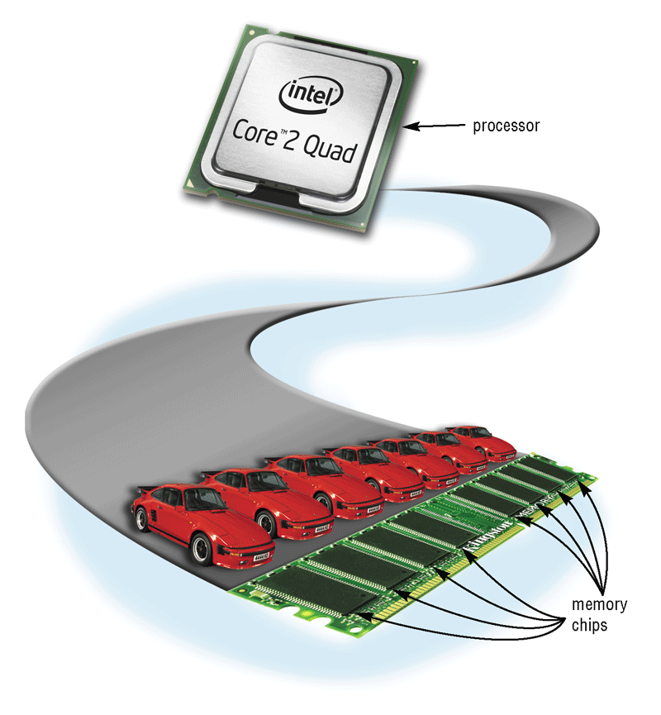
Buses
What is a bus?
  Channel that allows devices inside computer to communicate with each other
    System bus connects processor and RAM
    Bus width determines number of bits transmitted at one time
    Word size is the number of
    bits processor can interpret
    and execute at a given time
p. 211 - 212 Fig. 4-35
Next

Slide 45
Buses
What is an expansion bus?
  Allows processor to communicate with peripherals
PC Card
Bus
PCI
Express
Bus
AGP
Bus
USB
Bus
PCI
Bus
p. 212
Next

Slide 46
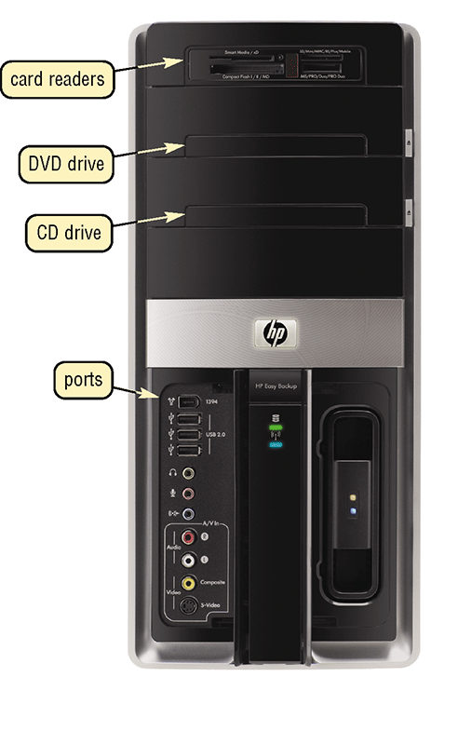
Bays
What is a bay?
  Opening inside system unit used to install additional equipment
  Drive bays typically hold disk drives
p. 212 Fig. 4-36
Next

Slide 47
Power Supply
What is a power supply?
Converts
AC Power
into
DC Power
Fan keeps
system unit components cool
External peripherals might use an AC adapter, which is an external power supply
p. 213
Next

Slide 48
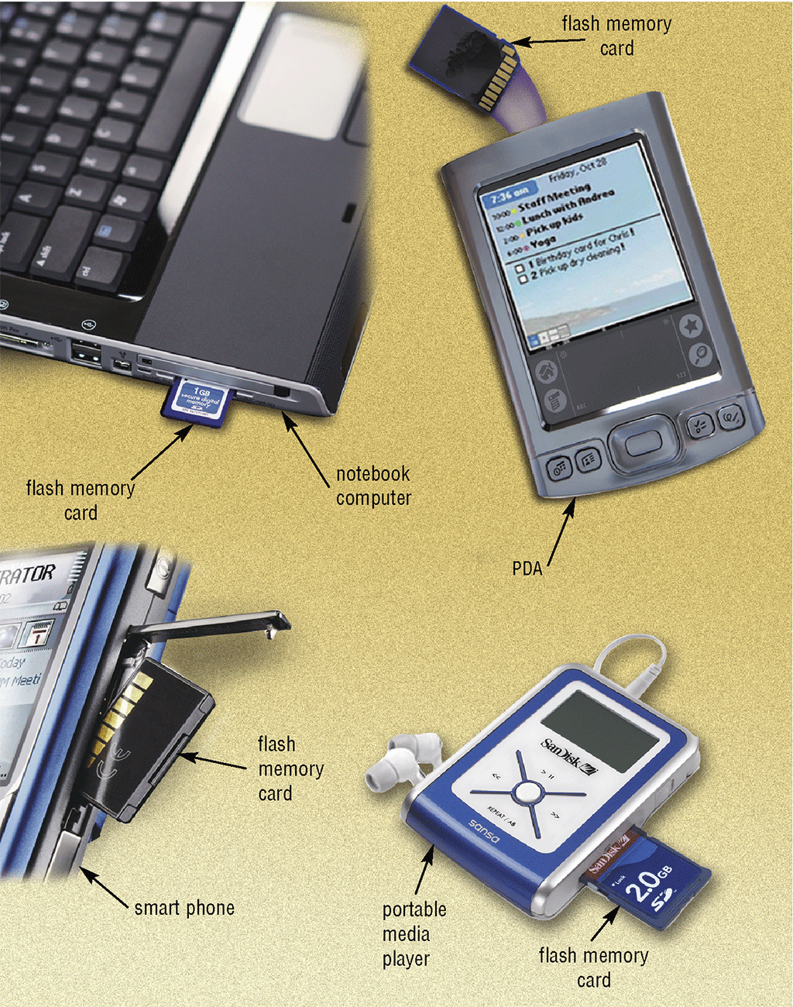
Mobile Computers and Devices
What is a mobile computer?
  Notebook, weighing between 2.5 and 10 pounds, or mobile device
p. 213 - 214 Fig. 4-37
Next

Slide 49
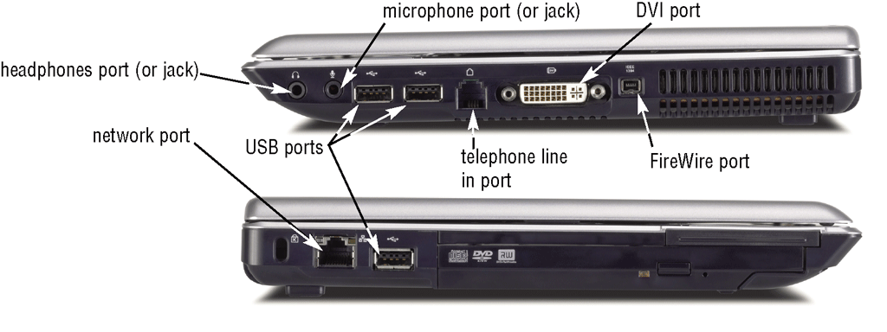
Mobile Computers and Devices
What ports are on a notebook computer?
p. 214 Fig. 4-38
Next

Slide 50
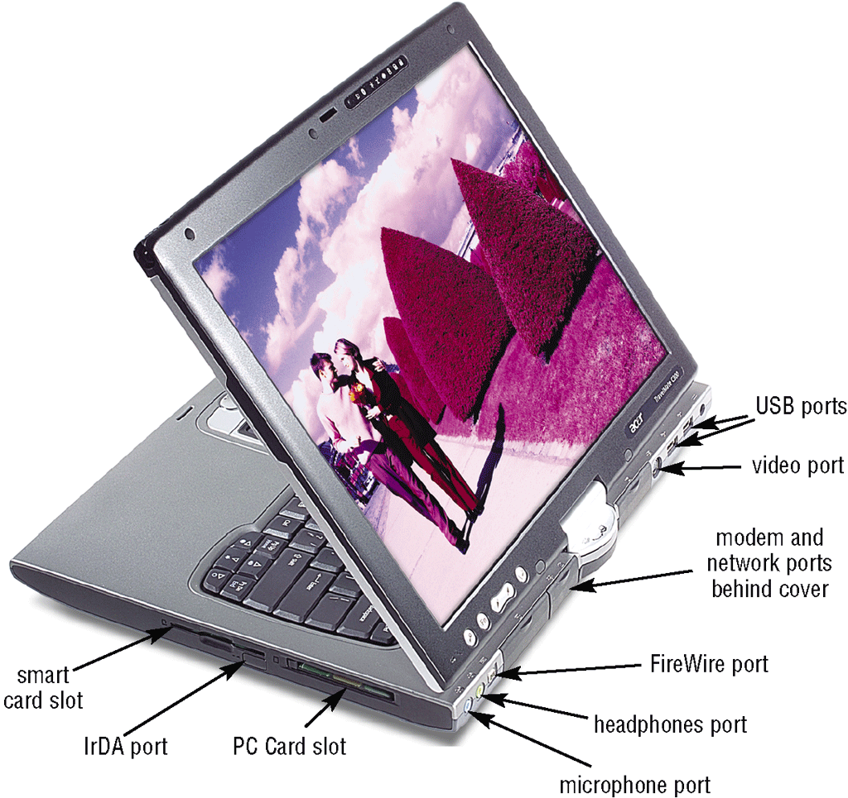
Mobile Computers and Devices
What ports and slots are on a tablet PC?
p. 214 Fig. 4-39
Next

Slide 51
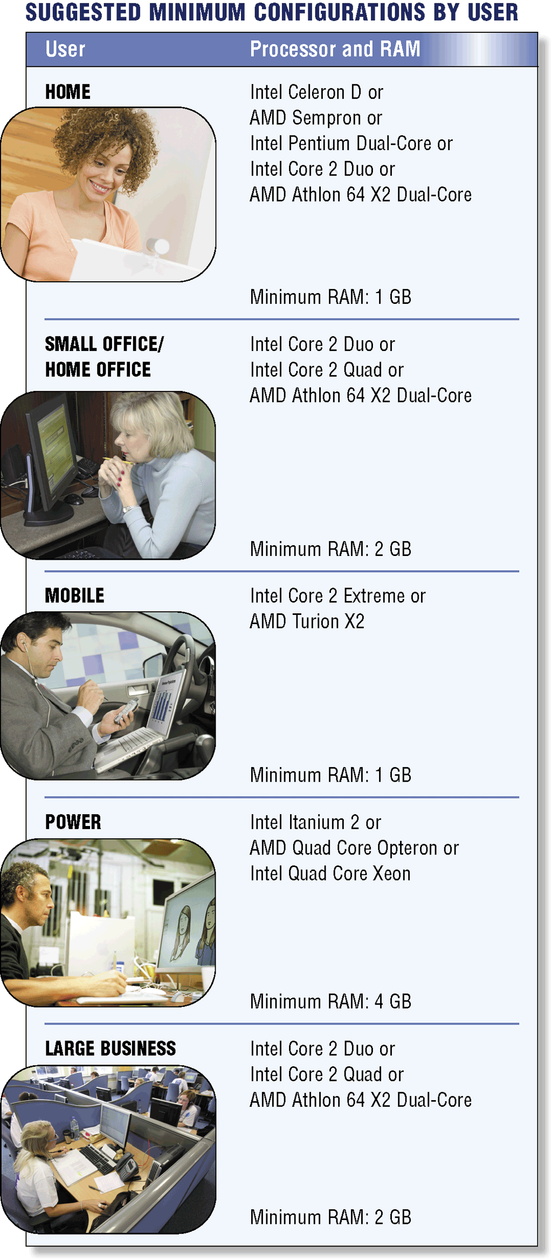
Putting It All Together
What are suggested processor and RAM configurations based on the needs of various types of users?
p. 215 Fig. 4-40
Next

Slide 52
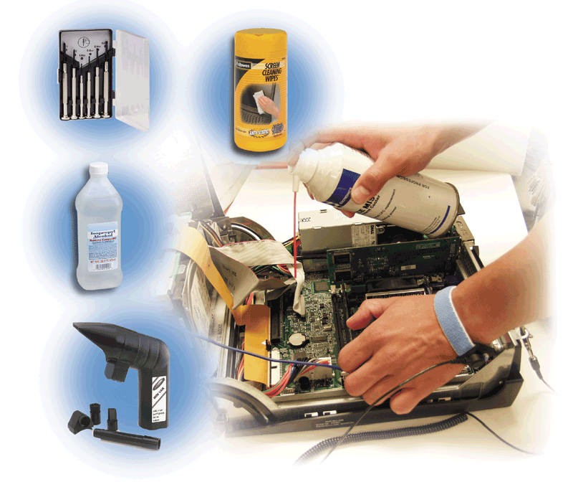
Keeping Your Computer Clean
Over time, the system unit collects dust – even in a clean environment
  Preventative maintenance requires a few basic products:
p. 216 Fig. 4-41
Next

Slide 53
Summary of the Components of the System Unit
  Components of the system unit
Comparison of various personal computer processors on the market today
How memory stores data, instructions,
and information
How to clean a system unit
Sequence of operations that occur when a computer executes an instruction
Chapter 4 Complete

