Slide 1
Chapter 3
Application Software

Slide 2
Chapter 3 Objectives
Identify the categories
of application software
Identify the key features of widely used home, personal, and educational programs
Explain ways software is distributed
Identify the types of application software used in communications
Explain how to work
with application software
Describe the function of several
utility programs
Identify the key features of widely
used business programs
Discuss the advantages of using
Web-based software
Identify the key features of widely used graphics and multimedia programs
Describe the learning aids available
for application software
Next

Slide 3
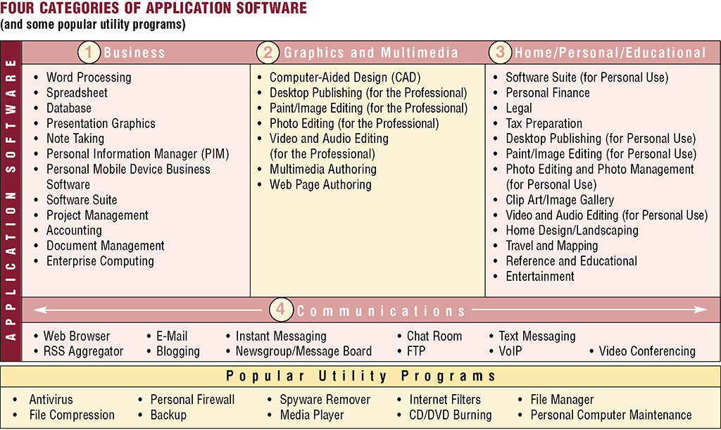
Application Software
What is application software?
Programs designed to make users more productive and/or assist them with personal tasks
p. 134 Fig. 3-1
Next

Slide 4
Application Software
How is software distributed?
  Packaged software, mass-produced
  Custom software, performs functions specific to a business or industry
  Web-based software, hosted by a Web site
  Open source software, provided for use, modification, and redistribution
  Shareware, copyrighted software that is distributed free for trial period
  Freeware, copyrighted software provided at no cost
  Public-domain software, freeware with no copyright restrictions
p. 134 - 135
Next

Slide 5
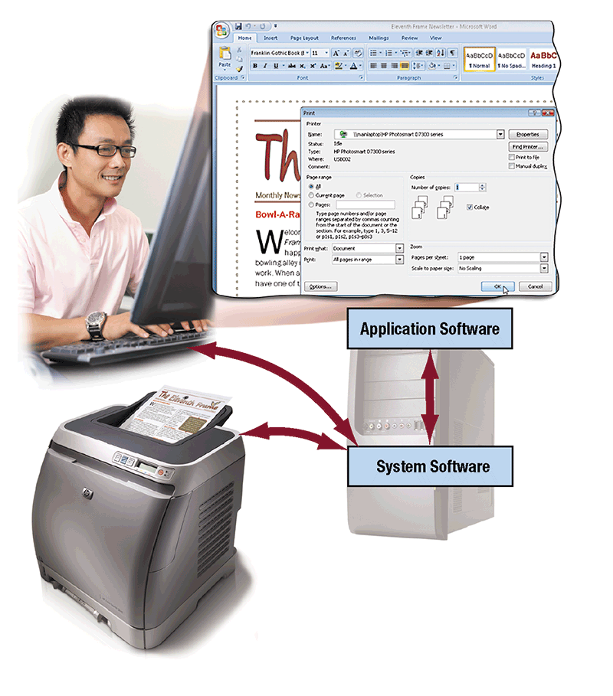
Application Software
What is system software?
  Serves as the interface between the user, the application software, and the computer’s hardware
p. 135 Fig. 3-2
Next

Slide 6
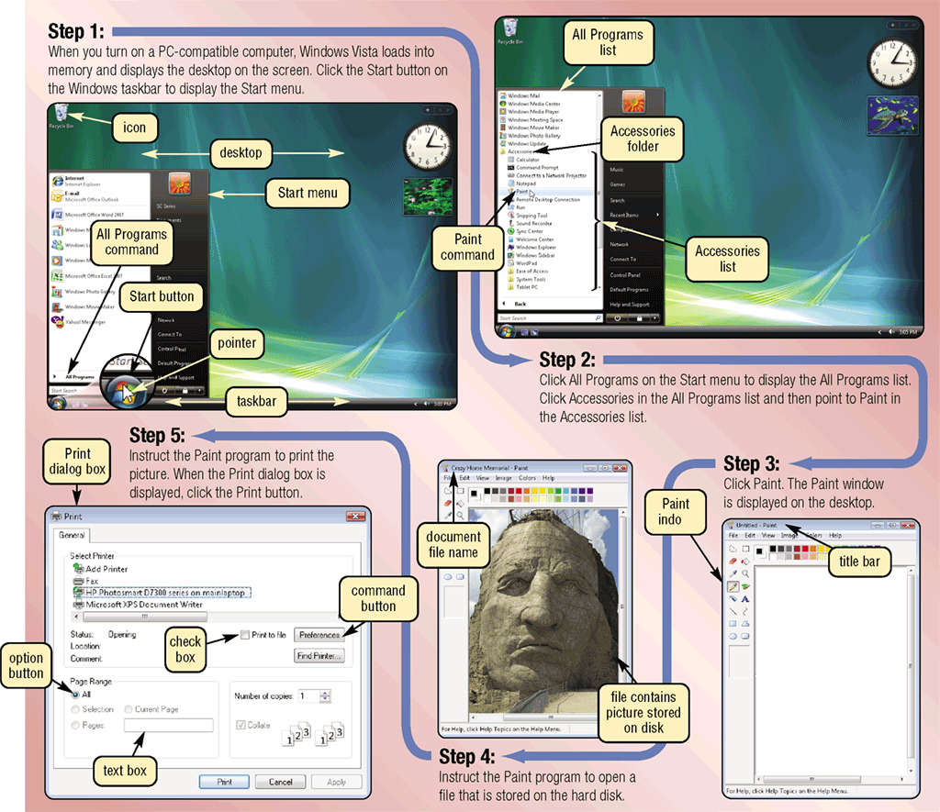
Application Software
How do you start an application?
  From the desktop, click the Start button, point to All Programs, and click the name of the application
  The program’s instructions load into memory
p. 136 - 137 Fig. 3-3
Next

Slide 7
Application Software
What is a window?
  A rectangular area of the screen that displays data and information
p. 136 - 137 Fig. 3-3
Next

Slide 8
Application Software
What is a dialog box?
  A window that provides information, presents available options, or requests a response
p. 136 - 137 Fig. 3-3
Next

Slide 9
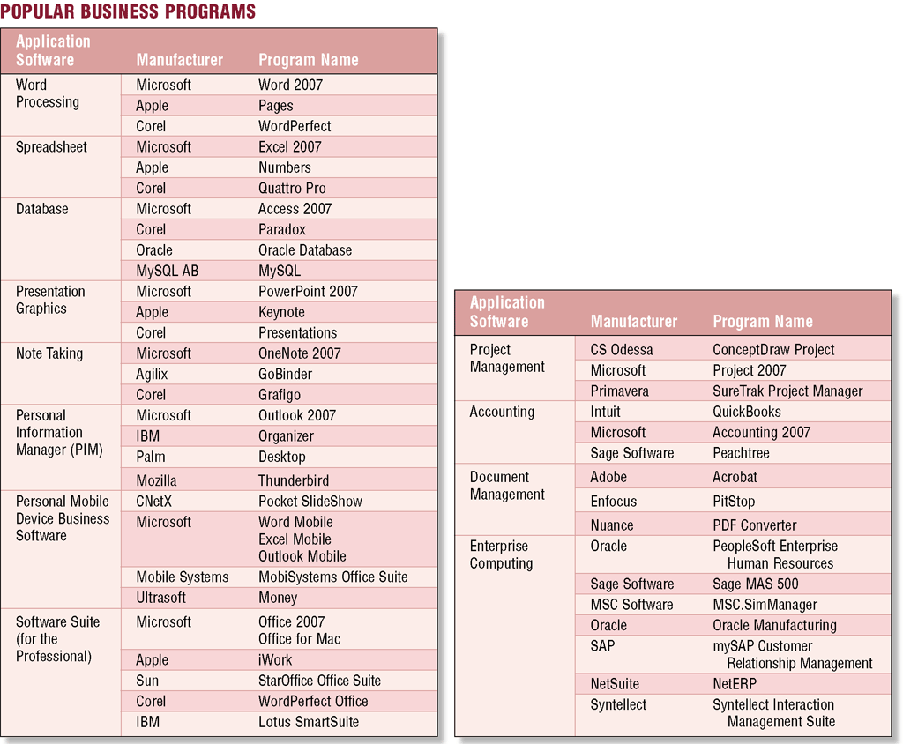
Business Software
What is business software?
  Application software that assists people in becoming more effective and efficient
p. 138 Fig. 3-4
Next

Slide 10
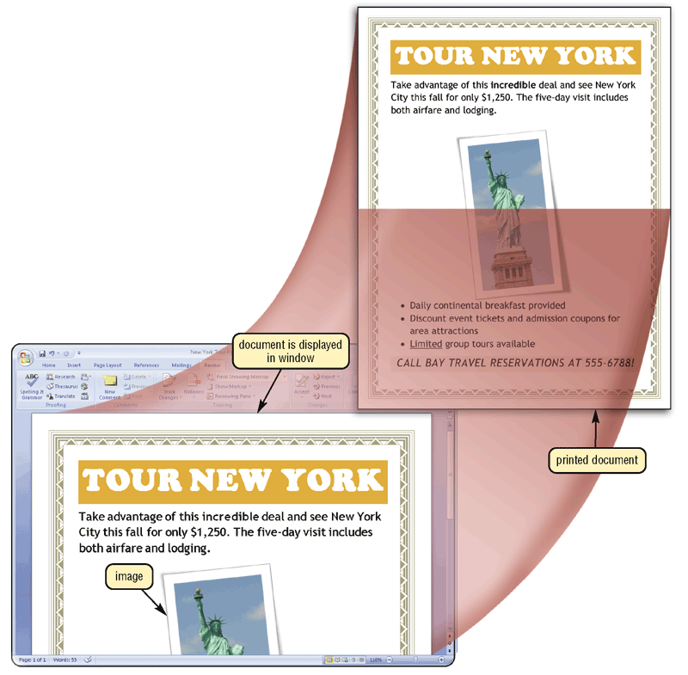
Business Software
What is word processing software?
  Allows users to create and
  manipulate text and graphics
    Clip art is a collection
    of graphics
    that you can
    insert in
    documents
Click to view Web Link,
click Chapter 3, Click Web Link
from left navigation,
then click Word Processing Software below Chapter 3
p. 138 – 139 Fig. 3-5
Next

Slide 11
Business Software
What are popular word processing features?
AutoCorrect
AutoFormat
Collaboration
Columns
Grammar
Checker
Ink Input
Macros
Mail Merge
Reading
Layout
Research
Smart Tags
Tables
Templates
Thesaurus
Tracking
Changes
Voice
Recognition
Web Page
Development
p. 140 Fig. 3-6
Next

Slide 12
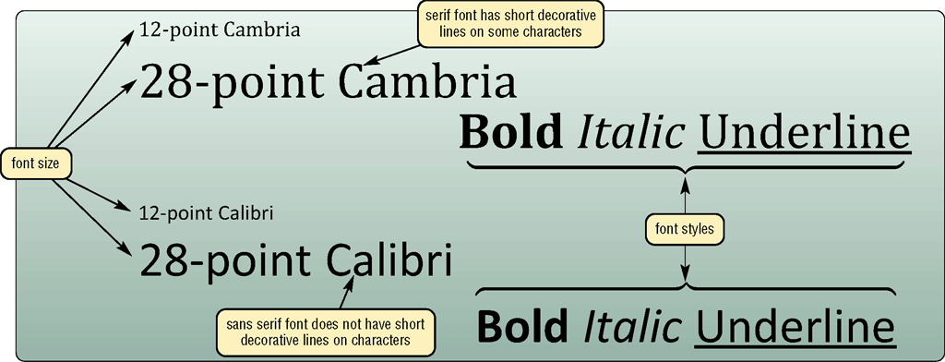
Business Software
What is a font?
  A name assigned to a specific design of characters
  Font size indicates the size of the characters in a particular font in points (a single point is about
  1/72 of an inch in height)
  Font style adds
  emphasis to a
  font such as
  bold, italic,
  and underline
p. 141 Fig. 3-7
Next

Slide 13
Business Software
What is spreadsheet software?
  Organizes data in rows and columns
  Performs calculations and
  recalculates when data changes
= A1+B2 (*C12)
= D1+E2 (*F12)
= SUM (C12:Y12)
p. 142 - 144
Next

Slide 14
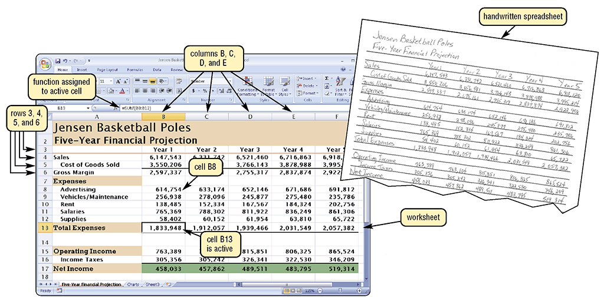
Business Software
How is a spreadsheet organized?
Columns identified by letters
Rows identified by numbers
A cell is the intersection of a column and row
p. 142 - 143 Fig. 3-8
Next

Slide 15
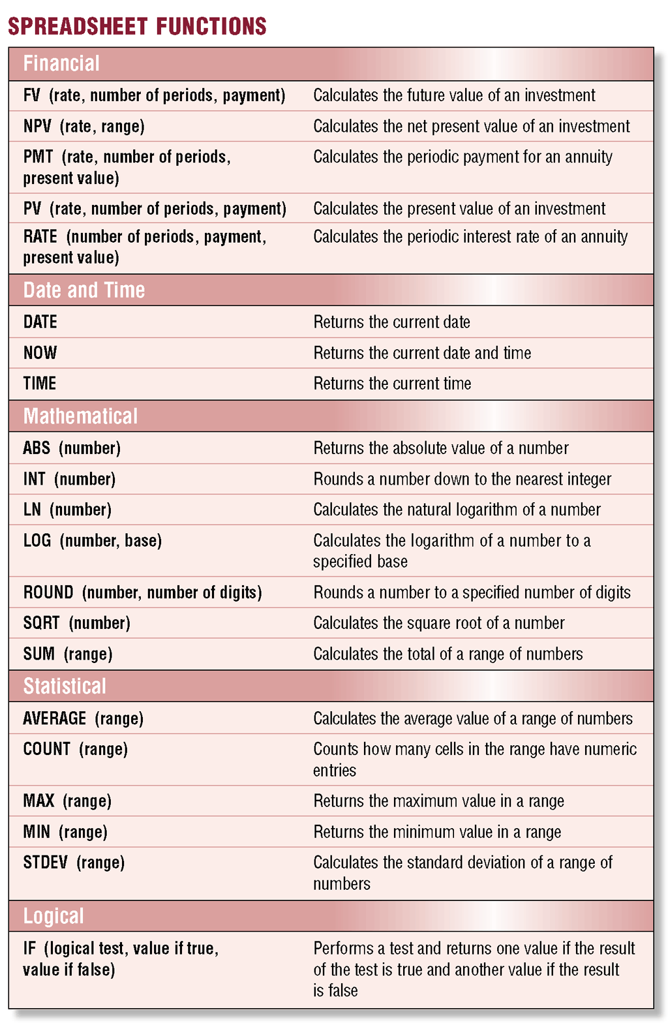
Business Software
What is a function?
  A predefined formula
  that performs
  common calculations
    =B8+B9+B10+B11+B12
    =SUM(B8:B12)
p. 143 Fig. 3-9
Next

Slide 16
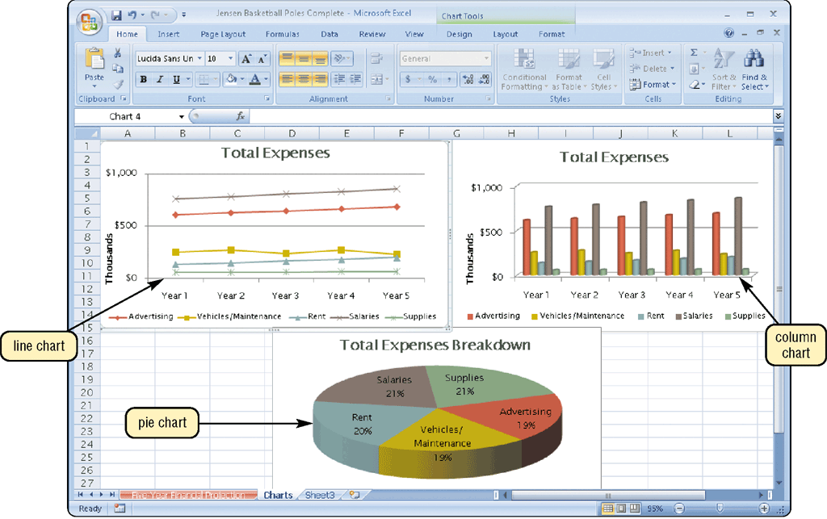
Business Software
What is charting?
  Allows you to display spreadsheet data in graphical form
Click to view Web Link,
click Chapter 3, Click Web Link
from left navigation,
then click Spreadsheet Software below Chapter 3
p. 144 Fig. 3-10
Next

Slide 17
Business Software
What is database software?
Allows you to create,
access, and
manage data
Add, change, delete,
sort, and retrieve data
p. 145
Next

Slide 18
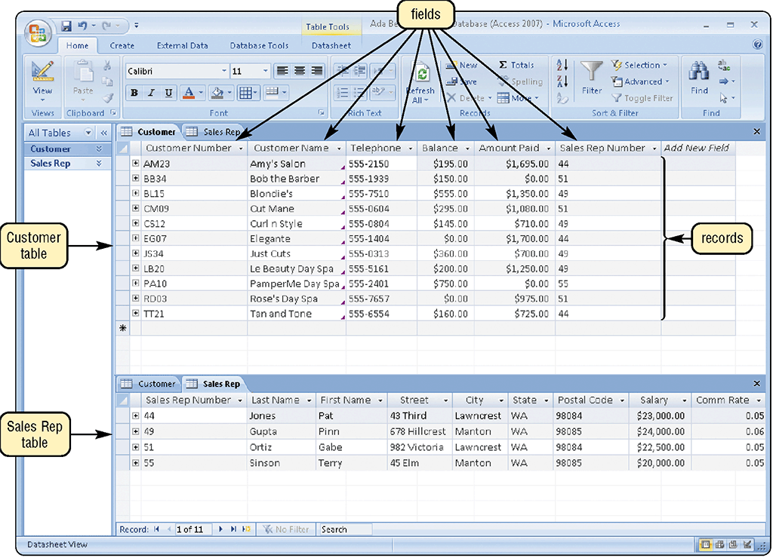
Business Software
What are the parts of a database?
  A table contains records
  A record is a row in a
  table that contains
  information about a
  given person, product,
  object, or event
  A field is a column in
  a table that contains
  a specific category of
  data within a record
p. 145 Fig. 3-11
Next

Slide 19
Business Software
How do you extract information from a database?
Run queries to retrieve data
Can be sent as a report to the printer
p. 145
Next

Slide 20
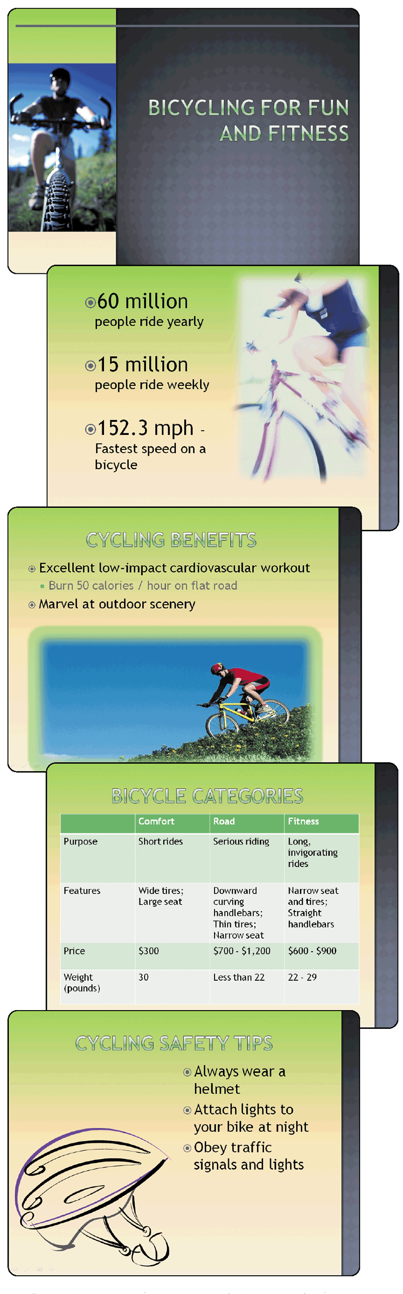
Business Software
What is presentation graphics software?
  Used to create visual aids for presentations
  A presentation is sometimes
  called a slide show
Click to view Web Link,
click Chapter 3, Click Web Link
from left navigation,
then click Presentation Graphics Software below Chapter 3
p. 146 Fig. 3-12
Next

Slide 21
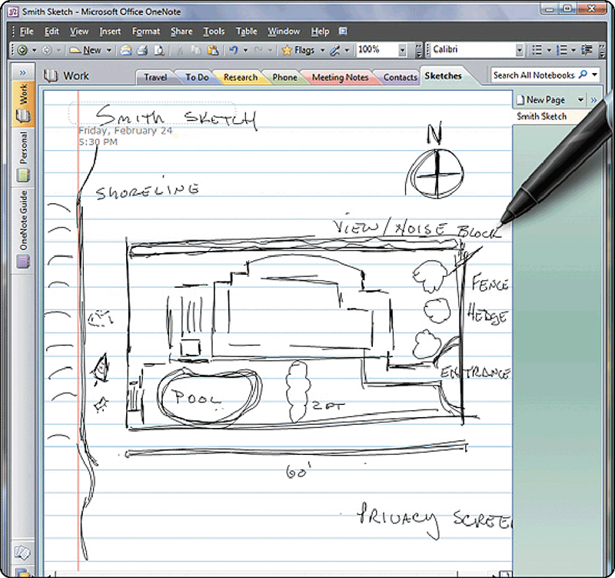
Business Software
What is note taking software?
  Enables users to enter typed text, handwritten comments, drawings, or sketches anywhere on the page
  Notes are organized like a notebook
p. 147 Fig. 3-14
Next

Slide 22
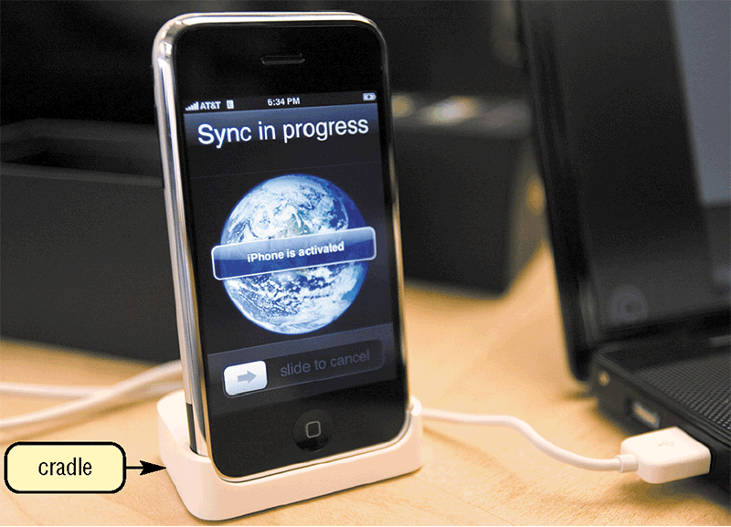
Business Software
What is Personal Information Manager Software?
  Includes a calendar, address book, notepad, and synchronization with
  desktop computer
  Most smart phones and PDAs include PIM functionality
p. 148 Fig. 3-15
Next

Slide 23
Business Software
What can you do with Personal Mobile Device business software?
Create documents
and worksheets
Manage databases
and lists
Create slide shows
Take notes
Manage budgets
and finances
View and edit
photos
Read electronic
books
Plan travel routes
Compose and read
e-mail messages
Send instant
messages
Browse the Web
p. 148
Next

Slide 24
Business Software
What is a software suite?
A collection of individual
programs sold as
a single package
Two major advantages:
lower cost
ease of use
p. 148
Next

Slide 25
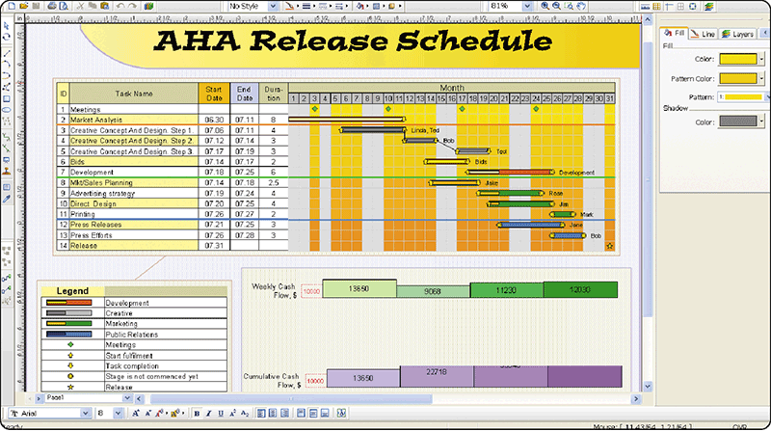
Business Software
What is project management software?
  Allows you to plan, schedule, track, and analyze
  the events, resources, and costs of a project
p. 149 Fig. 3-16
Next

Slide 26
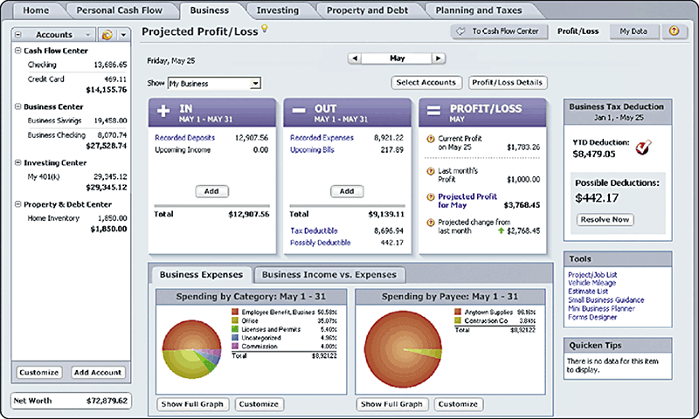
Business Software
What is accounting software?
  Helps companies
  record and report
  their financial
  transactions
p. 149 Fig. 3-17
Next

Slide 27
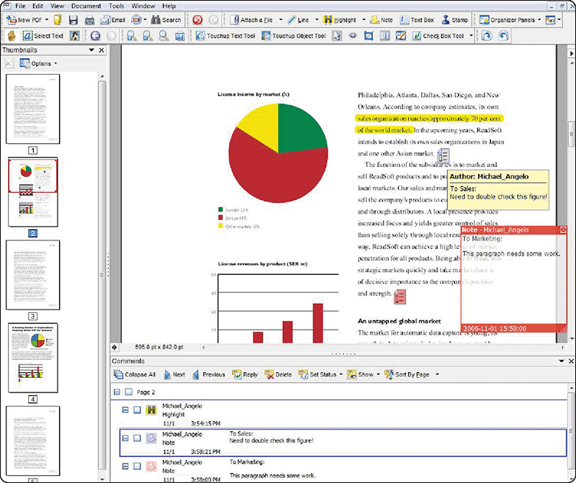
Business Software
What is document management software?
  Provides a means for sharing, distributing, and searching through documents by converting them into a format that can be viewed by any user
Click to view Web Link,
click Chapter 3, Click Web Link
from left navigation,
then click Document Management Software
below Chapter 3
p. 150 Fig. 3-18
Next

Slide 28
Business Software
What is enterprise computing software?
  Large organizations require special computing solutions
  Each functional unit has specialized software requirements
Human
Resources
Accounting
Engineering
Manufacturing
Marketing
Sales
Distribution
Customer
Service
IT
p. 150
Next

Slide 29
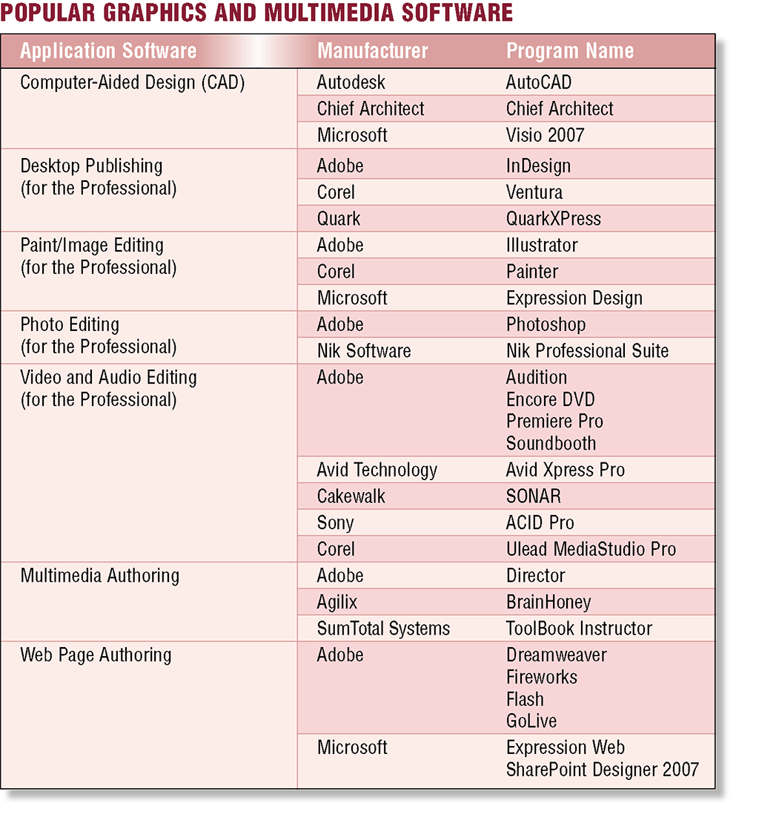
Graphics and Multimedia Software
What are some popular graphics
and multimedia
software products?
p. 151 Fig. 3-19
Next

Slide 30
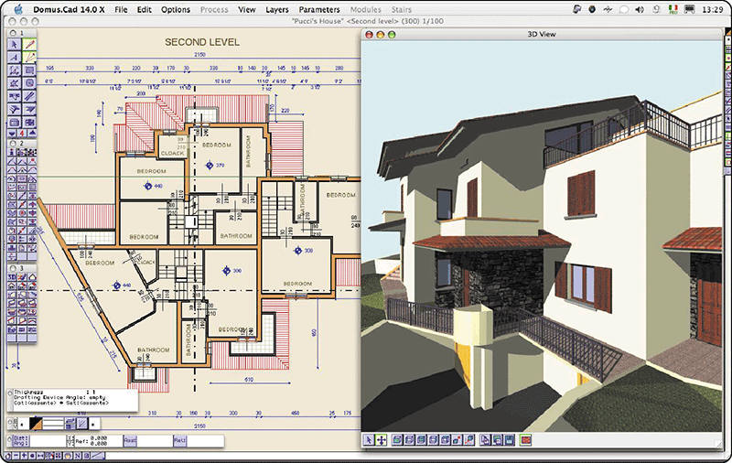
Graphics and Multimedia Software
What is computer-aided design (CAD)?
  Sophisticated application software that allows you to create engineering, architectural, and scientific designs
p. 151 Fig. 3-20
Next

Slide 31
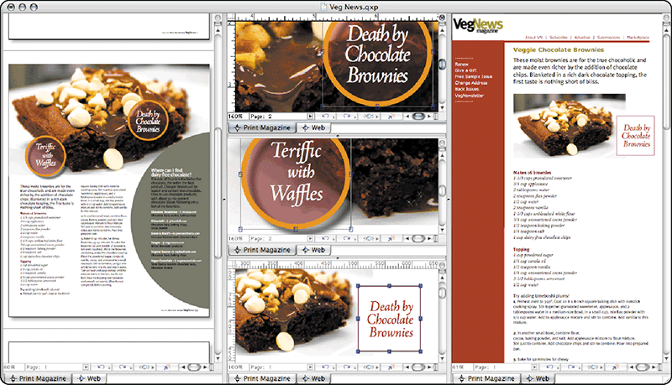
Graphics and Multimedia Software
What is desktop publishing software?
  Enables you to design and produce sophisticated documents that contain text, graphics,
  and many colors
p. 152 Fig. 3-21
Next

Slide 32
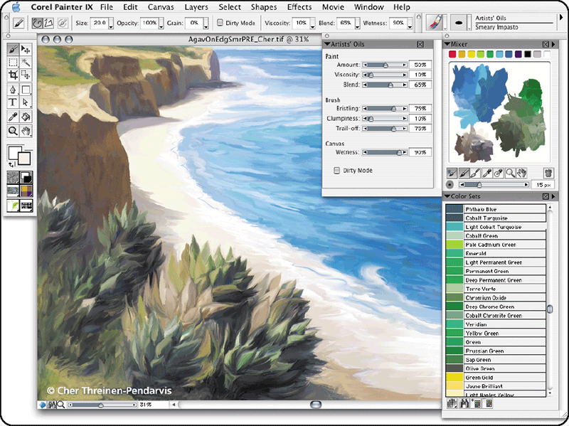
Graphics and Multimedia Software
What is paint/image editing software?
  Used to create and
  modify graphical
  images
  Sometimes called
  illustration
  software
p. 152 Fig. 3-22
Next

Slide 33
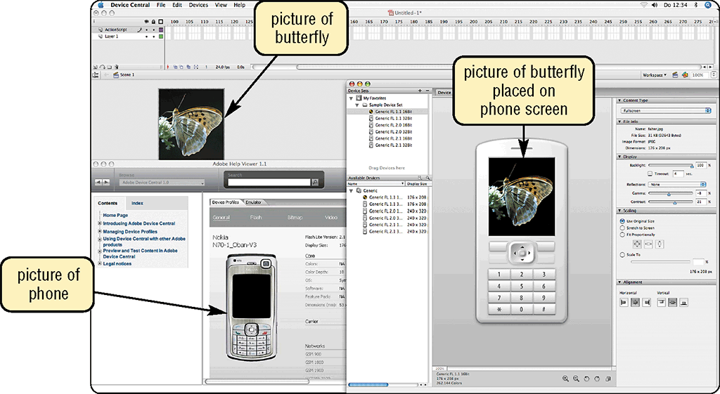
Graphics and Multimedia Software
What is professional photo editing software?
  Allows users to customize digital photos
  Save images in a variety of file formats
p. 152 - 153 Fig. 3-23
Next

Slide 34
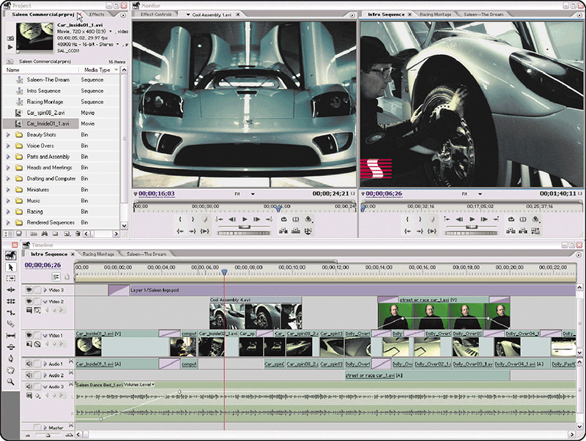
Graphics and Multimedia Software
What is video and audio editing software?
  Video editing software allows you to modify a
  segment of a video, called a clip
  Audio editing software allows you to modify
  audio clips
p. 153 Fig. 3-24
Next

Slide 35
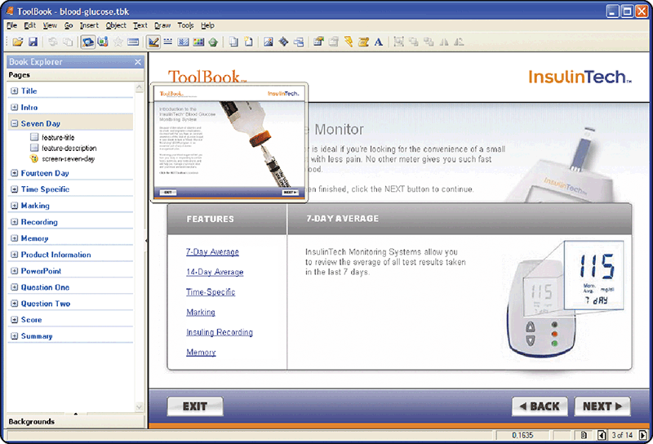
Graphics and Multimedia Software
What is multimedia authoring software?
  Allows you to combine
  text, graphics, audio,
  video, and animation
  in an interactive
  application
p. 154 Fig. 3-25
Next

Slide 36

Graphics and Multimedia Software
Video: MediaCell Video Converter
CLICK TO START
Next

Slide 37
Graphics and Multimedia Software
What is Web page authoring software?
  Helps users of all skill levels to create Web pages
    Some application software programs include Web page authoring programs
video
graphical
images
organize
Web sites
audio
animation
manage
maintain
p. 154
Next

Slide 38
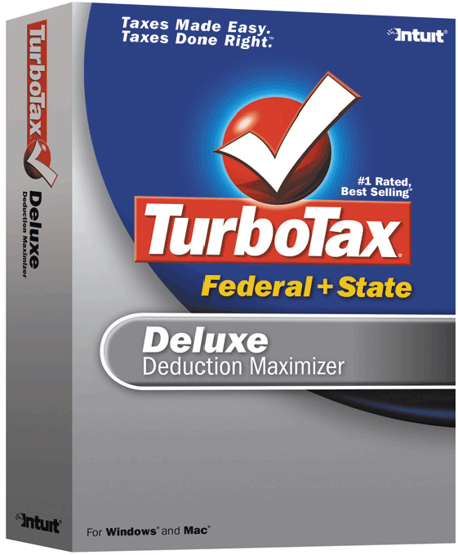

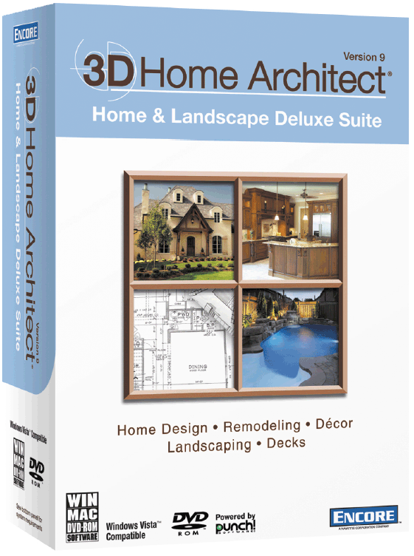


Software for Home, Personal, and Educational Use
What software products are
available for home, personal,
and educational use?
Click to view Web Link,
click Chapter 3, Click Web Link from left navigation, then click Tax Preparation Software, Personal DTP Software, Travel and Mapping Software, and Reference Software
below Chapter 3
p. 156 - 161 Figs. 3-30–3-39
Next

Slide 39
Application Software for Communications
What software facilitates communication?
Web Browser
E-mail
Instant Messaging
Chat Room
Text Messaging
RSS Aggregator
Blogging
Newsgroup/Message Board
FTP
VoIP
Video Conferencing
p. 161 Fig. 3-40
Next

Slide 40
Popular Utility Programs
What are some widely used stand-alone utility programs?
Antivirus
Program
Personal
Firewall
Spyware
Remover
Internet
Filters
File
Manager
File
Compression
Backup
Media
Player
CD/DVD
Burning
PC
Maintenance
Click to view
Web Link, click
Chapter 3, Click
Web Link from
left navigation, then
click Antivirus Programs below Chapter 3
p. 162 Fig. 3-41
Next

Slide 41
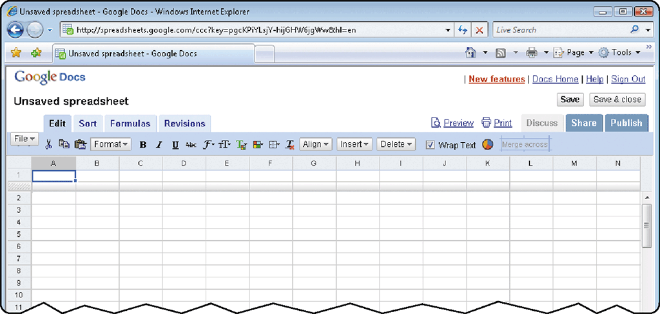
Web-based Software
What is a Web application?
  A software application that obtains information from the Web
    Some Web applications store your data and information at their site
    Some are free
p. 163 Figs. 3-43
Next

Slide 42
Web-based Software
What is Web 2.0?
  Web sites that offer Web-based software
  Provide users with a
  means to share and/or
  store personal
  information through
  Web-based software
Click to view
Web Link, click
Chapter 3, Click
Web Link from
left navigation, then
click Web 2.0
below Chapter 3
p. 163 - 164
Next

Slide 43
Web-based Software
What is an application service provider (ASP)?
Third-party organization that manages and distributes software
and services
on the Web
Allows companies to outsource information technology (IT) needs
p. 164
Next

Slide 44
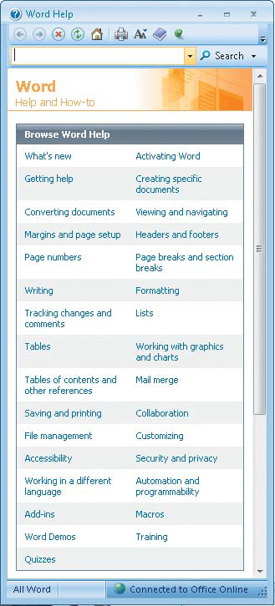
Learning Aids and Support Tools for Application Software
What is Online Help?
  Electronic equivalent of a user manual
p. 164 - 165 Fig. 3-44a
Next

Slide 45
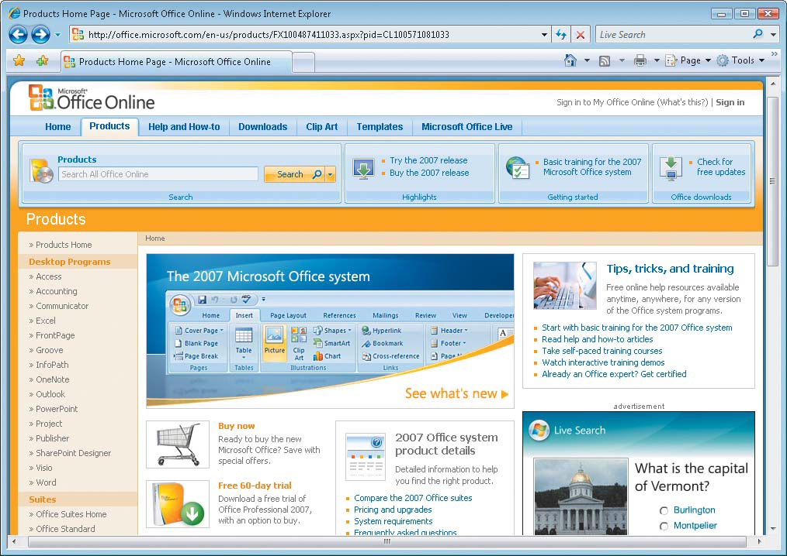
Learning Aids and Support Tools for Application Software
What is Web-based Help?
  A Web site linked from online Help
  Provides updates and more resources to respond
  to technical issues about a program
  Some Web sites contain
  chat rooms where a user
  can talk directly with a
  technical support person
p. 164 - 165 Fig. 3-44b
Next

Slide 46
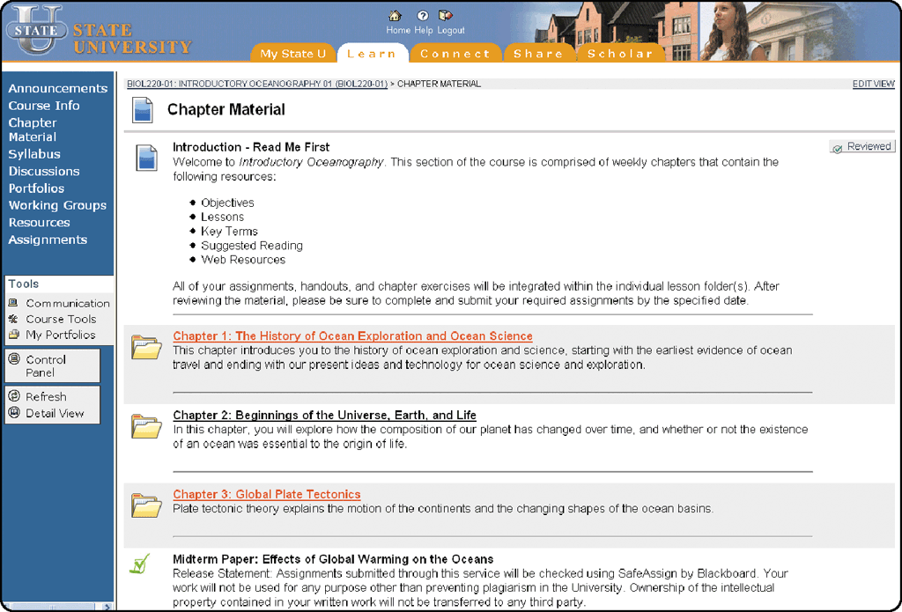
Learning Aids and Support Tools Within an Application
What is Web-based training (WBT)?
  Self-directed, self-paced
  instruction on a topic
  on the Web
    Distance learning (DL) is
    the delivery of education
    at one location while the
    learning takes place at
    other locations
p. 165 - 166 Fig. 3-45
Next

Slide 47
Summary of Application Software
Application software
Software for communications
Business software
Widely used utility programs
Graphics and multimedia software
Web-based software
Software for home, personal,
and educational use
Learning aids and support tools
within an application
Chapter 3 Complete

