Slide 1
Chapter 1 Introduction to
Computers

Slide 2
Chapter 1 Objectives
Recognize the importance of
computer literacy
Distinguish between system software and application software
Define the term, computer
Describe the categories of computers
Identify the components
of a computer
Identify the elements of
an information system
Discuss the advantages and disadvantages of using computers
Describe the various types
of computer users
Recognize the purpose of a network
Discuss various computer
applications in society
Discuss the uses of the Internet and World Wide Web
Next

Slide 3
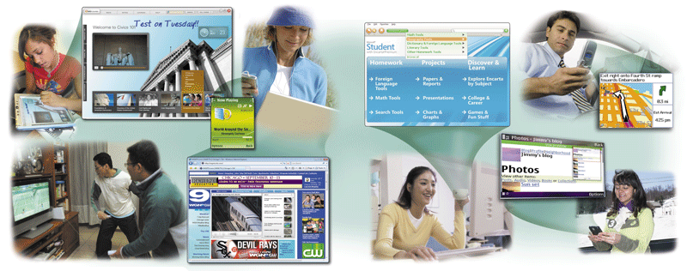
A World of Computers
What is computer literacy (digital literacy)?
  Current knowledge and understanding
  of computers and their uses
  Computers are everywhere
p. 4-5 Fig. 1-1
Next

Slide 4
What Is a Computer?
How is a computer defined?
  Electronic device operating under the control of instructions stored in its own memory
    Processes data into information
      Conveys meaning and is
      useful to people
    Accepts data
      Collection of unprocessed items
    Produces and stores results
p. 6
Next

Slide 5
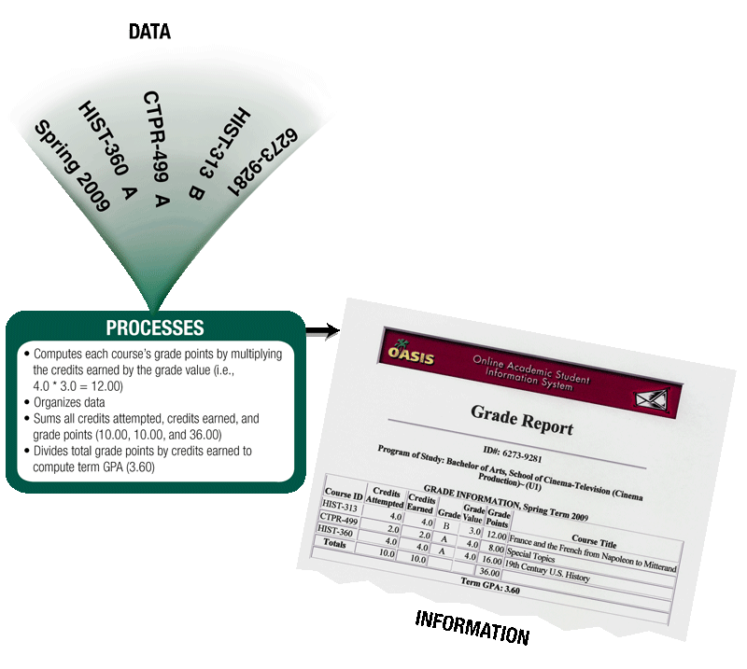
What Is a Computer?
What is the information processing cycle?
  Input
  Process
  Output
  Storage
  Communication
p. 6 Fig. 1-2
Next

Slide 6
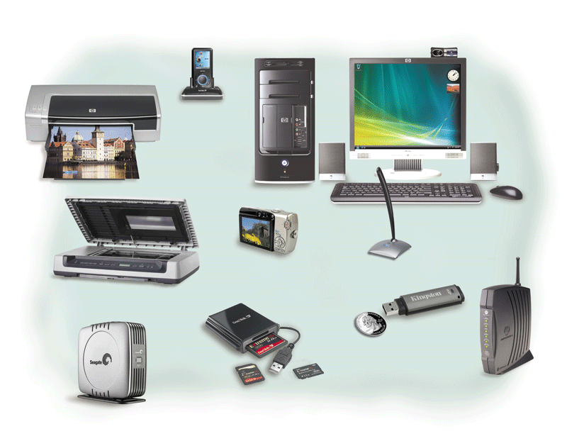
The Components of a Computer
What is an input device?
Hardware used
  to enter data
  and instructions
Click to view Web Link,
click Chapter 1, Click Web Link
from left navigation,
then click Input Devices
below Chapter 1
p. 7 Fig. 1-3
Next

Slide 7
The Components of a Computer
What is an output device?
Hardware that
  conveys information
  to one or more
  people
Click to view Web Link,
click Chapter 1, Click Web Link
from left navigation,
then click Output Devices
below Chapter 1
p. 7 - 8 Fig. 1-3
Next

Slide 8
The Components of a Computer
What is the system unit?
Case that contains
the electronic components of the computer that are used to process data
p. 7 - 8 Fig. 1-3
Next

Slide 9
The Components of a Computer
What are two main components on the motherboard?
  Processor
    Also called a Central Processing Unit (CPU)
    The electronic component that interprets and carries
    out the basic instructions that operate the computer
  Memory
    Consists of electronic components that store
    instructions waiting to be executed and data needed by
    those instructions
p. 8
Next

Slide 10
The Components of a Computer
What is storage?
  Holds data, instructions, and information
  for future use
  Storage media
      Physical material on which data, instructions,
      and information are stored
  Storage device
      Records and retrieves items to and from
      storage media
p. 8
Next

Slide 11
The Components of a Computer
What is a USB flash drive?
Portable storage device
Small and lightweight enough
to be transported on a keychain
or in a pocket
The average USB flash drive
can hold about 2 billion
characters
p. 8
Next

Slide 12
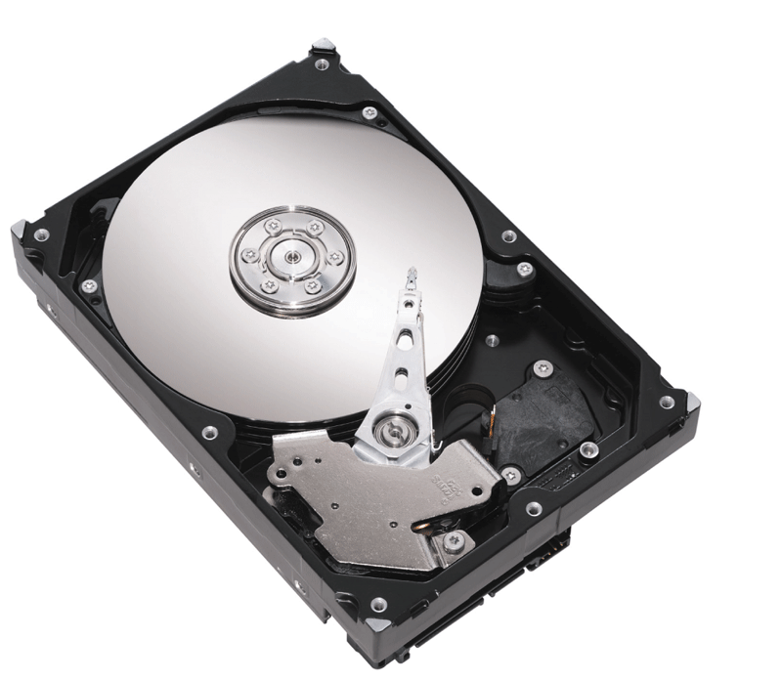
The Components of a Computer
What is a hard disk?
  Provides greater storage
  capacity than a
  USB flash drive
  Most are housed inside
  the system unit
p. 8 Fig. 1-4
Next

Slide 13
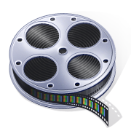
The Components of a Computer
Video: Speed Up Your Hard Drive
CLICK TO START
Next

Slide 14
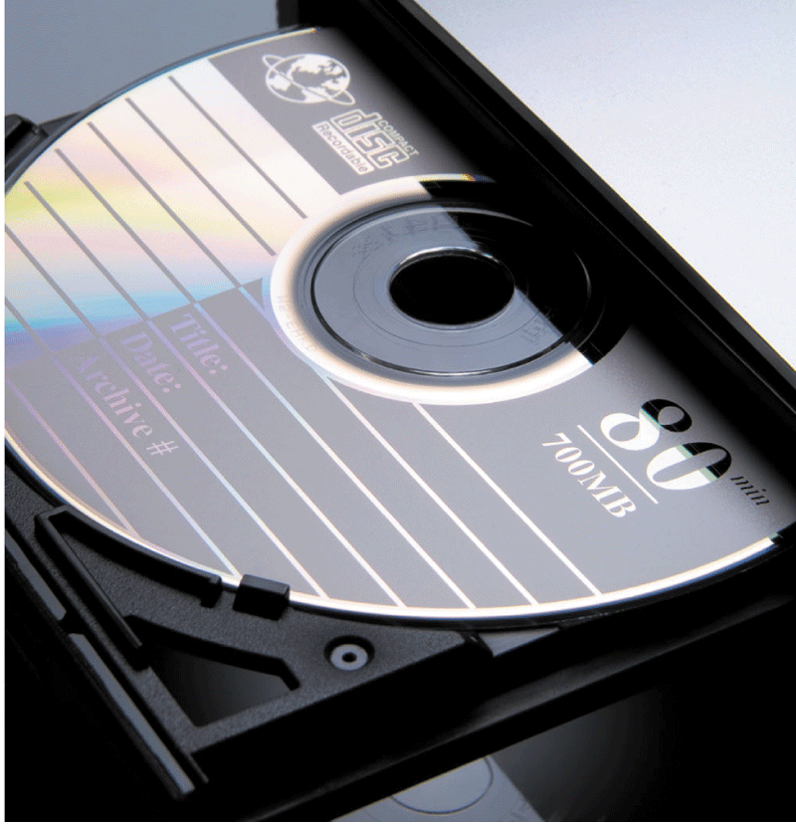
The Components of a Computer
What is a compact disc?
  Flat, round, portable metal disc
    CD
    DVD
p. 9 Fig. 1-5
Next

Slide 15
The Components of a Computer
What is a communications device?
Hardware component that
enables a computer to
send and receive data, instructions,
and information
Occurs over cables, telephone
lines, cellular radio networks,
satellites, and other
transmission media
Click to view Web Link,
click Chapter 1, Click Web Link
from left navigation,
then click Communications Devices below Chapter 1
p. 9
Next

Slide 16
Advantages and Disadvantages of Using Computers
What are the advantages of using computers?
Reliability
Speed
Consistency
Storage
Communications
p. 10
Next

Slide 17
Advantages and Disadvantages of Using Computers
What are the disadvantages of using computers?
Violation of
Privacy
Public Safety
Impact on
Labor Force
Health Risks
Impact on
Environment
p. 10 - 11
Next

Slide 18
Networks and the Internet
What is a network?
  Collection of computers and devices connected together, often wirelessly
Used to share
Resources
Hardware
devices
Software
programs
Saves
time
and
money
Data
Information
p. 11
Next

Slide 19
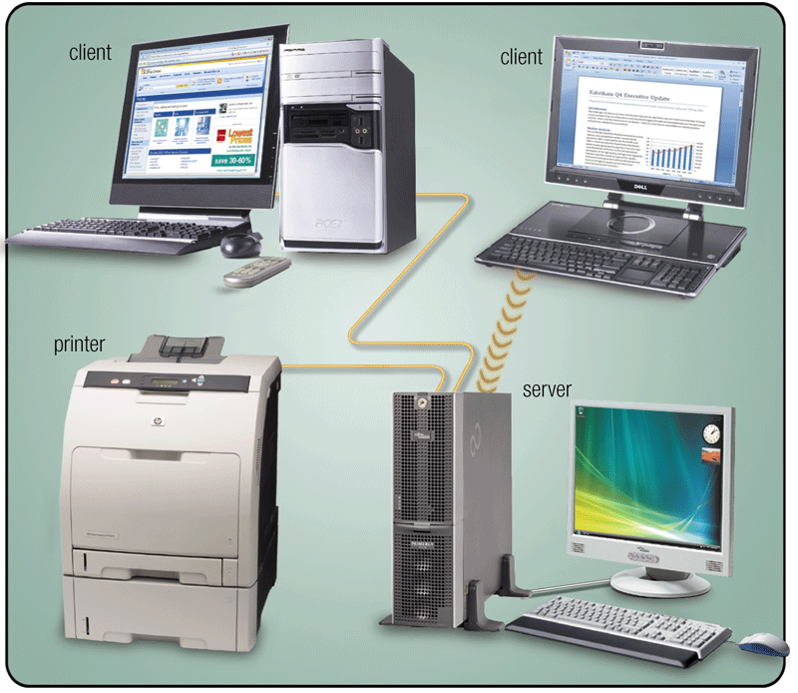
Networks and the Internet
What is a server?
  A server controls access to resources on a network
  Clients, or workstations, request resources from the server
p. 11 Fig. 1-6
Next

Slide 20
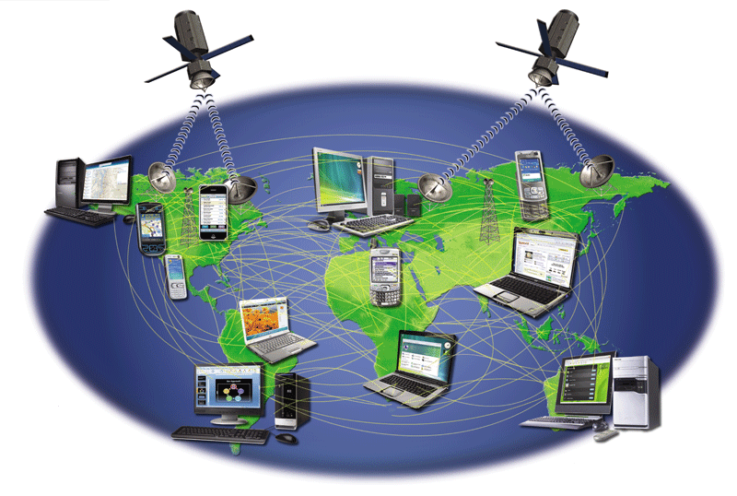
Networks and the Internet
What is the Internet?
  Worldwide collection of networks that connects
  millions of businesses, government agencies, educational institutions, and individuals
Click to view Web Link,
click Chapter 1, Click Web Link
from left navigation,
then click Internet
below Chapter 1
p. 12 Fig. 1-7
Next

Slide 21
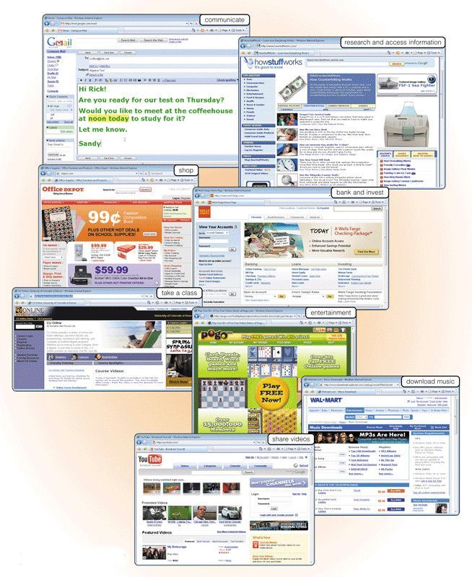
Networks and the Internet
Why do users access the Internet?
  Communications
Research and Information
Shopping
Banking and Investing
Classes
Entertainment
7. Download Music
8. Share Information
p. 12 - 13 Fig. 1-8
Next

Slide 22
Networks and the Internet
What is the Web?
  Billions of documents, called Web pages, available to anyone connected to the Internet
A Web site is
a collection of
related Web pages
You can share
information on a social
networking Web site or
a photo sharing
community
A podcast is
recorded audio
stored on a Web site
that can be
downloaded
A Web page contains
text, graphics, audio,
video, and links to
other Web pages
A blog consists of time-
stamped articles in
a journal format
Click to view
Web Link,
click Chapter 1,
Click Web Link
from left navigation,
then click Sharing Videos
below Chapter 1
p. 12 - 14
Next

Slide 23
Computer Software
What is software?
Consists of a series
of instructions that
tells the computer
what to do and
how to do it
Also called a
program
p. 15
Next

Slide 24
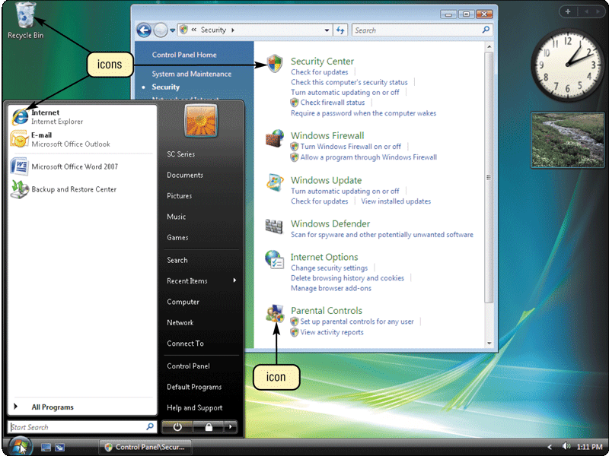
Computer Software
What is a graphical user interface (GUI)?
  Allows you to interact with the software using text, graphics, and visual images such as icons
  Controls how you enter data and instructions and how the screen displays information
p. 15 Fig. 1-10
Next

Slide 25
Computer Software
What is system software?
  Programs that control or maintain the operations of the computer and its devices
Operating System (OS)
is a set of programs
that coordinates all
activities among
computer hardware
devices
Utility Programs allow the user to
perform maintenance-type tasks
usually related to managing a
computer, its devices or its programs
Click to view Web Link,
click Chapter 1, Click
Web Link from
left navigation, then click Windows Vista below Chapter 1
p. 15-16
Next

Slide 26
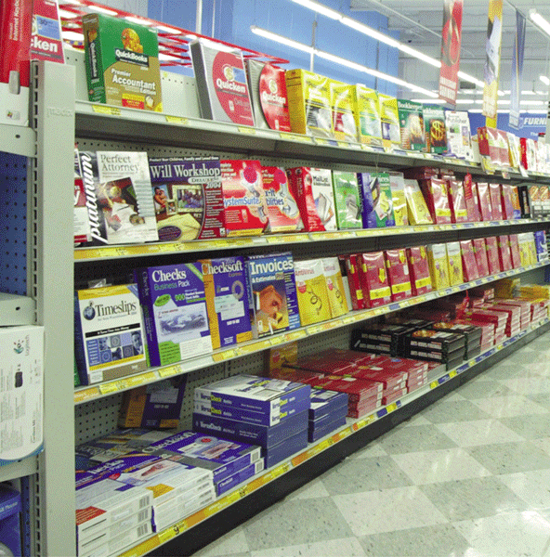
Computer Software
What is application software?
  Programs designed to make users more productive
Word
Processing
Spreadsheet
Database
Presentation
Graphics
p. 16 Fig. 1-11
Next

Slide 27
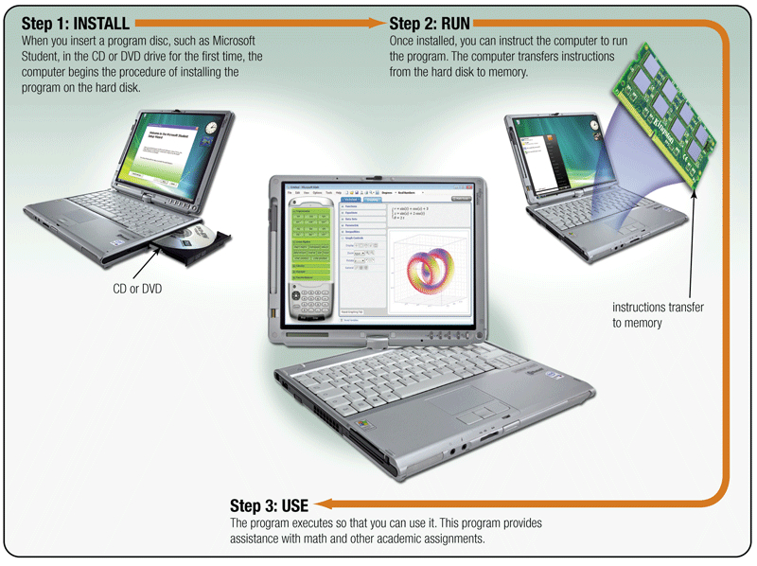
Computer Software
How do you install and run programs?
p. 17 Fig. 1-12
Next

Slide 28
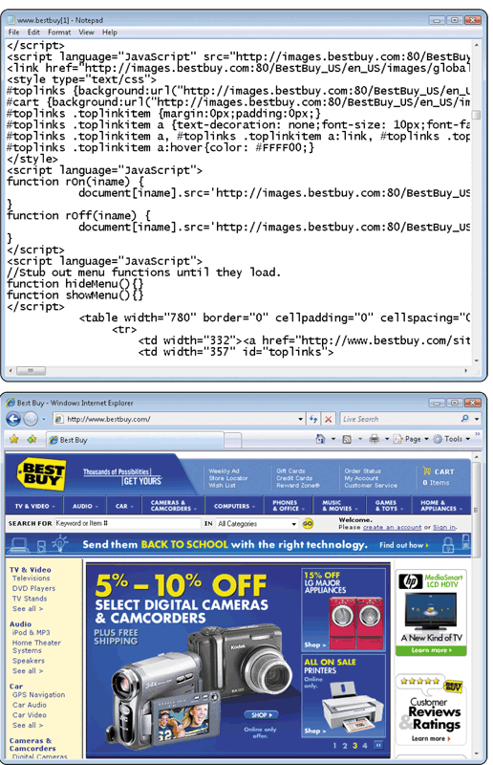
Computer Software
JavaScript
What is a programmer?
  Someone who develops
  software
    Programmer writes
    the instructions to
    direct the computer
    to process data into
    information
Web application
p. 18 Fig. 1-13
Next

Slide 29
Categories of Computers
What are the categories of computers?
Personal Computers
(desktop)
Mobile Computers and
Mobile Devices
Game Consoles
Servers
Mainframes
Supercomputers
Embedded Computers
p. 19
Next

Slide 30
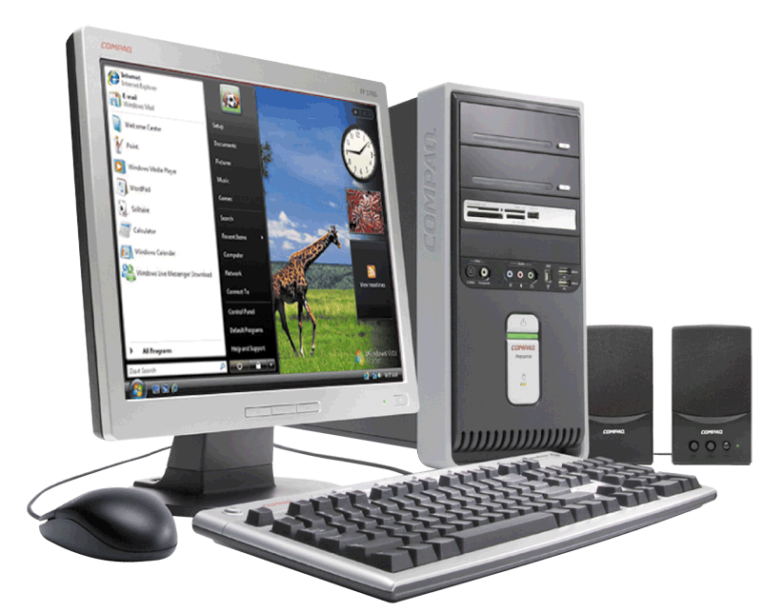
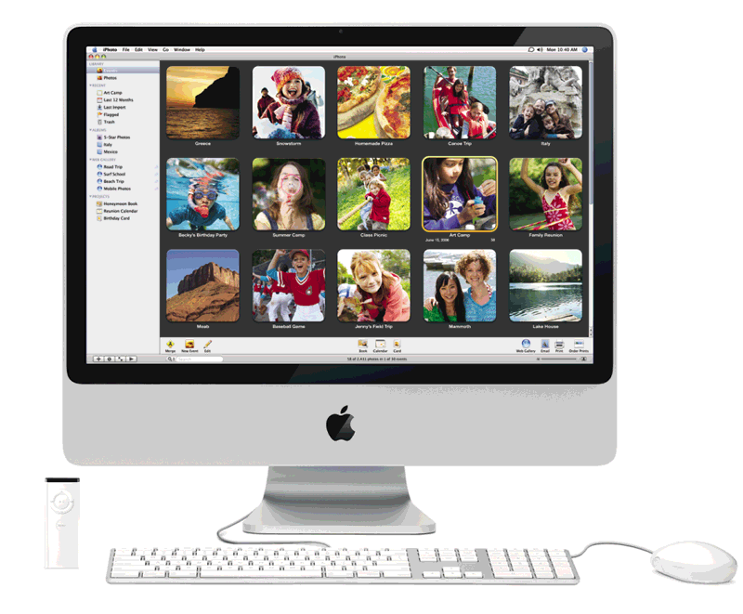
Personal Computers
What are the two most popular styles of personal computers?
PC and compatibles use the Windows operating system
Apple Macintosh usually uses the Macintosh operating system (Mac OS X)
Click to view Web Link,
click Chapter 1, Click
Web Link from left
navigation, then click Personal Computers below Chapter 1
p. 19 - 20 Figs. 1-15–1-16
Next

Slide 31
Personal Computers
What is a desktop computer?
  Designed so all of the components fit entirely on or under a desk or table
p. 19-20 Fig. 1-15
Next

Slide 32
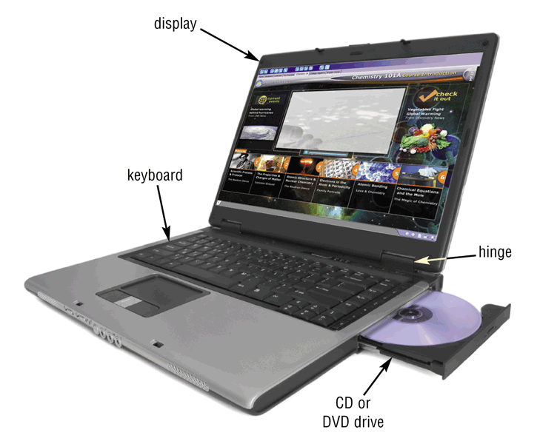
Mobile Computers and Mobile Devices
What is a notebook computer?
  Portable, small enough to fit on your lap
  Also called a laptop computer
  Usually more expensive than a desktop computer with equal capabilities
p. 20 Fig. 1-17
Next

Slide 33
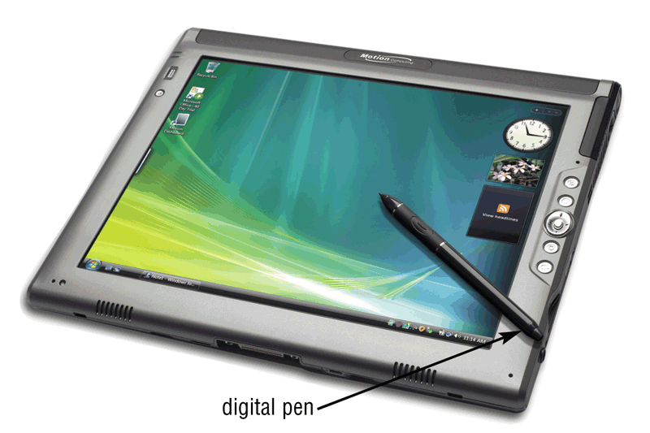
Mobile Computers and Mobile Devices
What is a Tablet PC?
  Resembles a letter-sized slate
  Allows you to write on the screen using a digital pen
  Especially useful for taking notes
p. 21 Fig. 1-18
Next

Slide 34
Mobile Computers and Mobile Devices
What are mobile devices?
Small enough to
carry in a pocket
Internet-enabled
telephone is a
“smart phone”
p. 21 - 22
Next

Slide 35
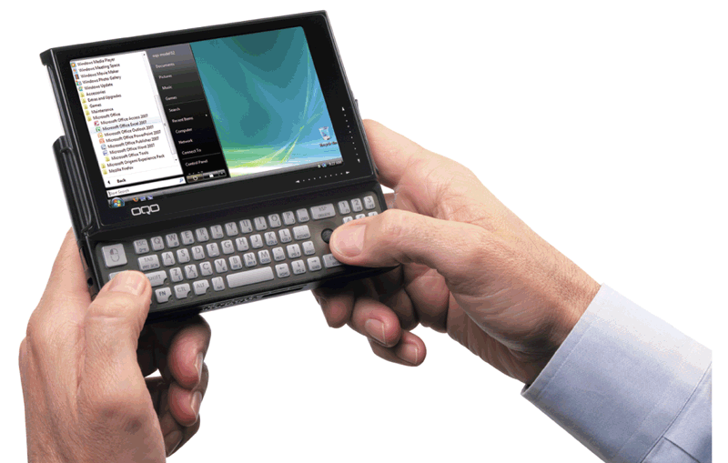
Mobile Computers and Mobile Devices
What is a handheld computer?
Used
by mobile employees such as meter readers and delivery people
Small
enough to fit
in one
hand
p. 21 Fig. 1-19
Next

Slide 36
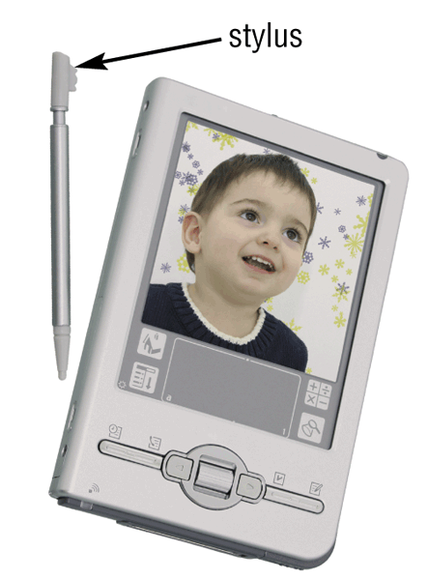
Mobile Computers and Mobile Devices
What is a personal digital assistant (PDA)?
  Provides personal organizer functions
    Calendar
    Appointment book
    Address book
    Calculator
    Notepad
p. 21 Fig. 1-20
Next

Slide 37
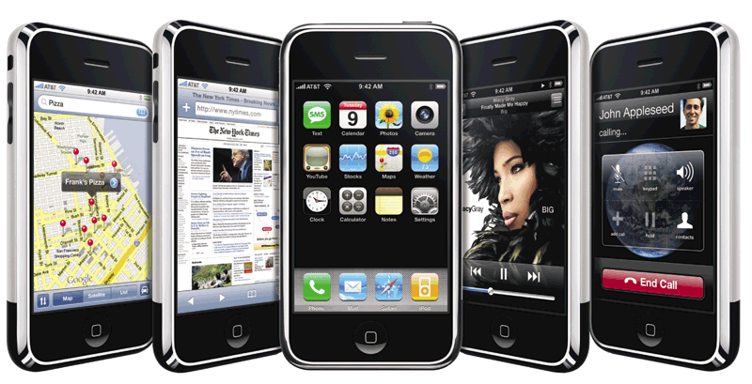
Mobile Computers and Mobile Devices
What are smart phones?
Click to view Web Link,
click Chapter 1, Click
Web Link from left
navigation, then click iPhone below Chapter 1
p. 22 Fig. 1-21
Next

Slide 38
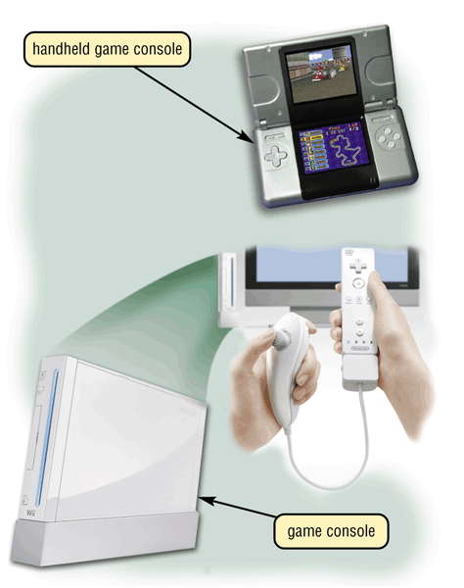
Game Consoles
What are game consoles?
Mobile computing device designed for single-player or multiplayer video games
p. 22 Fig. 1-22
Next

Slide 39
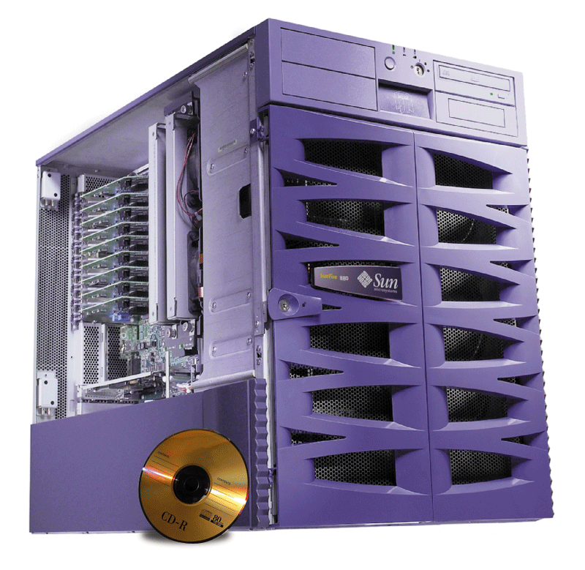
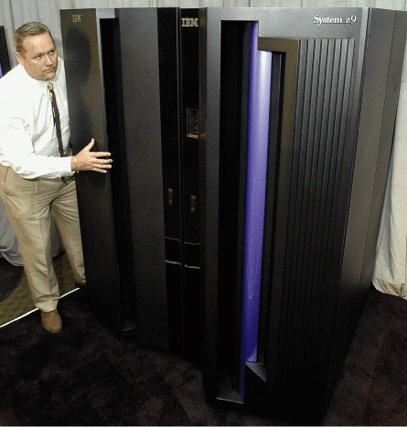
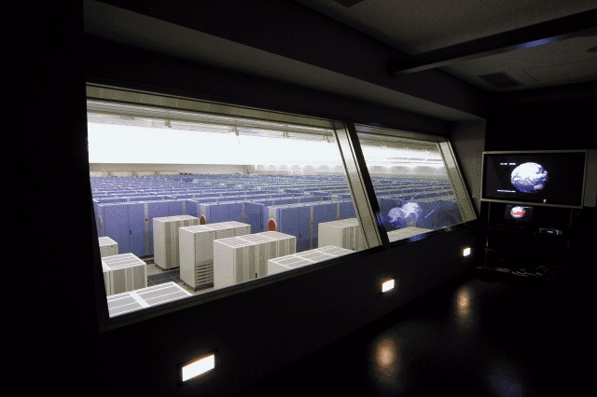
Servers
What types of servers are there?
A server controls access to network resources and provides centralized storage
Mainframe Very powerful, expensive computer that supports thousands of connected users
Supercomputer The fastest, most powerful, most expensive computer. Used for applications requiring complex mathematical calculations
p. 23 Figs. 1-23 – 1-25
Next

Slide 40
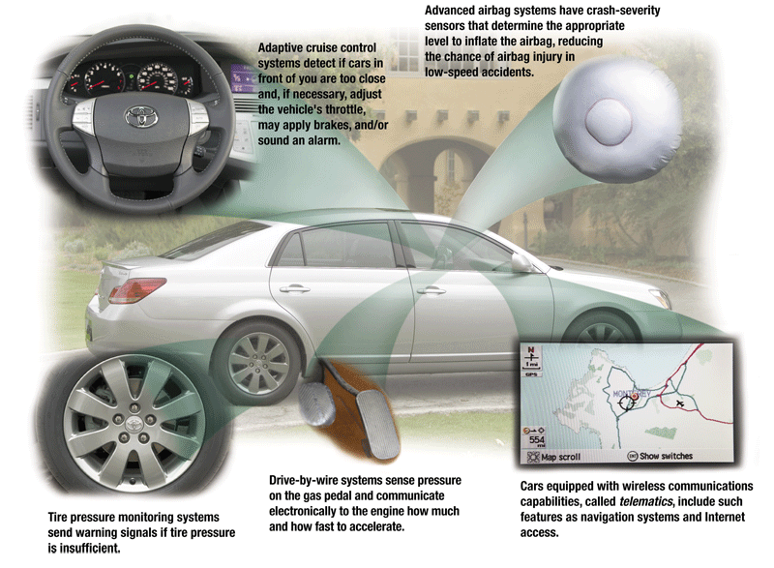
Embedded Computers
What is an embedded computer?
  A special-purpose computer that functions as a component in a larger product
p. 24 Fig. 1-26
Next

Slide 41
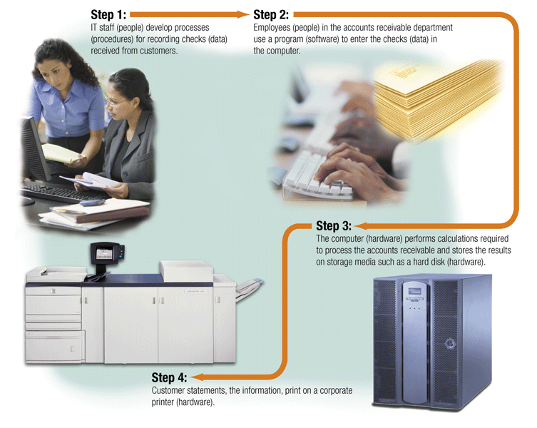
Elements of an Information System
What are information system elements?
  Hardware
  Software
  Data
  People
  Procedures
p. 25 Fig. 1-27
Next

Slide 42
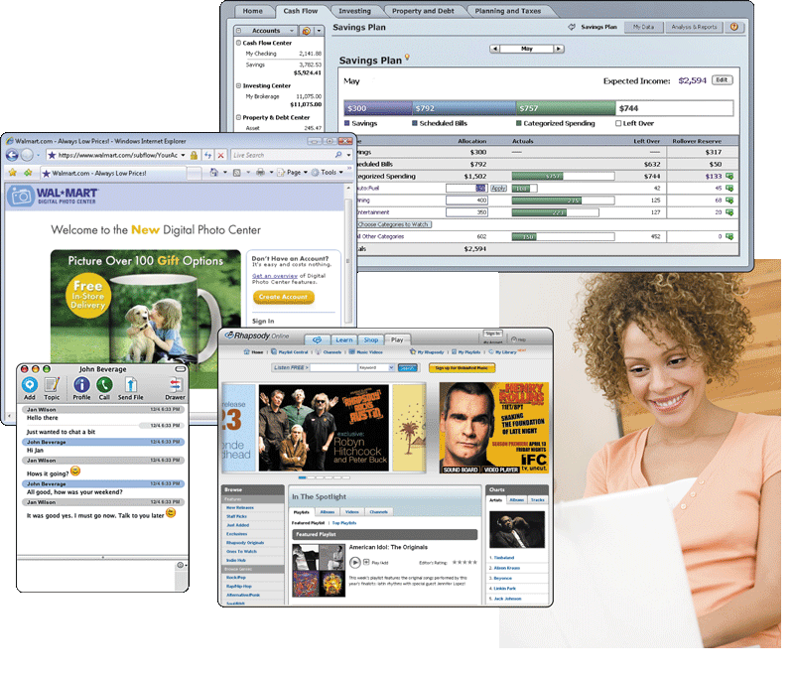
Examples of Computer Usage
What software is available for a home user?
  Personal finance management
  Web access
  Communications
  Entertainment
Click to view Web Link, click Chapter 1, Click Web Link from left navigation, then click Women in Technology below Chapter 1
Click to view Web Link, click Chapter 1, Click Web Link from left navigation, then click Minorities in Technology below Chapter 1
Next
p. 26 Fig. 1-28

Slide 43
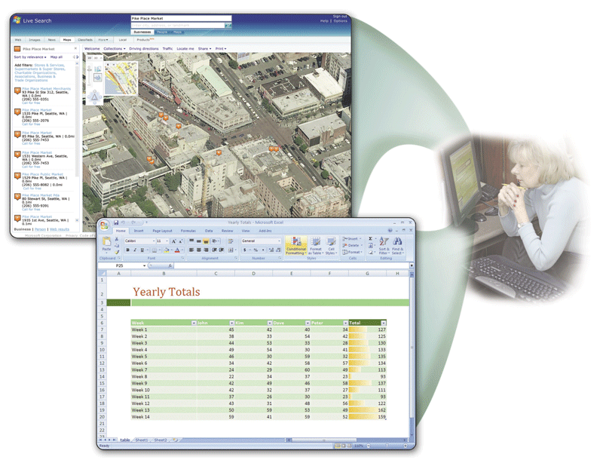
Examples of Computer Usage
What software is available for a small office/home office (SOHO) user?
  Productivity software
  Specialty software
  Web usage
  E-mail
p. 28 Fig. 1-30
Next

Slide 44
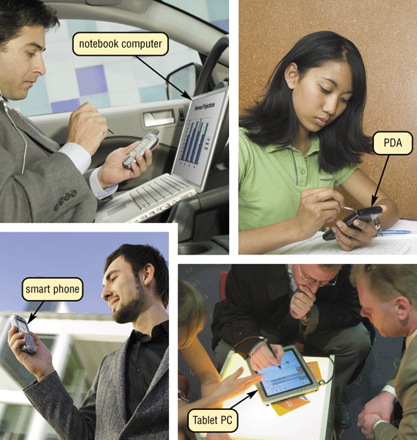
Examples of Computer Usage
What is available for
a mobile user?
  Hardware
    Notebook computers
    Tablet PCs
    Internet-enabled PDAs
    Smart phones
  Software
    Word processing
    Spreadsheet
    Presentation graphics
    software
p. 29 Fig. 1-31
Next

Slide 45
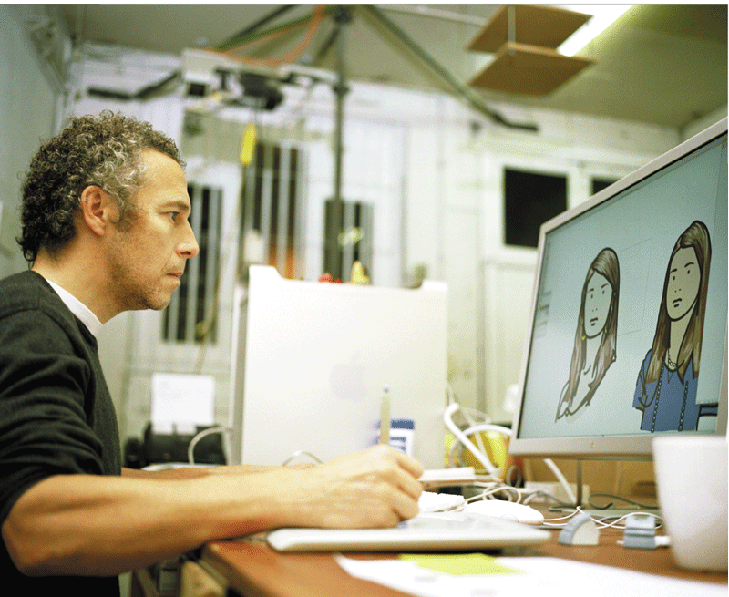
Examples of Computer Usage
What are the needs of a power user?
  Speed and large amounts of storage
  Types of power users
    Engineers
    Scientists
    Architects
    Desktop publishers
    Graphic artists
p. 29 Fig. 1-32
Next

Slide 46
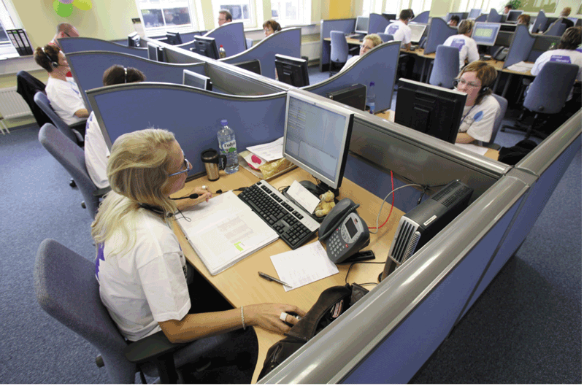
Examples of Computer Usage
What are the needs of the large business user?
  Payroll
  Inventory
  E-commerce
  Desktop publishing
p. 30 Figs. 1-33
Next

Slide 47

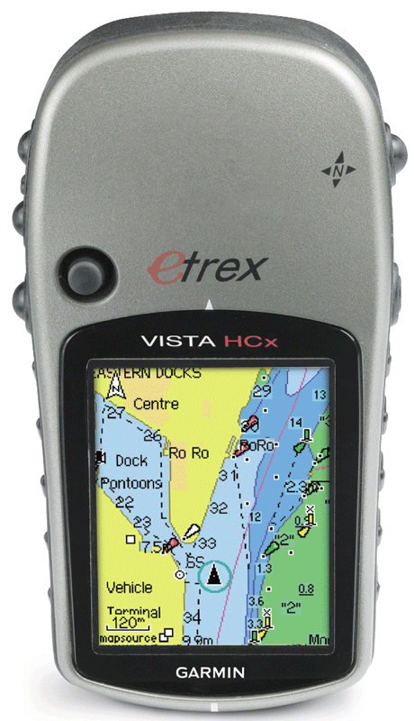
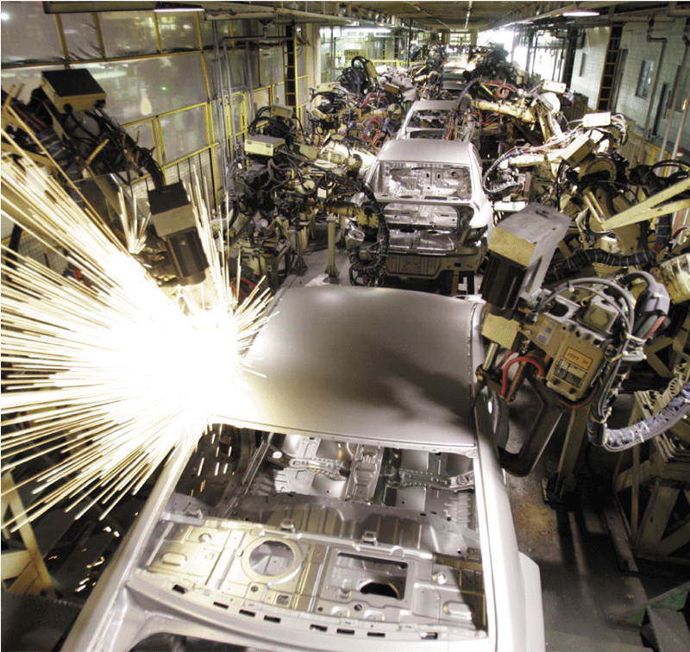
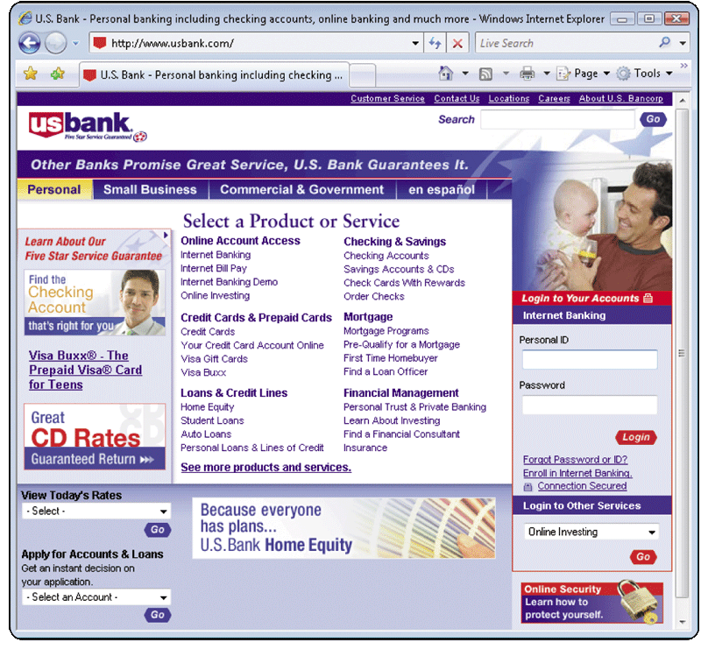
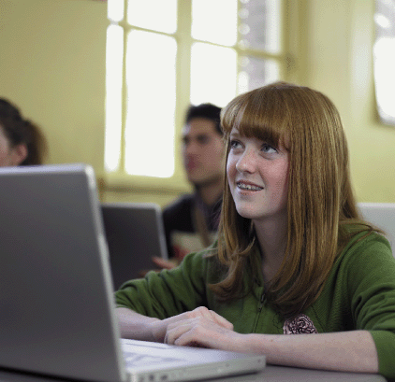
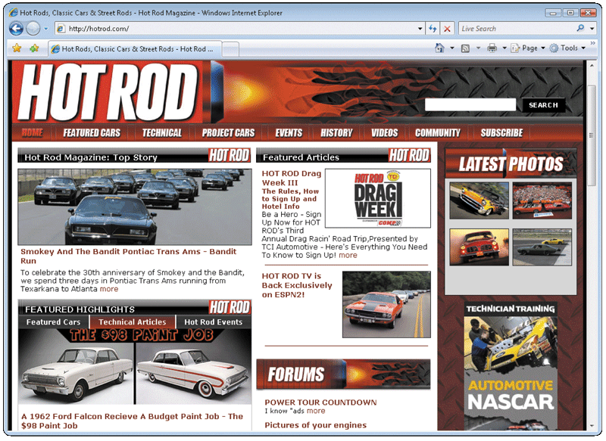
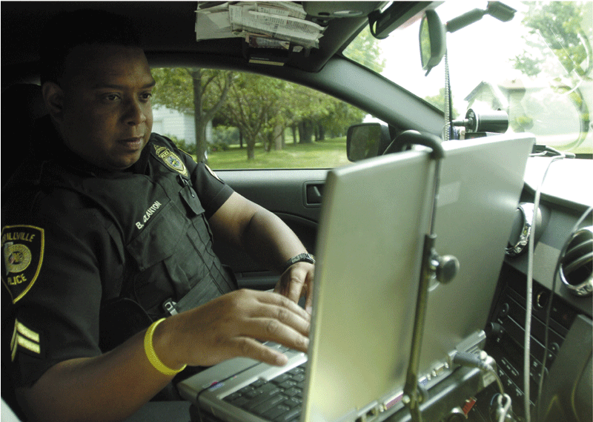
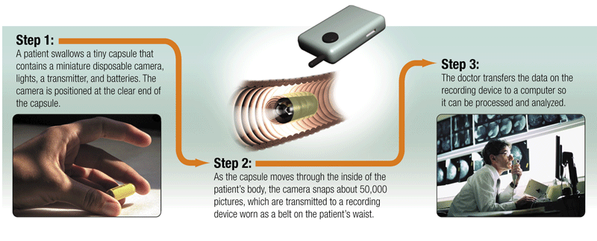
Computer Applications in Society
What are some examples
of computer applications
in society?
  Education
  Finance
  Government
  Health Care
  Science
  Publishing
  Travel
  Manufacturing
Click to view Web Link, click Chapter 1, Click Web Link from left navigation, then click Handheld Navigation Devices below Chapter 1
p. 32-36 Figs. 1-36–1-43
Next

Slide 48
Summary of Introduction to Computers
Basic computer concepts
The uses of the Internet
The term, computer
Computer software
The components of a computer
Categories of computers
The advantages and disadvantages of using computers
Types of computer users
The purpose of a network
Computer applications in society
Chapter 1 Complete

